Slide 1
Economic Forecast
Michael Bracken,
Managing Partner & Chief Economist
June 11, 2025

Slide 2
Presentation Sponsor:
Southern California Association of Governments
Honorable Cindy Allen, City of Long Beach (SCAG President 2025-26)
Honorable Jesus Escobar, Imperial County Board of Supervisors
Honorable Gil Rebollar, City Councilmember City of Brawley
Honorable Javier Amezcua, ICTC
Mr. Kome Ajise, Executive Director
Mr. David Salgado, Governmental Affairs Officer

Slide 3
“The American wage earner and the American housewife are a lot better economists than most economists care to admit”
- President Gerald R. Ford

Slide 4
Disclosures
Native of California (Rural San Diego County)
Education: B.A. / M.P.A. California State University
San Bernardino (GO YOTES!)
Politically: Registered as Decline to State
Political Bias:
Fiscally Conservative
Social Libertarian
Believe in Safety Nets
Personal Accountability

Slide 5
"America now is stumbling through the darkness of hatred and divisiveness."

Slide 6
- President Gerald R. Ford (1968)

Slide 7
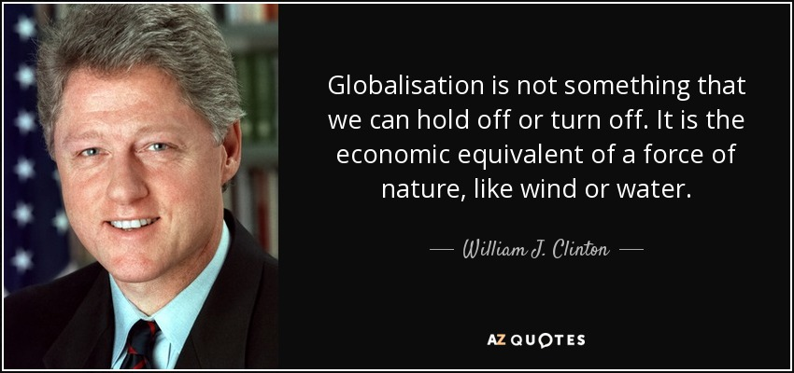
Global Economy

Slide 8
Map Container/Tanker Ships in Transit (Taken 6/5/25)

Slide 9
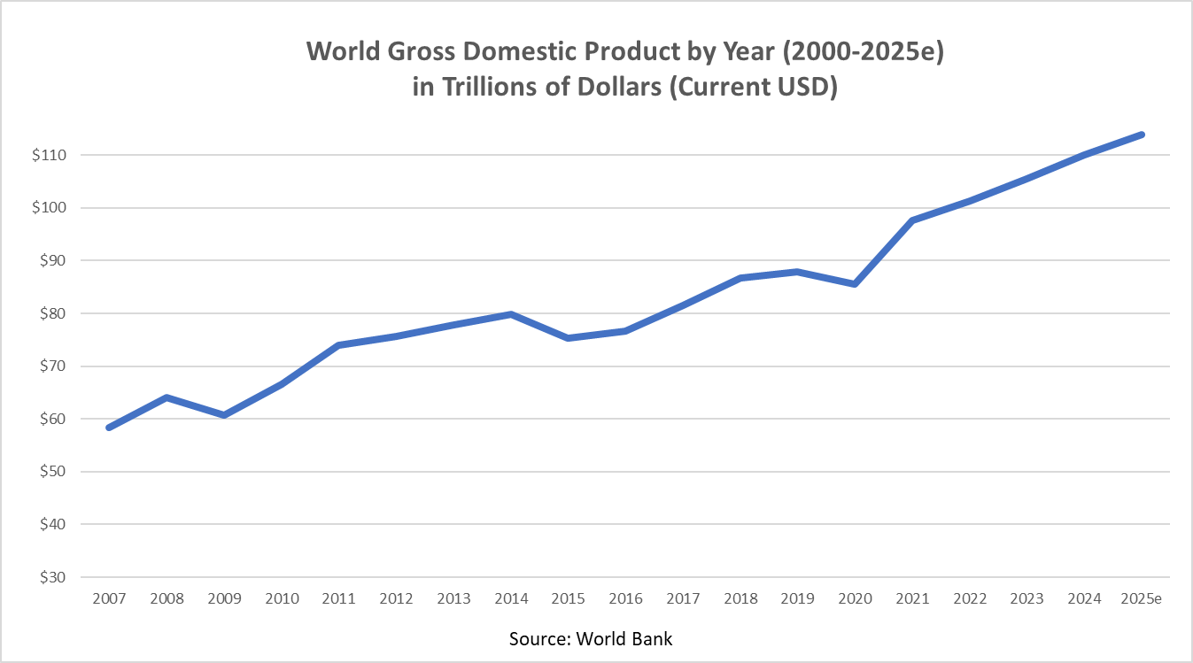
International GDP/Trade (2000-2025e)

Slide 10
Oil Prices (WTI) 6/5/25: $63.27 6/5/24: $75.08

Slide 11
Chinese Exports to USA 4/23: $33.1b * 4/24: $31.6b * 4/25: $25.4b

Slide 12
Global Conflicts
Ukraine vs. Russia
Israel vs. Hamas
North Korea vs. South Korea
China vs. Taiwan
Iran vs. (Seemingly Everyone)
China creating new allies

Slide 13
International Picture
Supply Chain Issues Largely “Fixed”
(Though LA Port Traffic OFF 50% in May, 2025 vs. May 2024)
World Inflation Cycle Cooling (Helps EVERYONE)
Chinese Export to USA are decreasing (Tariffs?)
Port Traffic to Long Beach Stable
Global Conflicts COULD be Major Disruptor
Anyone remember the Cold War?

Slide 14
National Economic Picture

Slide 15
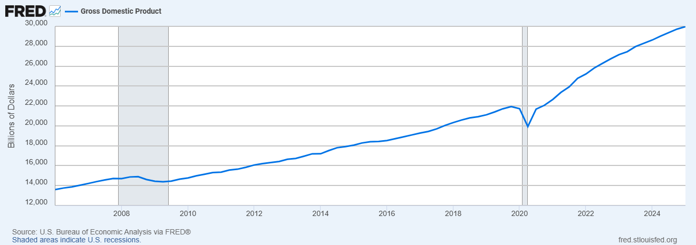
U.S. Gross Domestic Product (GDP) 1Q25 = -0.3%

Slide 16
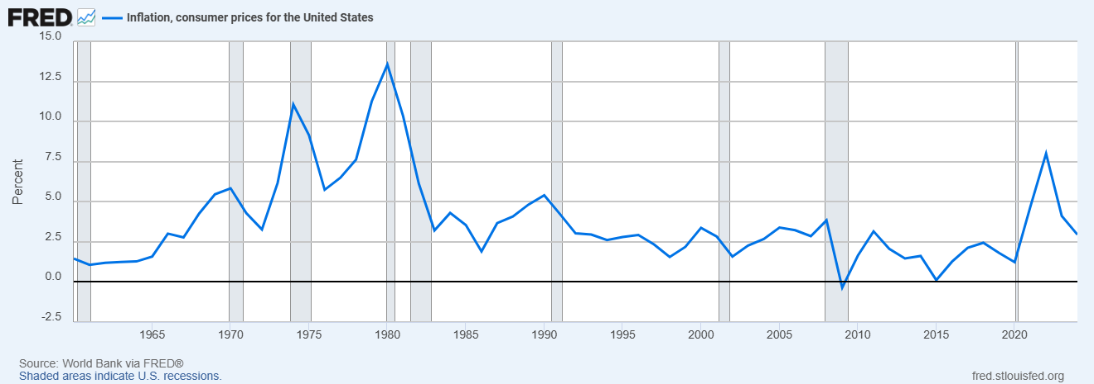
U.S. Inflation 2019-2024

Slide 17
Grocery Store Prices Index 12/19 = 205 / 4/25: 292 (+42%)
Source: U.S. Bureau of Labor Statistics

Slide 18
National Debt 1985-2025 ($.5T - $36.2T)

Slide 19
Recessions vs. Depression

Slide 20
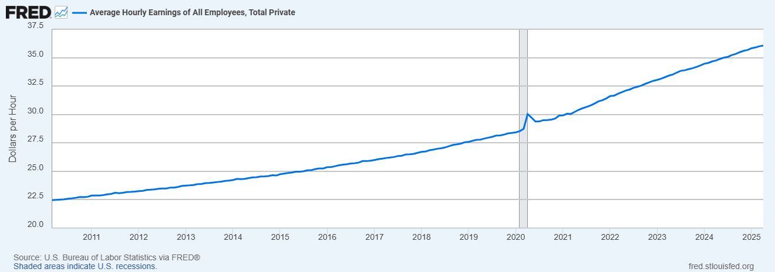
Average Hourly earnings (all-private) 2016: $25.69 / 2025: $36.06

Slide 21
Historical Fed Funds Effective Rates (1955-Current)

Slide 22
Synopsis of U.S. Economy
Economy is Statistically Stable
Unemployment Rates Marginally Higher
Interest Rates Likely Peaked in this Cycle
Inflation (from Supply Chain/Demand) under control
Inflation (Wage-Based) Likely to Cause Higher Inflation (3%-4% over next few years)
Government/Consumer/Student/Medical Debt is Concerning
Tariffs???

Slide 23
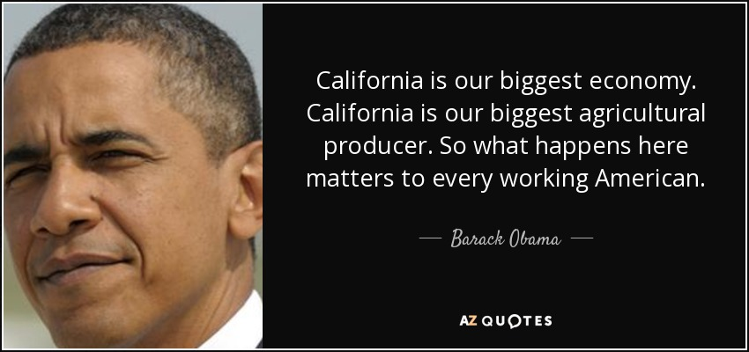
California Economic Picture

Slide 24
California GDP #4 in World (USA, China, Germany)

Slide 25
California Unemployment (April-25: 5.3%)

Slide 26
Housing Unit Approvals: California

Slide 27
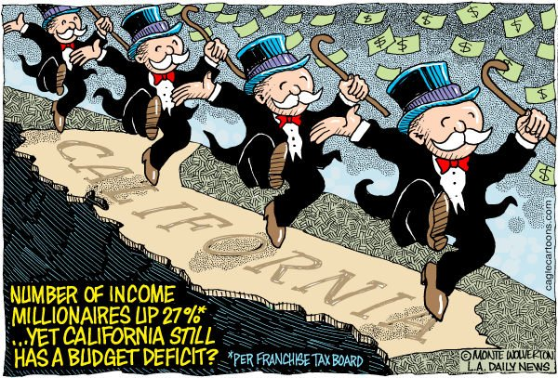
Tax Collections California

Slide 28
Housing Affordability Index
Sources: US Census Bureau, Realtor Assoc Based on Existing Sales Single Family Homes

Slide 29
Recap of California Economy
Unemployment Slightly Higher (Likely to Continue Increasing)
Housing Costs are unsustainable
New Construction Permit Activity is Level (not addressing housing shortage)
Housing Price Increases WILL Slow
Sacramento WILL Look to Increase Taxes (or Steal from Cities/Counties) (State FY25/26 Budget = Problematic)

Slide 30
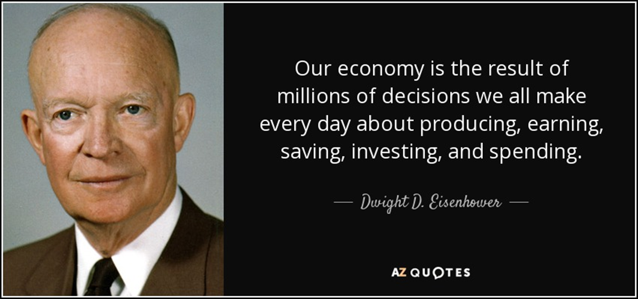
Imperial County Regional Economy

Slide 31
Imperial County Population

Slide 32
Imperial County Unemployment Rate (16%)

Slide 33
Imperial County Median Home Price 4/25 = $381k

Slide 34
Imperial County Rents (2-Bed/2-Bath) 2025: $1,462/mo.

Slide 35
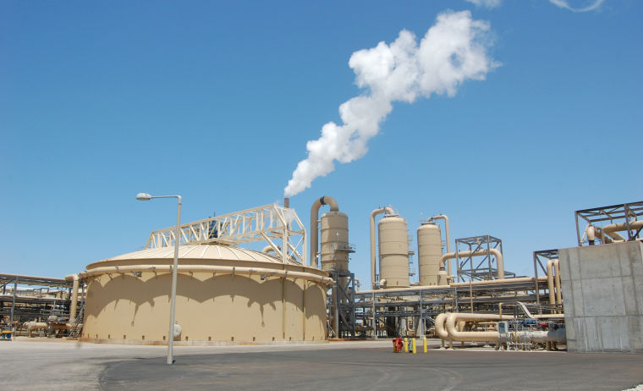
Geothermal/Lithium
14 Pipeline Projects
1,100 MW Geothermal Power (Baseload = 3 million people)
$22.1 Billion CAPX
7,100 Construction Jobs (1-Year FTE)
1,100 Full Time Operational Jobs

Slide 36
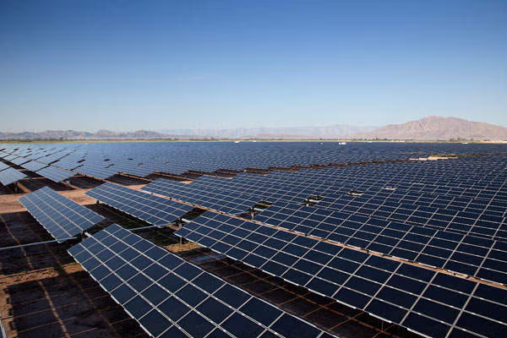
Solar/Battery Projects in Pipeline
15-20 Projects in Pipeline
20,000+ Acres
2,500+ MW Solar Power
3,500+ MW Battery Storage

Slide 37
Balance of 2025
President Trump WILL Govern as he said he would
1992= FOB * 2025 = FOD
Interest Rates Range: (-.50 + .25) (Unless Black Swan)
Inflation will be Moderate but Higher than Target 2%
Stock Market: Movement of Capital TO Tech & AI
Housing Costs will Stabilize (Demand Normalize)
Trump and Economic Advisors Not Allow Economy to Crash from Tariffs

Slide 38
Please Pray for Peace.

Slide 39
Michael Bracken, Managing Partner / Chief Economist
Development Management Group, Inc.
41-625 Eclectic Street, Suite D-2
Palm Desert, CA 92260
(760) 272-9136
michael@dmgeconomics.com

