Slide 1
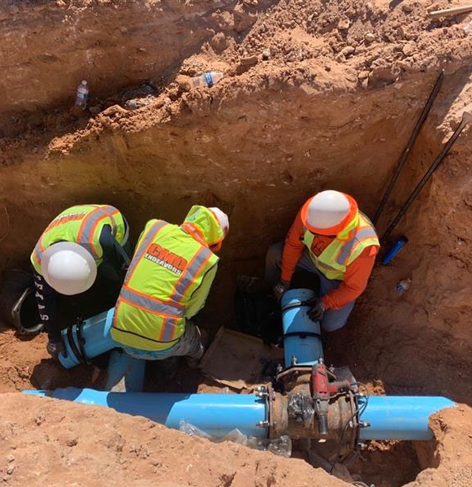
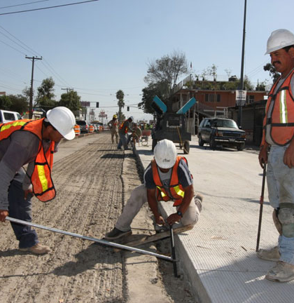
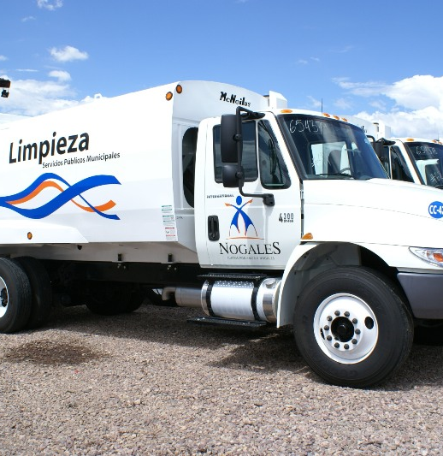
Addressing Environmental Issues on the U.S.-Mexico Border
December 31, 2024

Slide 2
NADBank
Established in 1994
Mandate: Develop and finance environmental infrastructure along the U.S.-Mexico border to improve the well-being of the population:
  Projects located within 100 km north and 300 km south of the border that
  Provide loans and grants for their implementation
  Offer technical assistance for project development
Structure: Owned and governed equally by the Governments of the United States and Mexico
Offices: San Antonio, TX and Ciudad Juarez, CHIH
Ratings: Aa1 – Moody's; AA – Fitch

Slide 3

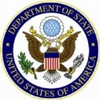




Governance
Board of Directors
NADBank has a ten-member, binational Board of Directors, with an equal number of representatives from each country.
U.S. Members | Mexico Members
Secretary of the Treasury | Secretary of Finance and Public Credit (SHCP)
Secretary of State | Secretary of Foreign Affairs (SRE)
Administrator of the Environmental Protection Agency | Secretary of the Environment and Natural Resources (SEMARNAT)
U.S. Border State Representative | Mexican Border State Representative
U.S. Border Public Representative | Mexican Border Public Representative

Slide 4
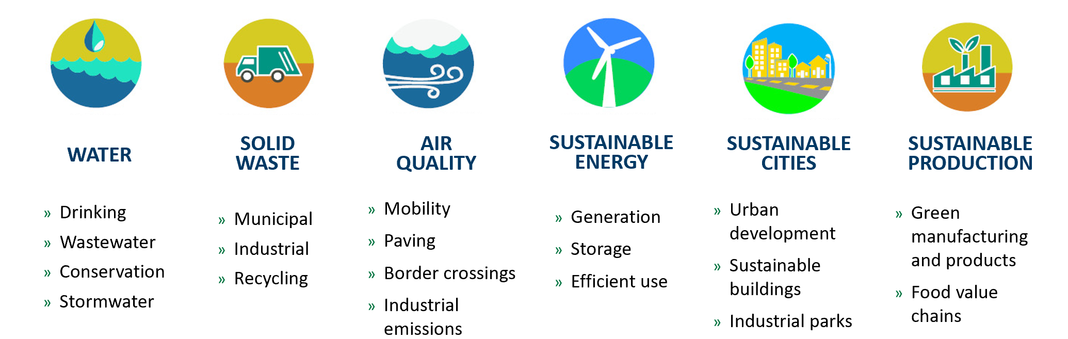
NADBank’s Development Strategy
Eligible Project Types

Slide 5
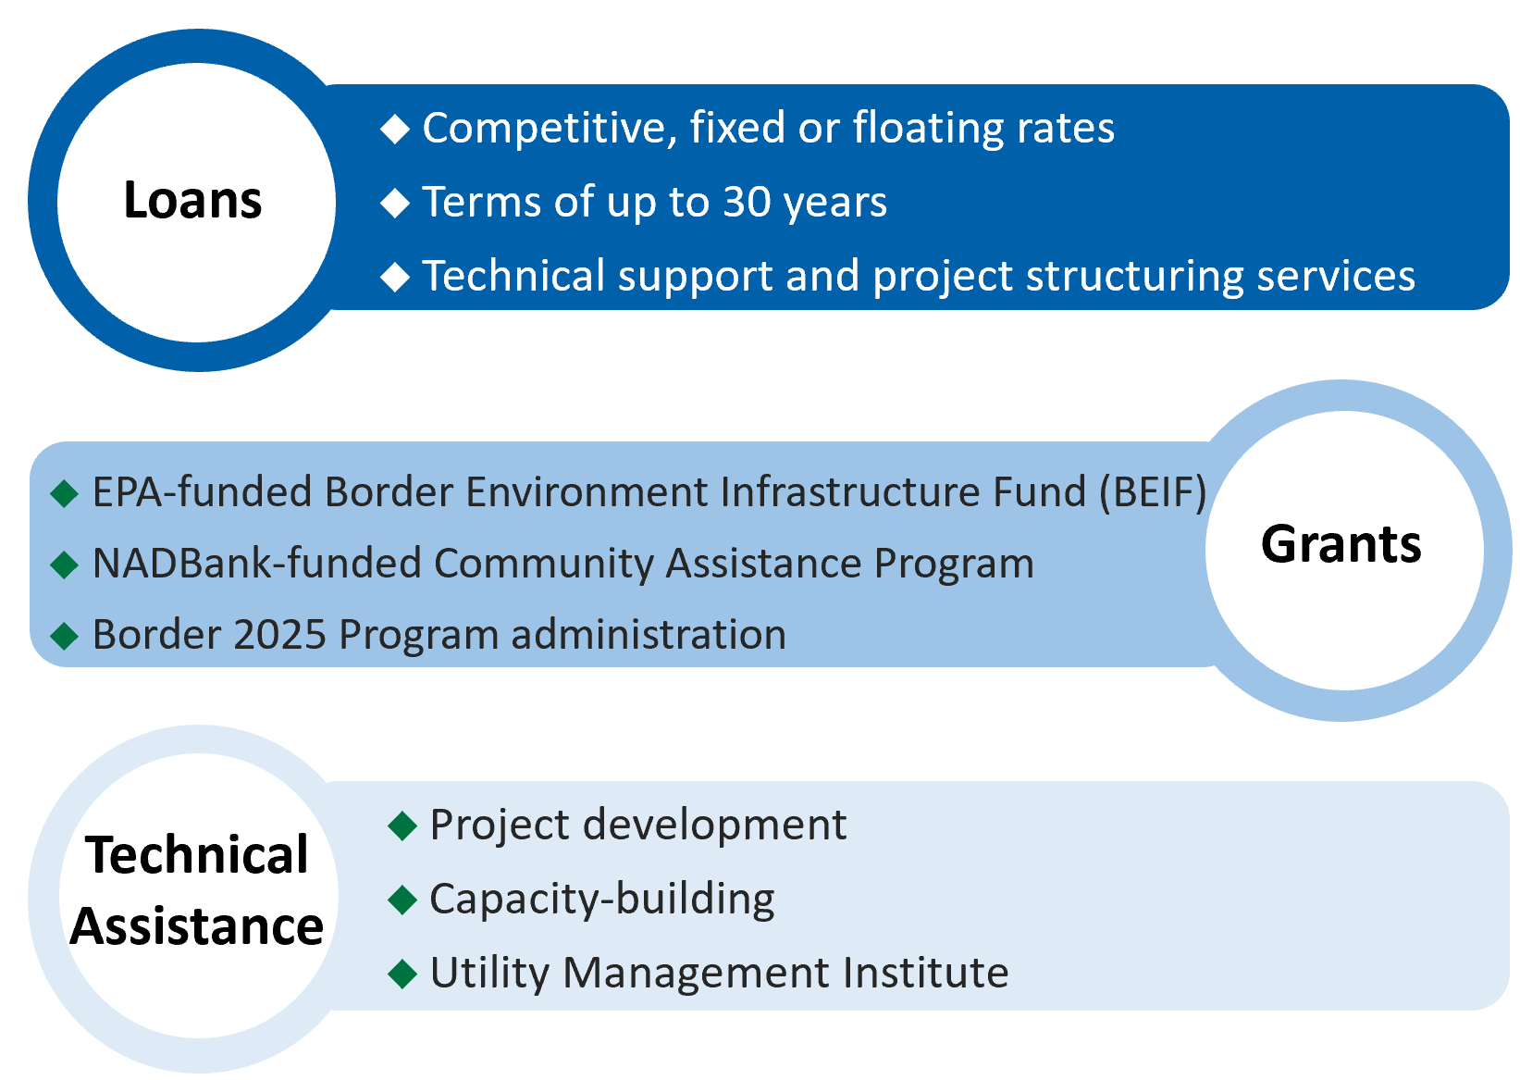
NADBank Programs

Slide 6
Certified Projects with Financing
December 31, 2024
California
Arizona
New Mexico
Texas
30 projects
$1,564.5 M
25 projects
$333.2 M
14 projects
$84.4 M
85 projects
$3,457.1 M
Projects:
323
8 projects
$197.2 M
MX Border Region
Total
investment:
US$12.3 billion
39 projects
$1,549.2 M
38 projects
$1,159.3 M
35 projects
$698.8 M
10 projects
$495.6 M
12 projects
$1,241.7 M
27 projects
$1,527.6 M
Baja California
Sonora
Chihuahua
Coahuila
Nuevo León
Tamaulipas
Notes:
Note: Only projects with NADBank funding contracted.
Three of the border-wide projects are in public transportation with a combined cost of $89.6 million that is distributed among the four states where they have been implemented to date: $13.5 million in Chihuahua; $9.3 million in Sonora; $56.4 million in Nuevo Leon and US$6.8 million in Baja California.

Slide 7
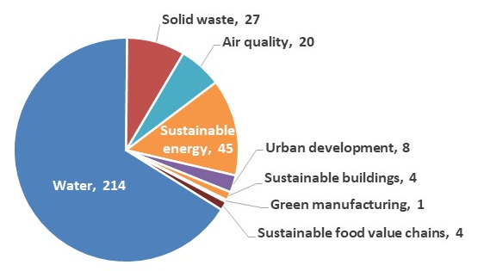
Projects Funded by Sector
December 31, 2024
323
projects
US$12.3 billion
total investment
  Water – Drinking water, wastewater, stormwater & conservation
  Solid waste – Landfills & equipment
  Air quality – Street paving, mobility, border crossings
  Sustainable energy – Solar, wind, biogas, biofuel, storage
  Urban development – Mix of public infrastructure & services (e.g., water, paving)
Notes:
Note: Only projects with NADBank funding contracted.

Slide 8

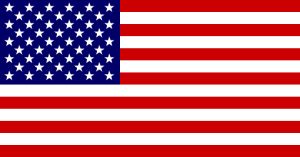
NADBank Financing in Clean Energy Sector
Since 2009
No. of projects and NADBank financing contracted in renewable energy
42
projects
17
25
$1.871 B
in loans
$803 M
$1.068 B
Amount in U.S. dollars
Total infrastructure investment in the clean energy sector of these 42 projects is over US$6.41 billion.
Notes:
Successful mobilization of private capital

Slide 9
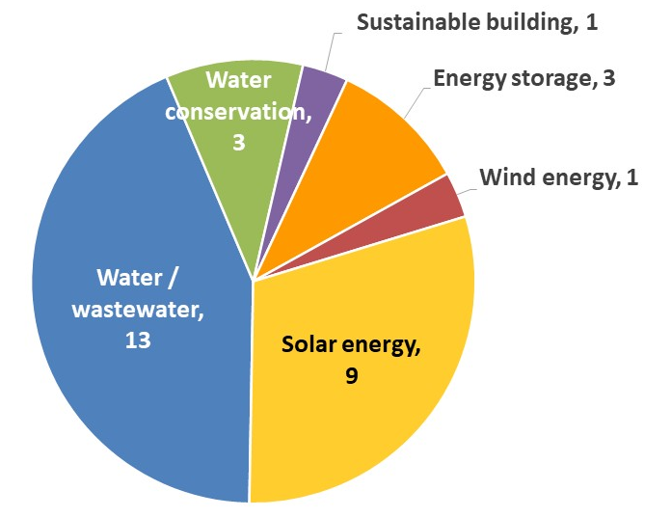
California
December 31, 2024
30 projects financed
US$537.9 million in financing contracted
US$ Million
Community | No. of Projects | Financing Contracted
Bard Water District | 1 | $ 4.0
Brawley | 4 | 25.4
Calexico | 1 | 6.5
Calipatria | 1 | 0.3
City of Imperial | 1 | 36.0
Desert Shores | 1 | 0.7
Dixieland | 1 | 9.7
El Centro | 1 | 76.5
Heber | 2 | 5.2
Holtville | 3 | 8.8
Imperial Irrigation District | 4 | 130.9
Ocotillo | 1 | 110.0
Poway | 1 | 60.0
Ramona | 2 | 18.6
Riverside & Imperial Counties | 1 | 3.9
San Diego | 2 | 20.6
Valley Center | 2 | 19.3
Westmorland | 1 | 1.8

Slide 10
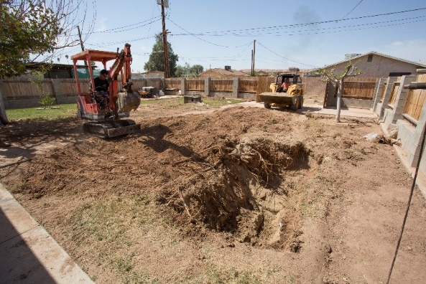
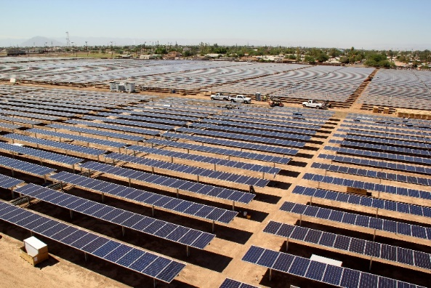
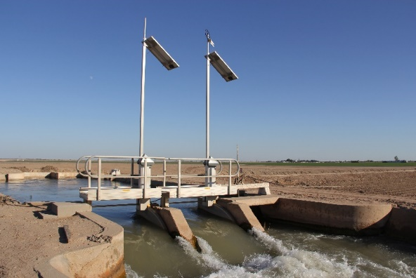
Impact in California
December 31, 2024
23 million gallons a day of new or improved water treatment capacity
10.8 million gallons a day of new or improved wastewater treatment capacity
9,659 acre-feet/year in water savings in irrigation districts
352.5 MW of installed solar and wind generation capacity, which is helping prevent the emission of approximately 178,082 metric tons/year of CO₂, equivalent to removing 38,371 passenger vehicles from the roadways

Slide 11
Participation in California
December 31, 2024
30 projects financed
US$537.9 million in financing contracted
Desert Shores
1 WW
Palm Springs
1 ES
Westmorland
1 WW
Niland
2 SE
Calipatria, 1 WW
Riverside
Imperial I.D., 2 WC
San Diego
Imperial
Brawley, 1 W, 1 W/WW, 1 WW, 1 SE
Valley Center
2 SE
City of Imperial
1 SB
ES = Energy storage
I.D. = Irrigation District
SB = Sustainable buildings
SE = Solar energy
W = Water
WC = Water conservation
WE = Wind Energy
WW = Wastewater
Ramona, 2 SE
Bard Water District
1 WC
Poway, 1 ES
Calexico
1 W
Ocotillo
1 WE
Holtville
3 WW
San Diego
1 WW, 1 ES
El Centro
1 SE
Dixieland
1 SE
Heber
1 WW, 1 W/WW

Slide 12

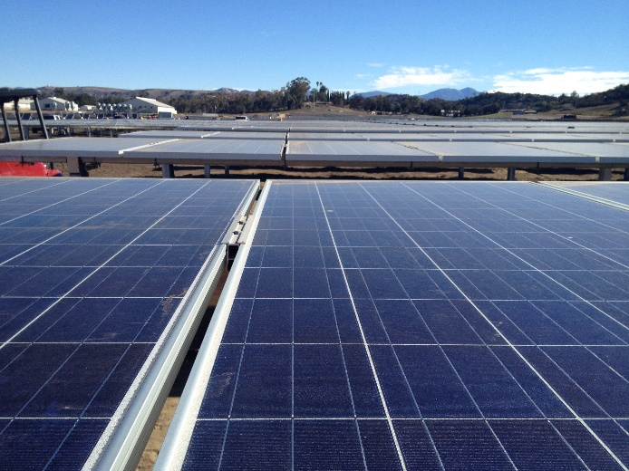
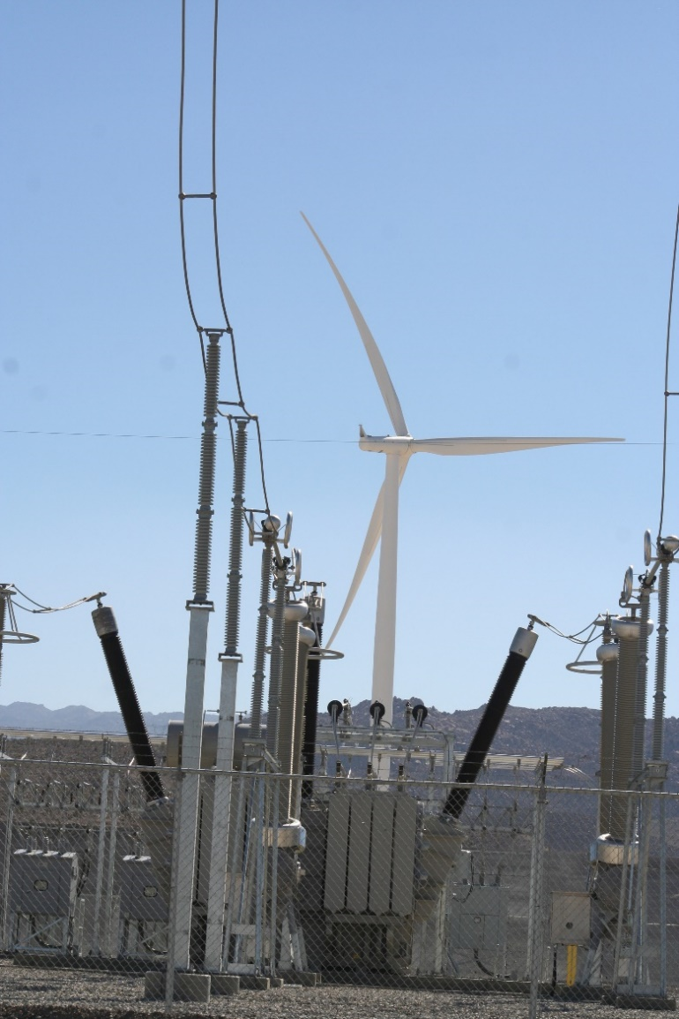

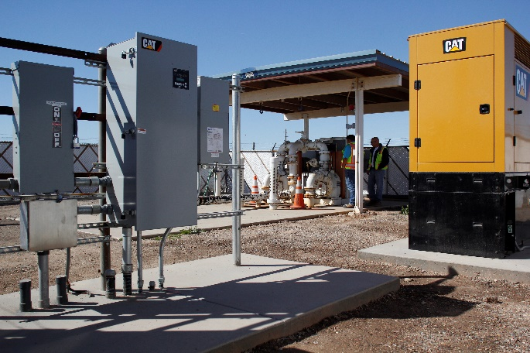

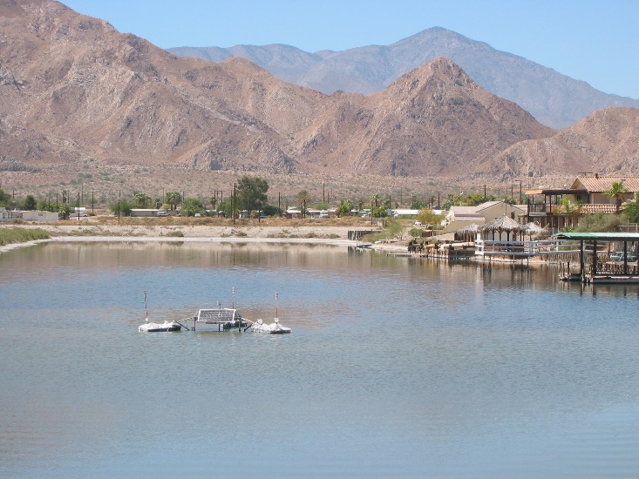
Projects in California
Imperial Irrigation District
Ramona, San Diego County
Ocotillo
El Centro
Brawley
Holtville
Desert Shores

Slide 13
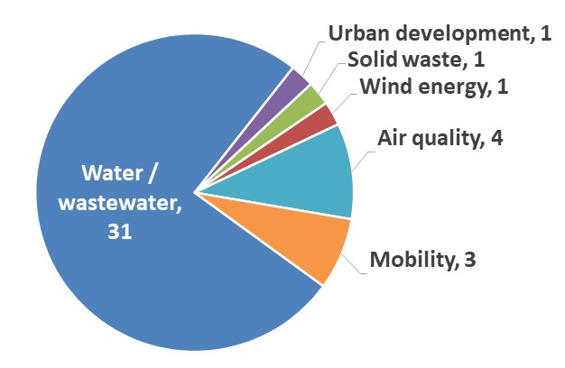
Baja California
December 31, 2024
41 projects financed
US$570.3 million in financing contracted*
US$ Million
Municipality | No. of Projects | Financing Contracted
Ensenada | 1 | $ 31.6
Mexicali | 9 | 70.5
Playas de Rosarito | 6 | 41.0
Tecate | 4 | 45.3
Tijuana* | 19 | 206.8
State Level | 2 | 175.1
* Includes participation of public transportation companies in 2 border-wide low-emission bus programs.
Notes:
Figures include 2 border-wide public transportation projects certified for the entire Mexican border region. Altogether, 76 diesel buses have been financed in Tijuana through the two programs with loans totaling US$5.14 million.
1st project - 3 diesel buses financed in Tijuana with a loan of US$149,522
2nd project – 73 diesel buses financed in Tijuana with a loan of US$4.99 million

Slide 14
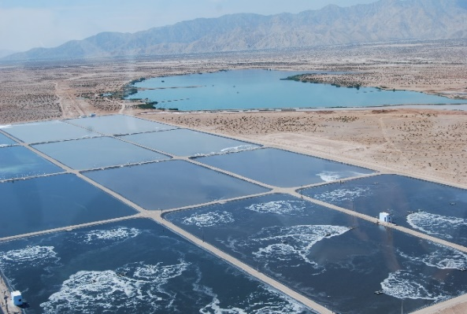
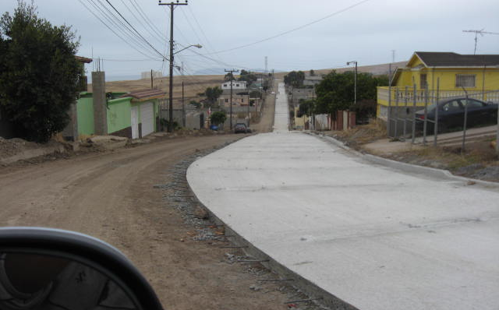
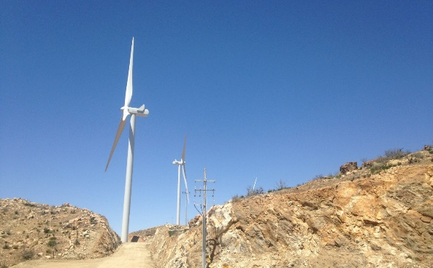
Impact in Baja California
December 31, 2024
5.7 million gallons a day (mgd) of water desalinization capacity
71 mgd of new or improved wastewater treatment capacity
Approximately 6 million square meters (m²) of roads paved or rehabilitated, reducing vehicular dust (PM₁₀) and other pollutants
155 MW of installed wind generation capacity, which is helping prevent the emission of approximately 100,686 metric tons/year of CO₂, equivalent to removing 21,695 passenger vehicles from the roadways
76 low-emission buses in circulation
Notes:
76 new diesel buses in Tijuana

Slide 15
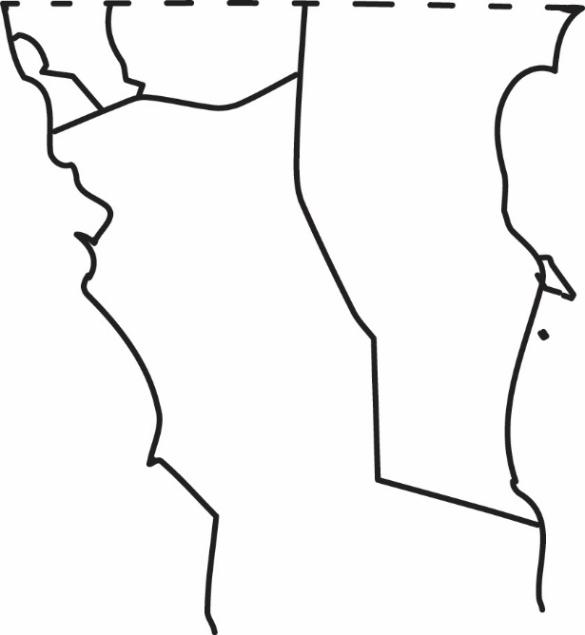
Participation in Baja California
December 31, 2024
41 projects financed | US$570.3 million in financing contracted
Tecate
2 W/WW, 1 WW, 1 WE
Tijuana*
13 WW, 1 W/WW, 1 SW,
1 AQ, 3 MO
Mexicali
8 WW, 1 AQ
Playas de Rosarito
3 WW, 1 W/WW,
1 UD, 1 AQ
State level
1 AQ, 1 AP/SAN
Ensenada
1 W
AQ = Air quality
MO = Mobility
SW = Solid waste
UD = Urban development
W = Water
WE = Wind energy
WW = Wastewater
* Includes participation in two border-wide public transportation projects
Notes:
Figures include 2 border-wide public transportation projects certified for the entire Mexican border region. A total of 76 diesel buses have been financed in Tijuana.
All air quality projects are related to street paving or other roadway improvements.

Slide 16
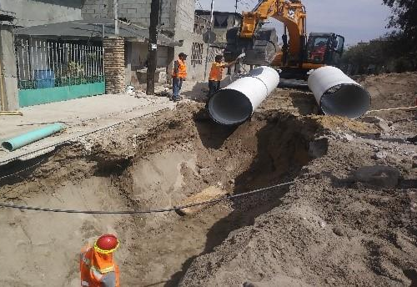

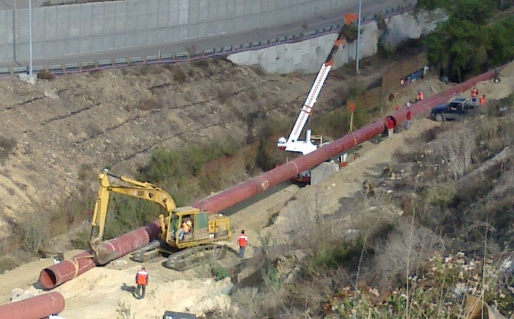
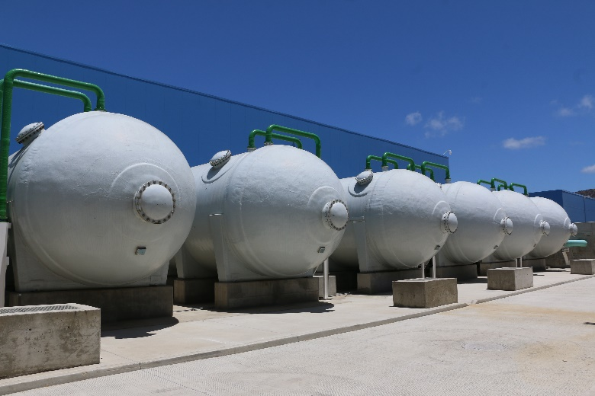

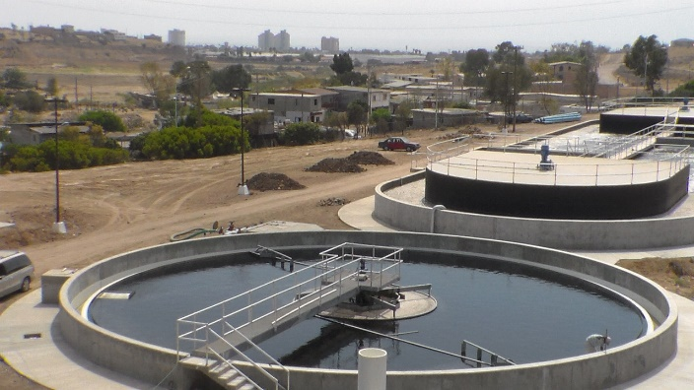
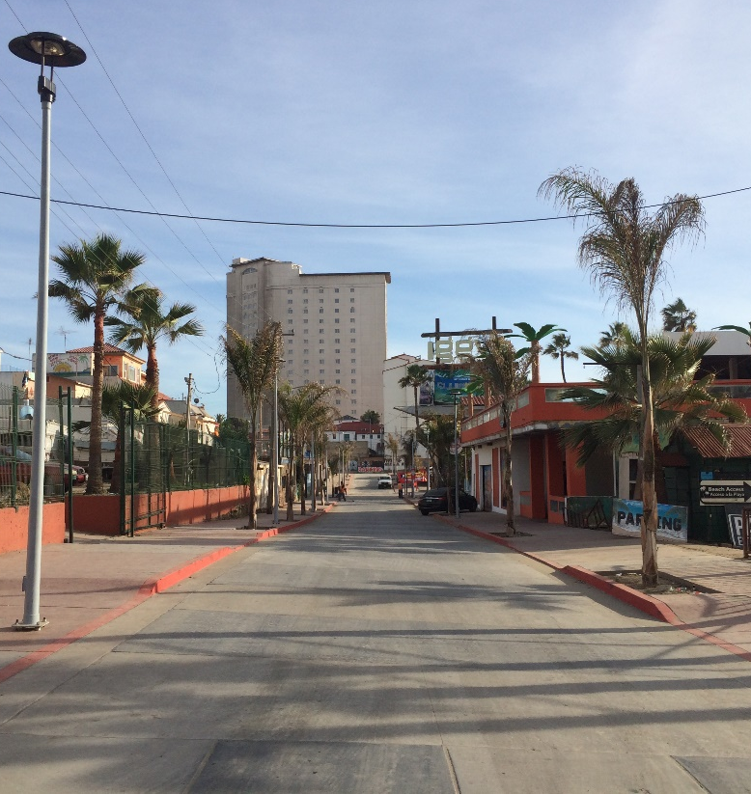
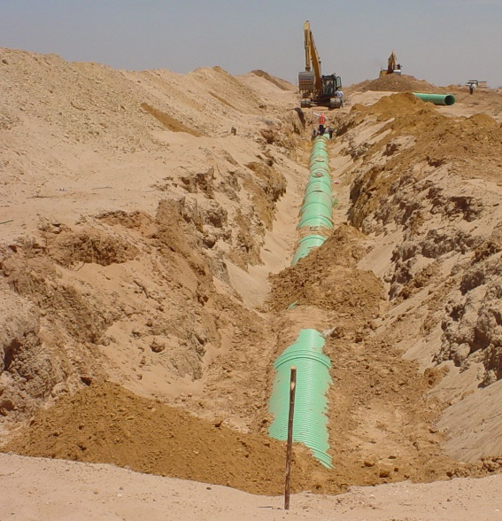
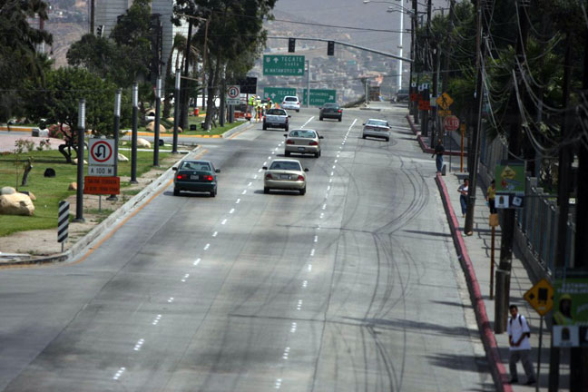
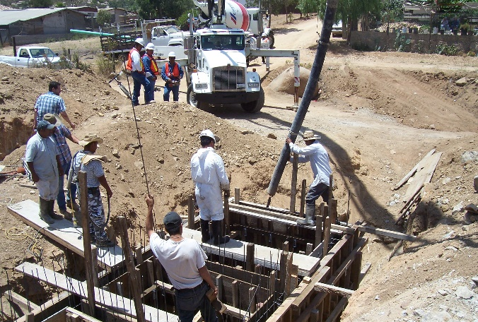
Projects in Baja California
Tijuana
ESJ 1, Tecate
Tijuana
Ensenada
Las Arenitas WWTP, Mexicali
Playas de Rosarito
Playas de Rosarito
Mexicali
Tijuana
Tecate

