Slide 1
XGS Energy
Clean. Low Cost. Round-the-Clock Energy. Everywhere. Forever.
Imperial Valley Economic and Energy Summit
June 11, 2025

Slide 2
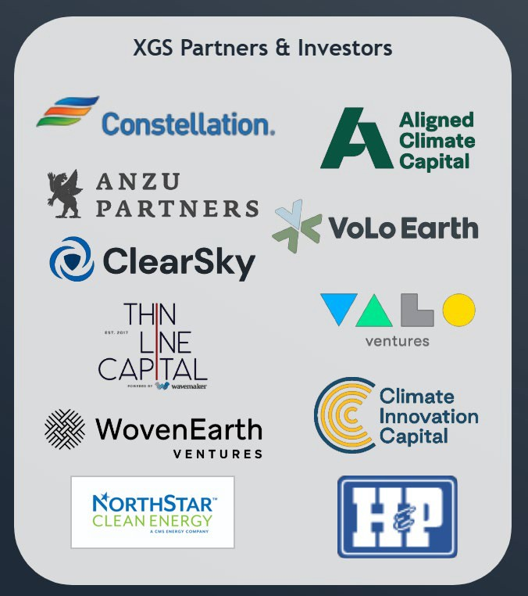
Who is XGS Energy?
Next-generation geothermal technology and project developer
Based in Houston, TX and Palo Alto, CA
Proprietary tech unlocks water-independent geothermal power production at scale
Commercial performance validated, underpinning growing project pipeline with substantial contracted offtake
CONFIDENTIAL

Slide 3
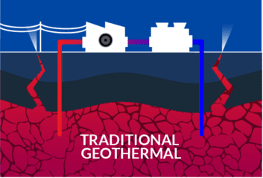
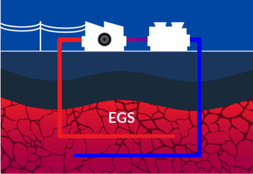
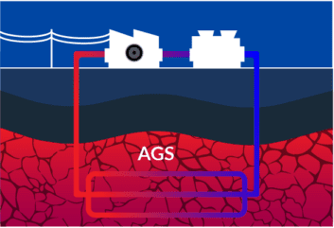
Geothermal Technologies
Next-Generation / Engineered Geothermal
Technology | Conventional Geothermal / Hydrothermal | Enhanced Geothermal Systems (EGS) | Closed Loop / Advanced Geothermal Systems or
Description | Multiple wells produce and re-inject fluid into a natural hot water reservoir (i.e., aquifers or hot springs) | Multiple wells produce and re-inject fluid into a man- made hot water reservoir created through fracking | Deeply buried pipes circulate working fluid in closed loop; multiple geometries possible including horizontal wells and ‘tube-in-tube’ wells (XGS)
Requirements | Hot rock Right geology Abundant water | Hot rock Abundant water | Hot rock

Slide 4
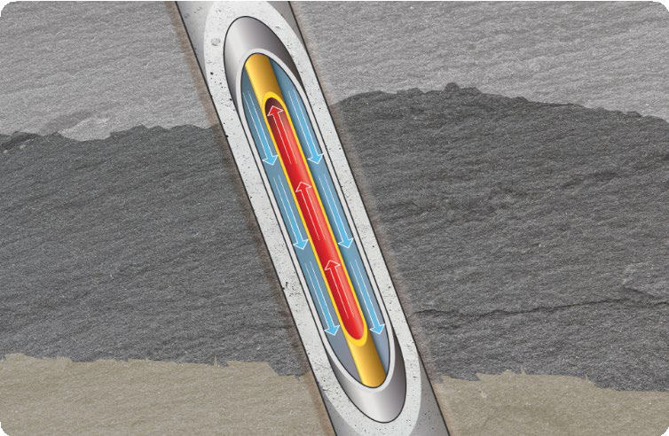
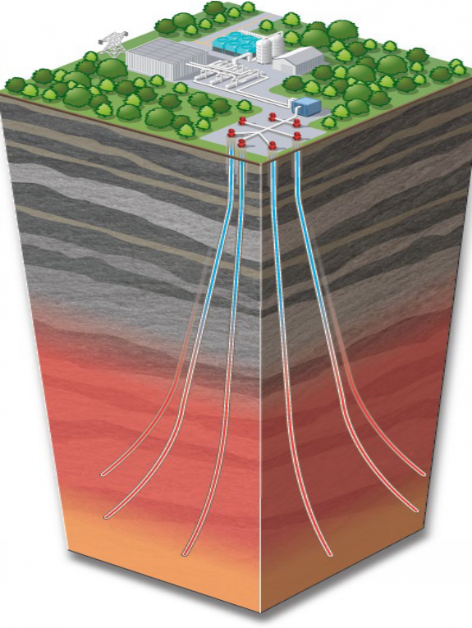
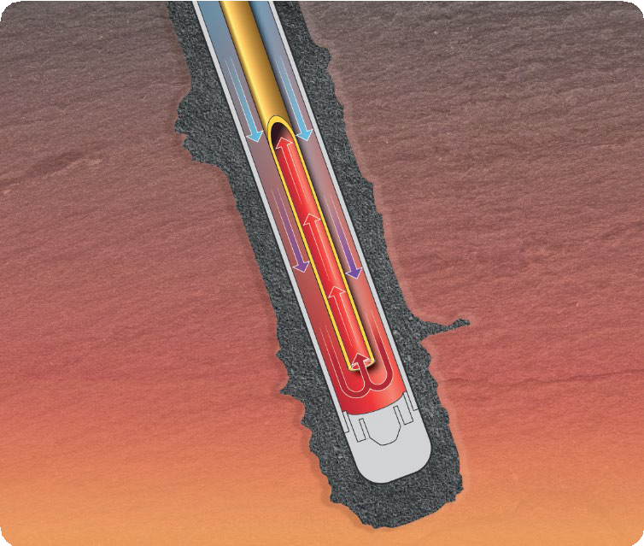
How It Works: XGS Geothermal System
XGS has 75+ awarded and pending patents for its geothermal system
XGS’s closed-loop system is both water and geology independent, allowing it to be deployed anywhere in the world
How it works:
Drill: A single well is drilled to access hot rock using proven oil and gas procedures
Enhance: Advanced thermally conductive materials are “squeezed” into hot rock around the well
Close the loop: Hot fluid returned to the surface in insulated inner-tube, creating tube-in-tube closed loop
TRE
Proprietary design of Thermal Reach Enhancement (TRE) enables 30-50% more heat capture from hot rock

Slide 5
XGS Geothermal in Imperial Valley
Experience: XGS Energy and partner Greenflash Infrastructure bring 10 GW+ of project development experience, backed by Constellation Energy and H.I.G. Capital
Flexible Scale: XGS system is highly modular and can flexibly scale from 5 MW to 100s of MW for front of meter, behind the meter, and off-grid applications
Co-development Potential: XGS system can be deployed in parallel with other geothermal technologies to boost overall field capacity (e.g. repowering dry wells that still have hot rock)
Streamlined Permitting: XGS system has demonstrated successful permitting, efficiently passing EPA environmental review and receiving BLM permits at commercial demonstration site in central CA
Job Creation: XGS is targeting >1 GW of development in California, with opportunity to create 16,000+ construction jobs and 400+ operational jobs
24/7 Clean Firm Energy: Primed to meet rising demand for clean firm power in the region; engineered for zero subsurface operational costs with rapid time-to-power

Slide 6
Please reach out to discuss potential partnerships
Logan Stephens
XGS Energy, VP & Head of Development Email: lstephens@xgsenergy.com Phone: (336) 708-5161

