Slide 1
RENEWING EARTH’S ENERGY FUTURE
June 2025
COPYRIGHT © 2025 ORMAT TECHNOLOGIES, INC.

Slide 2
SAFE HARBOR STATEMENT AND NON-GAAP METRICS
THIS PRESENTATION INCLUDES FORWARD-LOOKING STATEMENTS, AND THE DISCLAIMER SHOULD BE READ CAREFULLY
FORWARD-LOOKING STATEMENTS
This presentation, and information provided during any discussion accompanying this presentation, may contain “forward-looking statements” within the meaning of the Private Securities Litigation Reform Act of 1995. These statements involve estimates, expectations, projections, goals, objectives, assumptions and risks, and activities, events and developments that may or will occur in the future. When used in or during the course of this presentation, the words “may”, “will”, “could”, “should”, “expects”, “plans”, “anticipates”, “believes”, “estimates”, “predicts”, “projects”, “thinks”, “forecasts”, “guidance”, “continue”, “goal”, “outlook”, “potential,” “prospect” or “target”, or the negative of these terms or other comparable terminology are intended to identify forward-looking statements, although not all forward-looking statements contain such words or expressions. Such forward-looking statements include, but are not limited to: statements about Ormat Technologies, Inc.’s and its affiliates’ (“Ormat”) business strategy; statements about Ormat’s competitive strengths; statements about Ormat’s development and operation of electricity generation, storage and energy management assets, including distributed energy resources; statements about Ormat’s other plans, expectations, objectives and targets; statements about Ormat’s views on market and industry developments and economic conditions, and the growth of the markets in which Ormat conducts its business; and statements about the growth and diversification of Ormat’s customer base and Ormat’s future revenues, expenses, earnings, capital expenditures, regional market penetration, ability to capitalize on increased demand, electricity generation, and other operational performance metrics, including statements about “target” or “targeted” amounts for 2028 growth (MW) metrics such as growth (MW), adjusted EBITDA, portfolio growth and potential and planned capacity (MW), and statement regarding Ormat’s ESG plans, initiatives, projections, goals, commitments, expectations or prospects, among others.
These forward-looking statements are not intended to be a guarantee of future results, but instead constitute Ormat’s current expectations based on assumptions that Ormat currently believes are reasonable. You are cautioned not to place undue reliance on the expectations, projections and other forward-looking statements made in or during the course of this presentation as actual future results and developments may differ materially from such expectations, projections and forward-looking statements due to a number of risks, uncertainties and other factors, many of which are beyond Ormat’s control.
These risks, uncertainties and other factors include, but are not limited to, the risks, uncertainties and other factors described in Ormat Technologies, Inc.'s most recent Form 10-K and in subsequent filings filed with the SEC.
NON-GAAP METRICS
RECONCILIATION TO US GAAP FINANCIAL INFORMATION
This presentation includes certain “non-GAAP financial measures” within the meaning of Regulation G
under the Securities Exchange Act of 1934, as amended, including EBITDA and Adjusted EBITDA. The presentation of these non-GAAP financial measures is not intended as a substitute for financial information prepared and presented in accordance with GAAP and such non-GAAP financial measures should not be considered as a measure of liquidity or as an alternative to cash flow from operating activities, net income or any other measures of performance prepared and presented in accordance with GAAP. Such non-GAAP financial measures may be different from non-GAAP financial measures used by other companies.
The appendix slides in this presentation reconcile the non-GAAP financial measures included in the presentation to the most directly comparable financial measures prepared and presented in accordance with U.S. GAAP. The Company is unable to provide a reconciliation for its Adjusted EBITDA projections range to net income without unreasonable efforts due to high variability and complexity with respect to estimating certain forward-looking amounts. These include impairments and disposition and acquisition of business interests, income tax expense, and other non-cash expenses and adjusting items that are excluded from the calculation of Adjusted EBITDA.
All of these and other forward-looking statements made in or during the course of this presentation are made only as of the date hereof and Ormat undertakes no obligation to update or revise any forward-looking statements, whether as a result of new information, future developments or otherwise, except as required by law. Forward-looking statements about “target” or “targeted” amounts represent current goals of Ormat’s management and are neither estimates of Ormat’s actual results nor financial projections or forecasts that have been prepared in accordance with Securities and Exchange Commission (“SEC”) rules or guidelines adopted by the American Institute of Certified Public Accountants.
Copyright © 2025 Ormat Technologies, Inc. All Rights Reserved. This document contains information proprietary to Ormat Technologies, Inc. Reproduction in any form without prior written permission is strictly prohibited
COPYRIGHT © 2025 ORMAT TECHNOLOGIES, INC.

Slide 3
COPYRIGHT © 2025 ORMAT TECHNOLOGIES, INC.

Slide 4
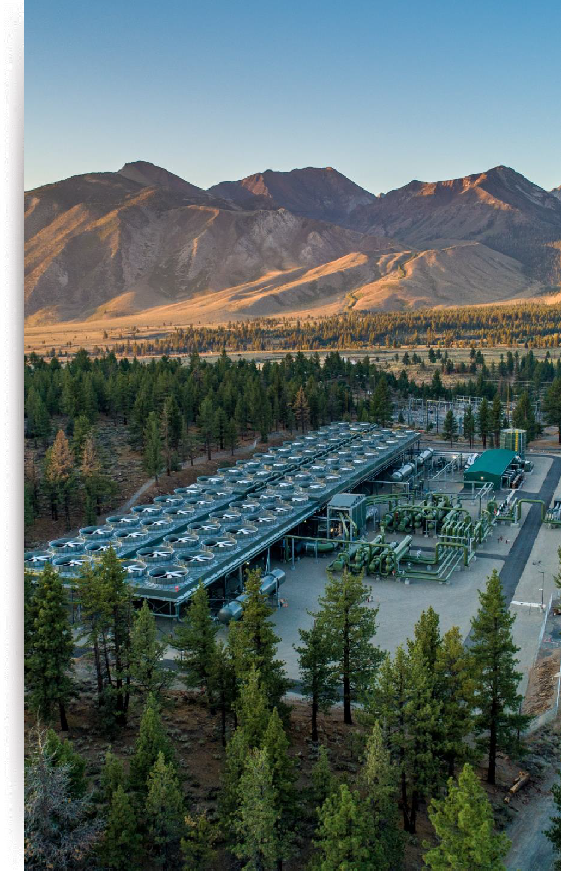
A LEADING RENEWABLE ENERGY PROVIDER
WITH A PROVEN TRACK RECORD IN GEOTHERMAL AND
ENERGY STORAGE
CD4, Mammoth Complex, NV, USA, 65MW
Own & Operate
1.5GW
Geothermal, Storage,
Solar PV & REG¹
60
Years of
experience
~1,500
Employees
REG – Recovered Energy Generation
See appendix for reconciliation of non-GAAP financial measures.
Net income attributable to the company stockholders
COPYRIGHT © 2025 ORMAT TECHNOLOGIES, INC.
4
COPYRIGHT © 2025 ORMAT TECHNOLOGIES, INC. 4

Slide 5
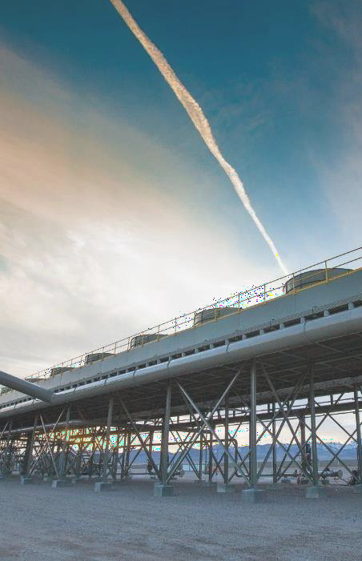
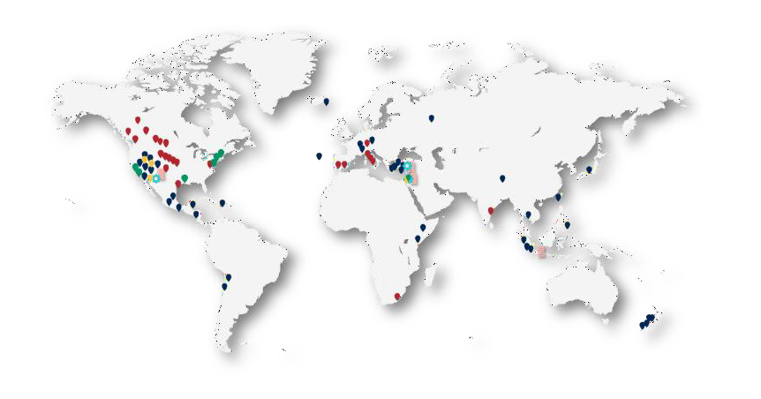
GLOBAL PRESENCE
MEETING THE NEEDS OF CUSTOMERS WORLDWIDE
#1
Ormat - the largest geothermal owner & operator
Geothermal Projects / complexes REG (Waste Heat) Projects Energy Storage Projects
Solar Projects Manufacturing shop
Office
STAR ENERGY
ABOITIZ POWER
ORMAT
PERTAMINA
CONTACT
REYKJAVIK
CALPINE
KENGEN
EDC
CFE
ENEL
Chart Source : ThinkGeoEnergy - “Geothermal Market Analysis September 2024” by Alexander Richter; Data is presented at gross installed capacity.
COPYRIGHT © 2025 ORMAT TECHNOLOGIES, INC.

Slide 6
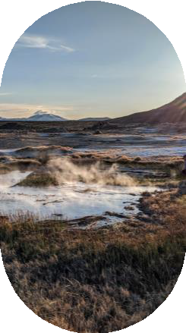
KEY FACTORS DRIVING ORMAT’S ACCELERATED GEOTHERMAL DEVELOPMENT IN THE U.S.
INCREASED DEMAND
For renewable high- capacity factor power sources
PPAS
Availability
IRA
Strong tailwind from tax benefits
EXPLORATION
Extended drilling activity
COPYRIGHT © 2025 ORMAT TECHNOLOGIES, INC.

Slide 7
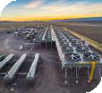
PROJECTS IN IMPERIAL VALLEY
OPERATING
RELEASED FOR CONSTRUCTION
PROJECTS IN DEVELOPMENT
BRAWLEY COMPLEX CALIFORNIA, 7 MW
HEBER COMPLEX CALIFORNIA, 81 MW
MAMMOTH COMPLEX CALIFORNIA, 65 MW
ORMESA COMPLEX CALIFORNIA, 36 MW
ARROWLEAF SOLAR
CALIFORNIA, 42 MW
WISTER
CALIFORNIA, 20 MW
DOGWOOD, 25 MW
GEOTHERMAL/PV SOLAR
TRUCKHAVEN, 25 MW
GEOTHERMAL/PV SOLAR
"Our projects in California showcase Ormat's dedication to sustainable energy and innovation," says Alissa Sanchez, Director of Business Development at Ormat Technologies.
COPYRIGHT © 2025 ORMAT TECHNOLOGIES, INC.

Slide 8
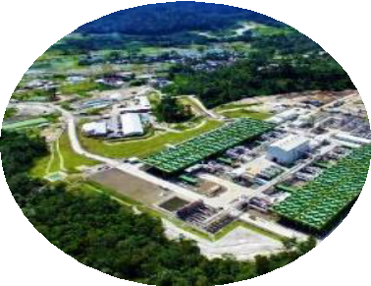
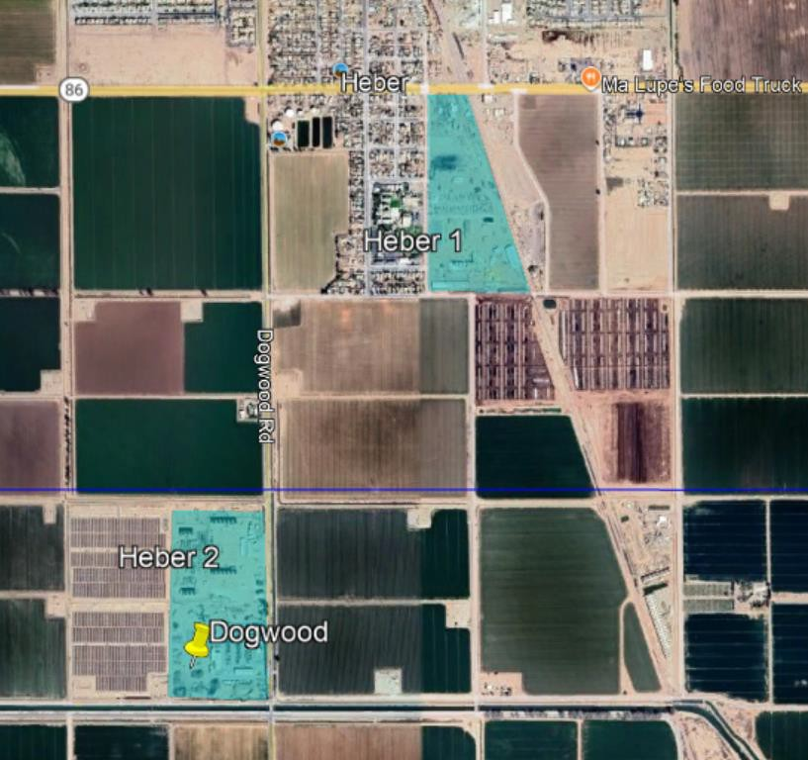
DOGWOOD GEOTHERMAL PROJECT IN DEVELOPMENT
New geothermal power plant (Dogwood)
New parasitic solar field for Dogwood plant
New parasitic solar field for the existing Heber 2 plant
DOGWOOD (25MW)
GEOTHERMAL / PV SOLAR AIR-COOLED BINARY PLANT
COPYRIGHT © 2025 ORMAT TECHNOLOGIES, INC. 8

Slide 9
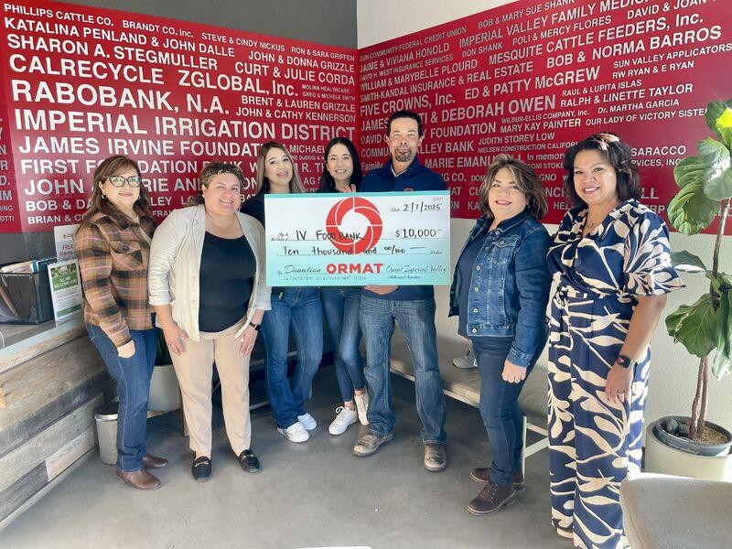
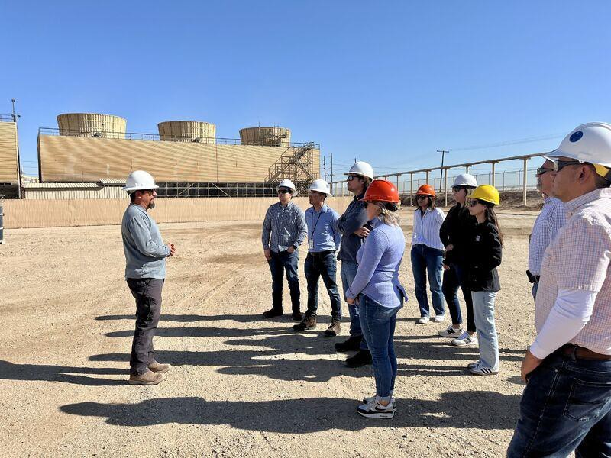
MAINTAINING A STRONG COMMITMENT TO THE COMMUNITY
ROOTED IN SERVICE, GROWING TOGETHER
IN 2024, ORMAT
DONATED
$45,000 BACK TO THE COMMUNITY
Renewable | Reliable | Sustainable
Job Creation
Community
Education
IN 2025
$10,000
9
COPYRIGHT © 2025 ORMAT TECHNOLOGIES, INC. 9

Slide 10
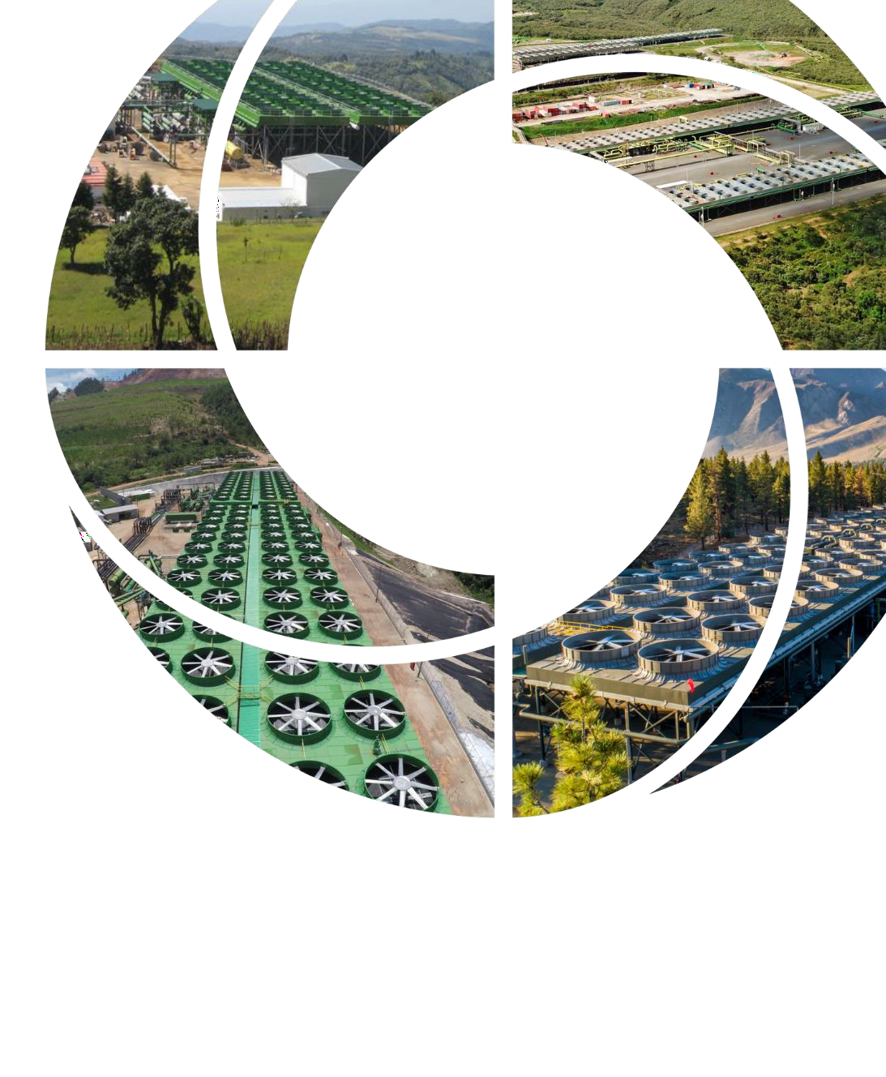
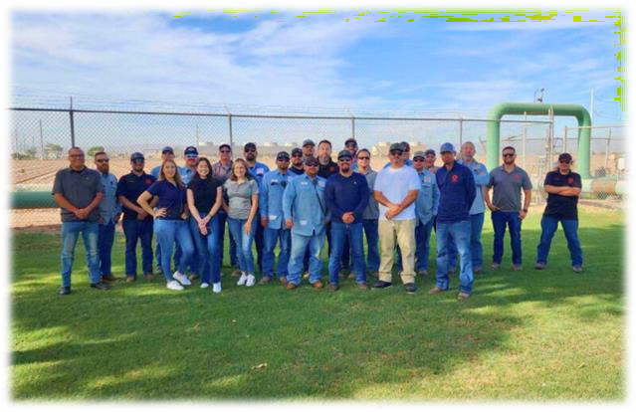
COPYRIGHT © 2025 ORMAT TECHNOLOGIES, INC.

