Slide 1
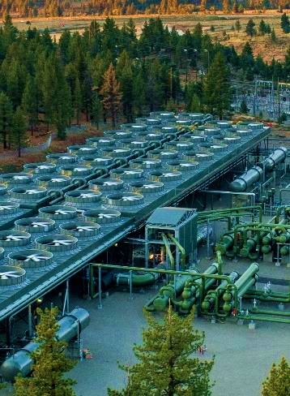
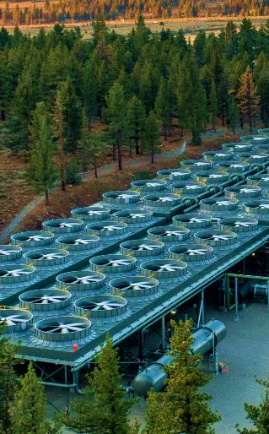
TRANSMISSION & INTERCONNECTION
Imperial valley economic & energy summit
June 2025
Copyright © 2024 Ormat Technologies, Inc.

Slide 2
Safe Harbor Statement and NON-GAAP Metrics
This presentation includes Forward-Looking Statements, and the disclaimer should be read carefully
Forward-Looking Statements
This presentation, and information provided during any discussion accompanying this presentation, may contain “forward-looking statements” within the meaning of the Private Securities Litigation Reform Act of 1995. These statements involve estimates, expectations, projections, goals, objectives, assumptions and risks, and activities, events and developments that may or will occur in the future. When used in or during the course of this presentation, the words “may”, “will”, “could”, “should”, “expects”, “plans”, “anticipates”, “believes”, “estimates”, “predicts”, “projects”, “thinks”, “forecasts”, “guidance”, “continue”, “goal”, “outlook”, “potential,” “prospect” or “target”, or the negative of these terms or other comparable terminology are intended to identify forward-looking statements, although not all forward-looking statements contain such words or expressions. Such forward-looking statements include, but are not limited to: statements about Ormat Technologies, Inc.’s and its affiliates’ (“Ormat”) business strategy; statements about Ormat’s competitive strengths; statements about Ormat’s development and operation of electricity generation, storage and energy management assets, including distributed energy resources; statements about Ormat’s other plans, expectations, objectives and targets; statements about Ormat’s views on market and industry developments and economic conditions, and the growth of the markets in which Ormat conducts its business; and statements about the growth and diversification of Ormat’s customer base and Ormat’s future revenues, expenses, earnings, capital expenditures, regional market penetration, electricity generation, and other operational performance metrics, including statements about “target” or “targeted” amounts for 2025 growth (MW) and 2023 operational performance metrics such as growth (MW) and adjusted EBITDA, among others.
All of these and other forward-looking statements made in or during the course of this presentation are made only as of the date hereof and Ormat undertakes no obligation to update or revise any forward-looking statements, whether as a result of new information, future developments or otherwise, except as required by law. Forward-looking statements about “target” or “targeted” amounts represent current goals of Ormat’s management and are neither estimates of Ormat’s actual results nor financial projections or forecasts that have been prepared in accordance with Securities and Exchange Commission (“SEC”) rules or guidelines adopted by the American Institute of Certified Public Accountants.
These forward-looking statements are not intended to be a guarantee of future results, but instead constitute Ormat’s current expectations based on assumptions that Ormat currently believes are reasonable. You are cautioned not to place undue reliance on the expectations, projections and other forward-looking statements made in or during the course of this presentation as actual future results and developments may differ materially from such expectations, projections and forward-looking statements due to a number of risks, uncertainties and other factors, many of which are beyond Ormat’s control.
These risks, uncertainties and other factors include, but are not limited to, the risks, uncertainties and other factors described in Ormat Technologies, Inc.'s Form 10-K filed with the SEC on February 24, 2023, and from time to time, in Ormat’s quarterly reports on Form 10-Q that are filed with the SEC.
NON-GAAP Metrics
Reconciliation to US GAAP Financial Information
This presentation includes certain “non-GAAP financial measures” within the meaning of Regulation G under the Securities Exchange Act of 1934, as amended, including EBITDA and Adjusted EBITDA. The presentation of these non-GAAP financial measures is not intended as a substitute for financial information prepared and presented in accordance with GAAP and such non-GAAP financial measures should not be considered as a measure of liquidity or as an alternative to cash flow from operating activities, net income or any other measures of performance prepared and presented in accordance with GAAP. Such non-GAAP financial measures may be different from non-GAAP financial measures used by other companies.
The appendix slides in this presentation reconcile the non-GAAP financial measures included in the presentation to the most directly comparable financial measures prepared and presented in accordance with U.S. GAAP .
Copyright © 2024 Ormat Technologies, Inc. All Rights Reserved. This document contains information proprietary to Ormat Technologies, Inc. Reproduction in any form without prior written permission is strictly prohibited.

Slide 3
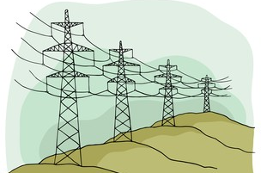
What is interconnection?
This is the process of connecting a new generator to an existing transmission system
What is TRANSMISSION?
This is the process of moving power across an existing transmission system

Slide 4
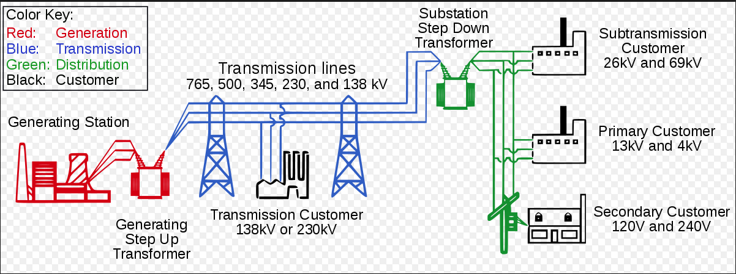
Transmission system

Slide 5
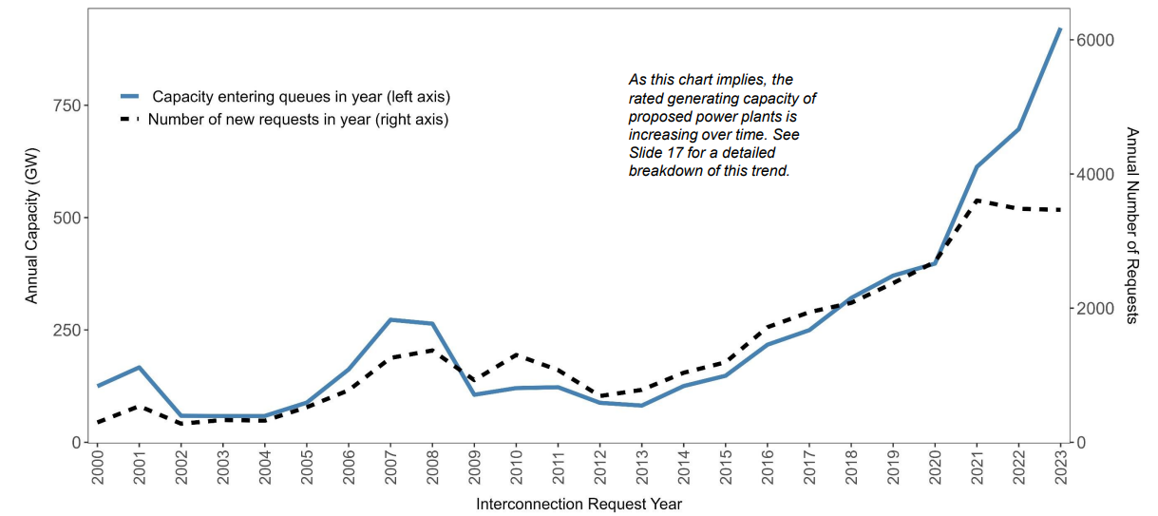
INTERCONNECTION QUEUES
The number of new interconnection requests has grown dramatically in the last decade.

Slide 6
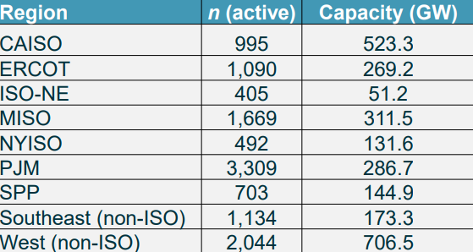
2024 interconnection queues in the us

Slide 7
FERC ORDER 2023
First major overhaul to the interconnection process since 2003
FERC’s response to the recent uptick and backlog of interconnection requests
What changed?
Implementing a transitional cluster study meant to “weed out” nonviable projects from the queue
$5M study deposit
100% site control required
Implement stricter requirements for both developers and utilities for all subsequent clusters
Increased study deposits and readiness deposits (ex: $150K study deposit + $300K readiness deposits)
Stricter site control requirements (90% site control required to enter the queue)
Penalize utilities for not meeting the study timelines outlined in the tariff

Slide 8
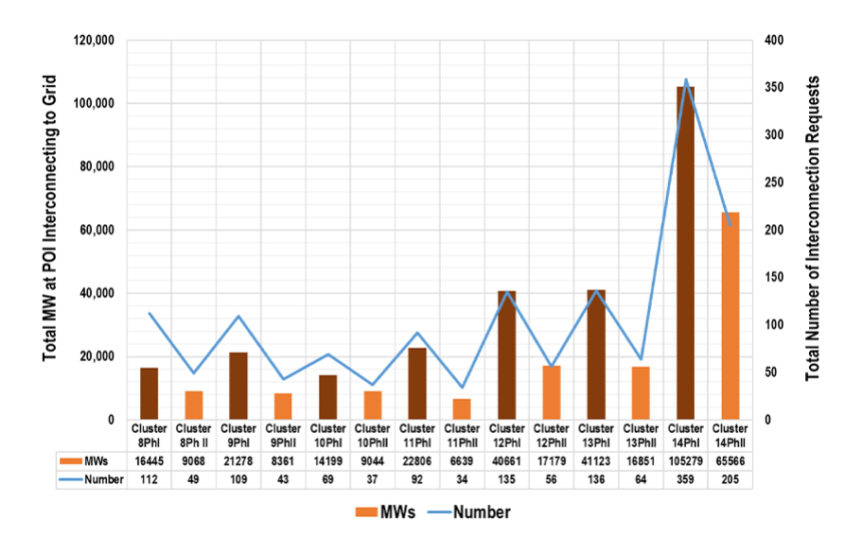
CAISO response to ferc order 2023
Prioritize requests where transmission system has available existing or planned capacity and limit requests in a study area based on planed transmission capacity
Require power purchase agreements to proceed to Phase II studies
Delayed Cluster 16 to October 2026 due to queue volume and pending reforms

Slide 9
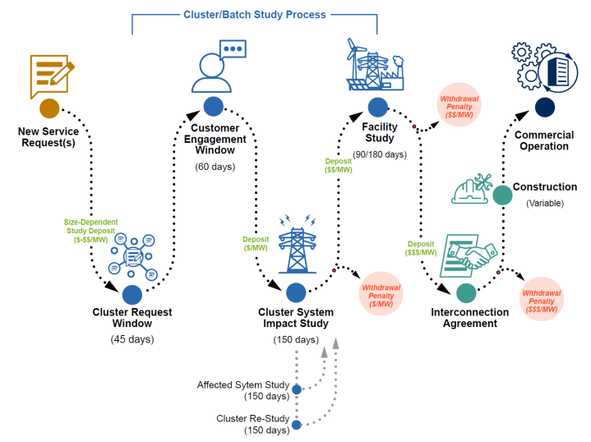
what about developers?
How to navigate the interconnection process
Understand the process
Prepare thorough and complete documentation
Engage with utilities early and often
Leverage expertise by using consultants with strong experience in the area
Build relationships
Plan for contingencies

Slide 10
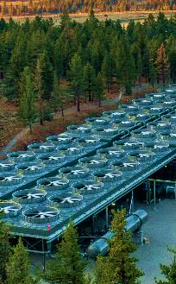
THANK You!
Questions?
Copyright © 2024 Ormat Technologies, Inc.

