Slide 1
Imperial Irrigation District Open Access Transmission Tariff - Imperial Valley Economic & Energy Summit
Lauren Olivo
Manager, Energy Business & Reg. Compliance
June 11, 2025

Slide 2
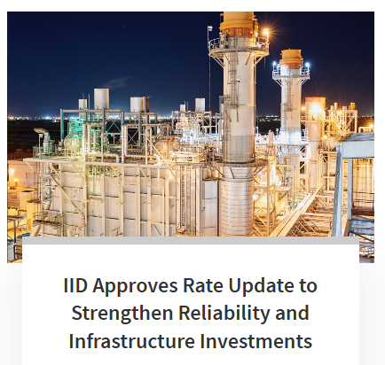
Imperial Irrigation District
IID is a publicly owned utility with local ratemaking authority.
IID is not specifically jurisdictional to the Federal Energy Regulatory Commission (FERC).
FERC does have some jurisdiction over IID under Section 210 of the Federal Power Act.
IID must provide rates that are “just and reasonable” and service that is “nondiscriminatory.”
2

Slide 3
Open Access Transmission Tariff
IID’s tariff was adopted by the IID board in 2001
IID operates under its own Open Access Transmission Tariff (OATT), which is not regulated by FERC for rate setting. IID sets its own transmission rates and policies to manage transmission costs, ensuring it can serve local energy needs independently.
IID’s OATT contains three parts:
Part I: Transmission Service
Part II: Network Integration Service
Part III: Generator Interconnection Service
The OATT identifies the process and has template agreements used by IID, including study agreements, the standard generator interconnection agreement and transmission service agreements.
OATT also defines required deposits for reserving capacity and initiating interconnection process.
3

Slide 4
FERC Order 2023
On June 16, 2022 FERC initiated interconnection reforms with a Notice of Proposed Rulemaking to address widespread concerns with interconnection study delays due, in part, to the significant number of speculative generation projects entering the interconnection queues.
FERC proposed various reforms including a first-ready, first-served study process allowing projects that are ready to move through the interconnection process to do so faster and with reduced adverse consequences from projects that are not ready to interconnect. FERC issued a Final Rule on July 28, 2023 on interconnection reforms.
In order for IID to continue to follow the FERC pro forma, IID approved an interconnection reform to its Open Access Transmission Tariff.
4

Slide 5
Key Changes
Consistent with FERC Order No. 2023, IID is moving to a cluster study process rather than a serial system impact study process with the Cluster Request Window opening once a year for a 45 day period starting January 2, 2026.
IID’s reform adopted the FERC Order No. 2023’s individual Interconnection Facilities Study.
Interconnection Customers must submit with the interconnection request study deposits between seventy five thousand dollars ($75,000) and two hundred and fifty thousand dollars ($250,000), depending on the size of the project.
IID reforms require certain documentation to show commercial readiness. Payments in lieu of commercial readiness are initially but, by the end of the study process, actual documentary evidence of commercial readiness is required, or the project will be withdrawn from the cluster.
The Interconnection Customer shall submit with its interconnection request an irrevocable letter of credit or another form of security acceptable to IID for an amount equal to nine (9) times the initial study deposits.
5

Slide 6
Process
IID will open its Cluster Request Window for a 45 calendar day period, interconnection requests deemed valid will undergo the following:
Scoping Meeting
IID has a 60 day customer engagement window to meet with all customers.
System Impact Study
Identifies impacts and defines mitigations
Facility Study
Mitigations are refined and cost estimates provided including potential timelines.
Generator Interconnection Agreement
Agreement contains infrastructure requirements and costs, along with milestone payment and construction schedules.
6

Slide 7
Questions
Contact:
Lauren Olivo
lolivo@iid.com

