Slide 1
Imperial Irrigation District Electric Transmission System- Imperial Valley Economic & Energy Summit
Paul Rodriguez, P.E.,
Deputy Power Manager
June 11, 2025

Slide 2
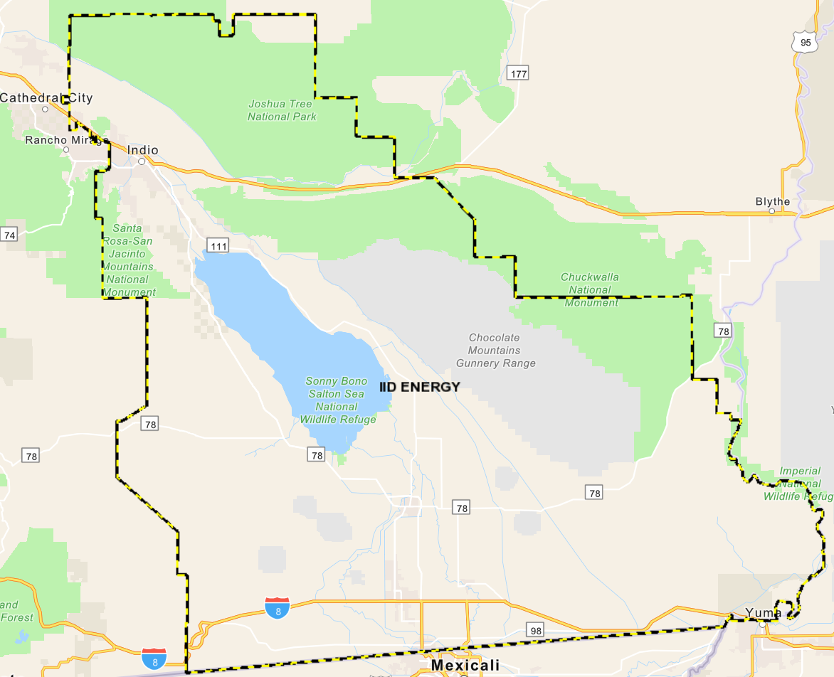
Electric System
Service territory of 6,471 square miles
Summer Peaking Utility (1,177MW)
Over 165,000 residential and commercial customers
1,780-mile transmission network and 5,004-mile distribution lines.
IID Total Generation Capacity is over 2,181MW
Coachella Valley Area
25 Substations
Imperial Valley Area
42 Substations
2

Slide 3
Vertical Integration
IID is a vertically integrated utility
Meaning it manages and controls all aspects of the electric grid, including:
Generation
Transmission
Distribution
Balancing Authority Functions
3

Slide 4
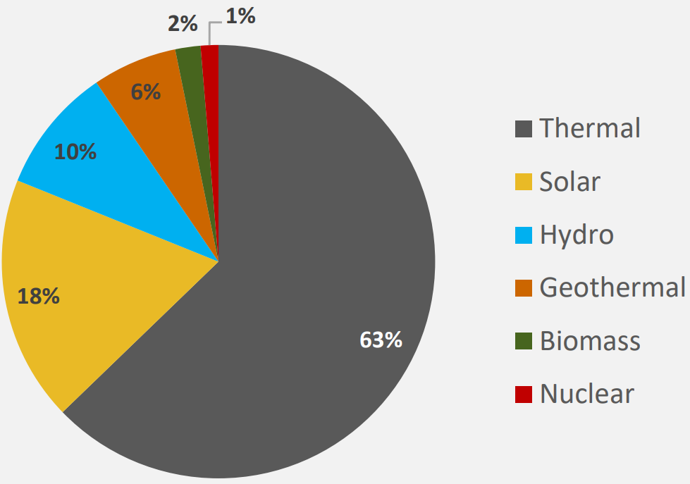
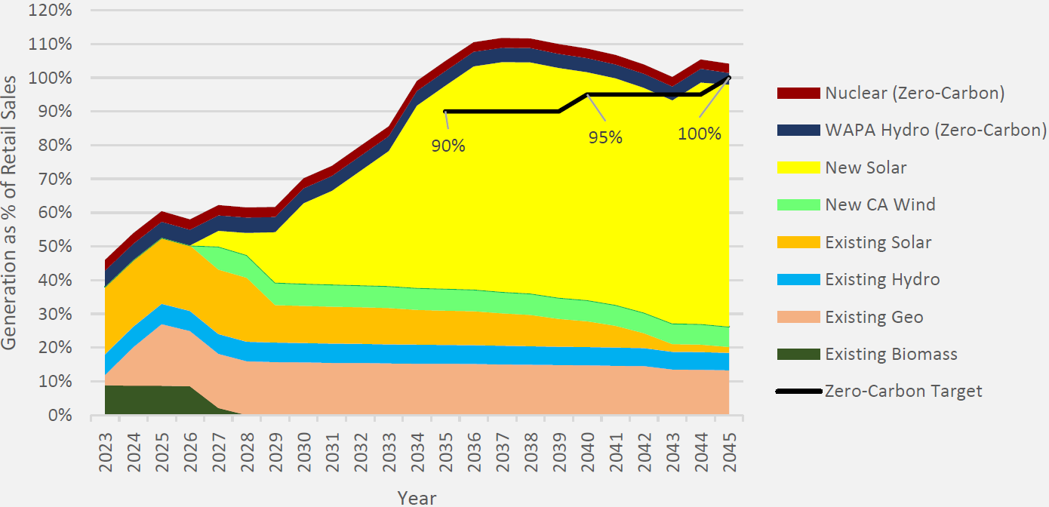
Generation Portfolio w/Targets
4

Slide 5
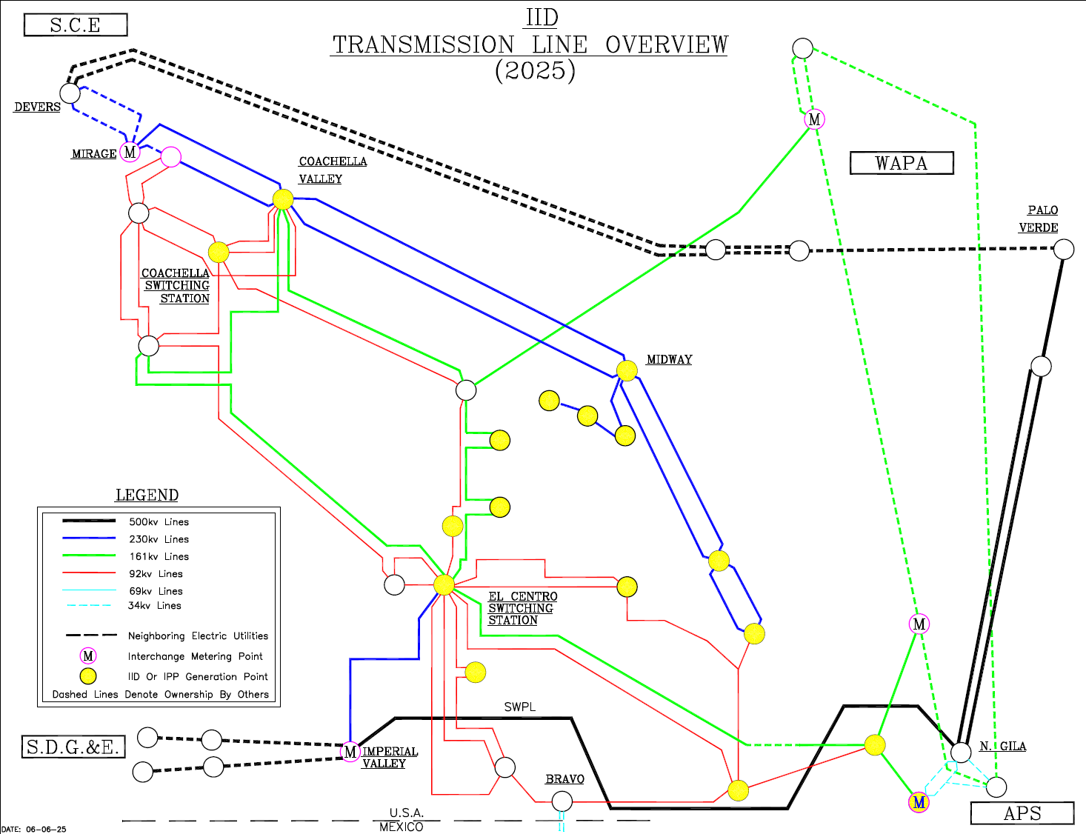
IID’s Transmission System
5

Slide 6
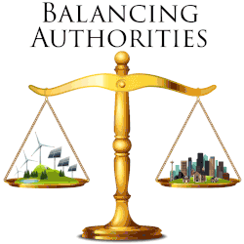
Balancing Authority
Responsible for managing real-time balancing of electric supply and demand within its territory.
Maintains a FERC-Compliant Open Access Transmission Tariff (OATT)
Facilitates Resource Interconnection and Power Transactions
Promotes Regional Grid Reliability and Planning
6

Slide 7
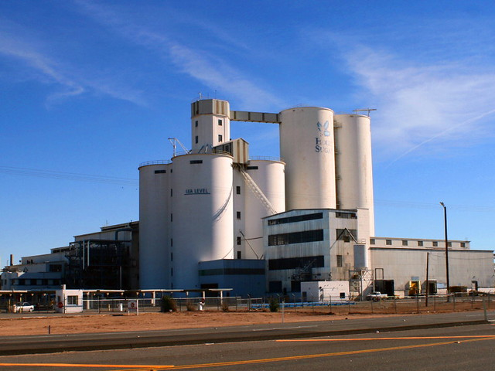
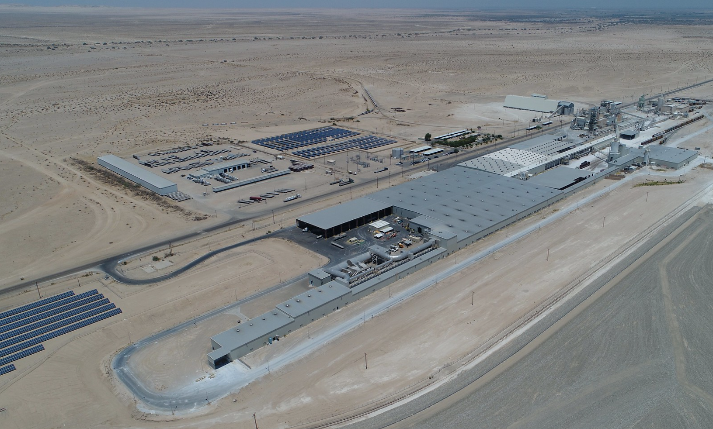
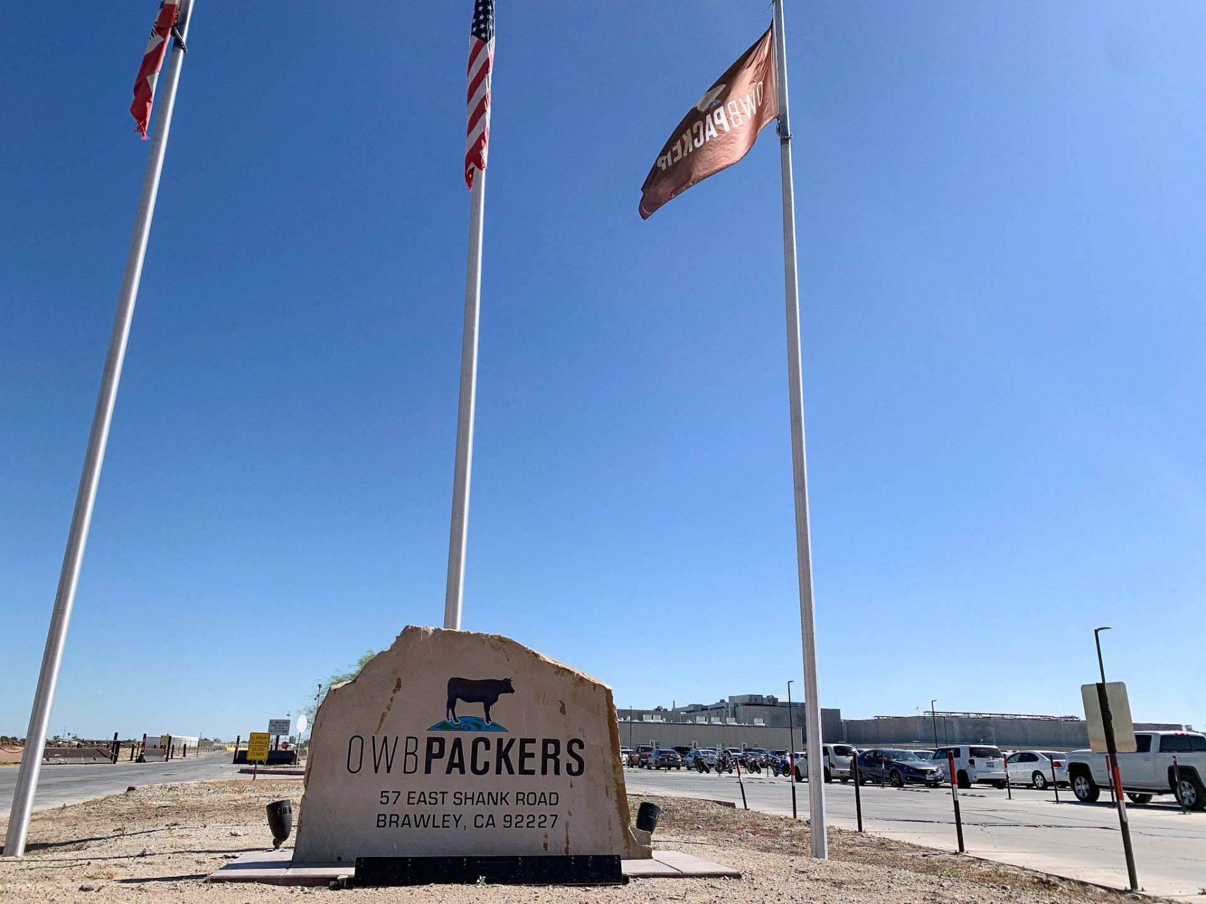
Large Load Customer (TCSP)
Applies to customers with large demand
Service provided at ≥34kV transmission voltage
Recent inquiries have involved demand levels as high as 1,000 MW.
Interest is coming from a diverse range of industries, including mineral extraction, hydrogen production, and data centers.
IID is actively developing new frameworks to address the unique requirements of these large-load interconnections.
This effort is essential, as not all large-load customers have the same infrastructure, operational, or interconnection needs
7

Slide 8
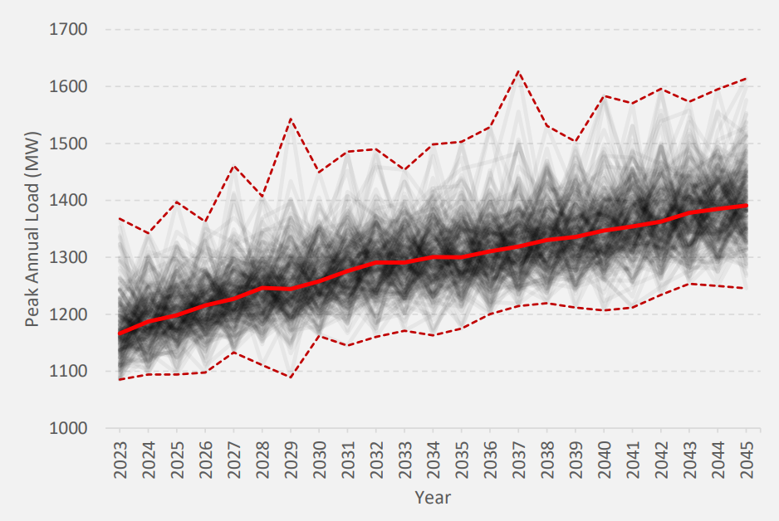
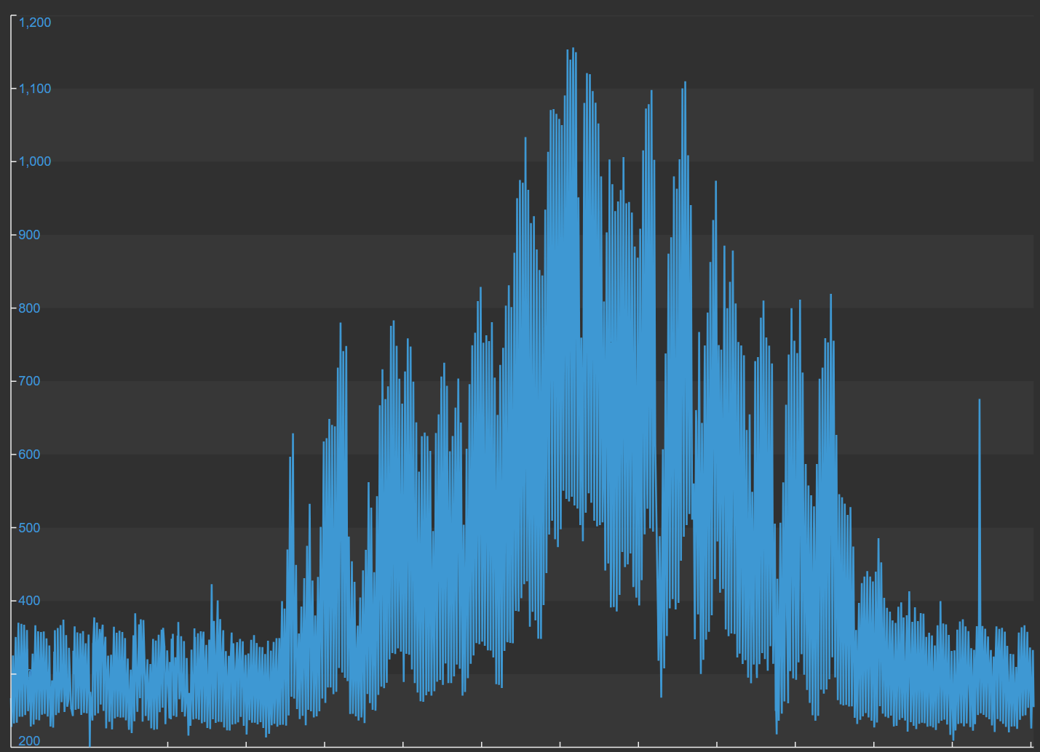
High-Demand Interconnection Challenges
Annual load growth is forecasted at roughly 2%
Mostly driven by electrification mandates
And growth in the Coachella Valley
IID’s load profile shows ample winter capacity but tight summer conditions
8

Slide 9
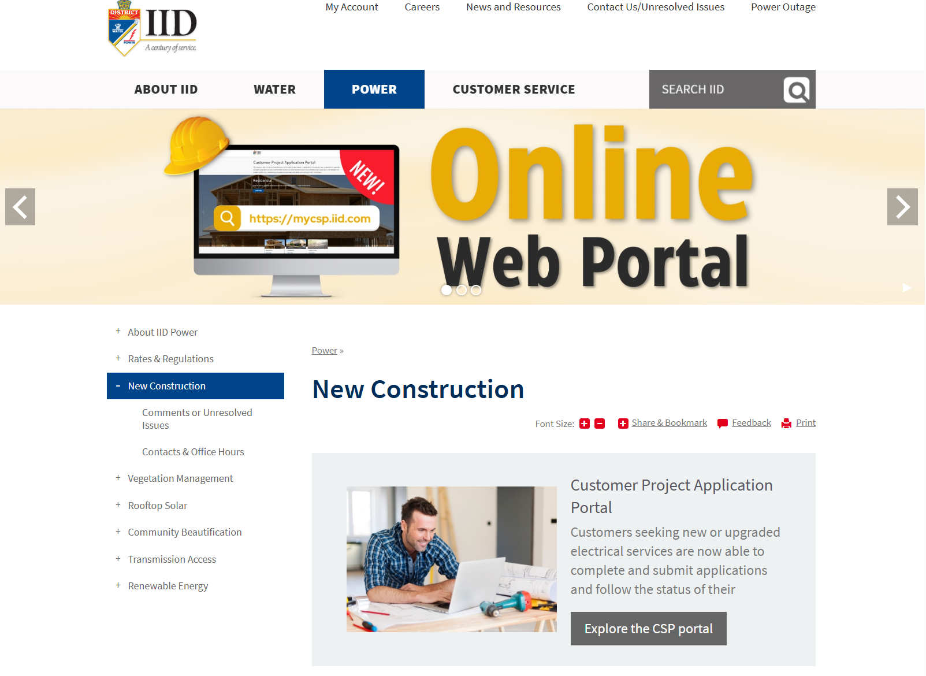
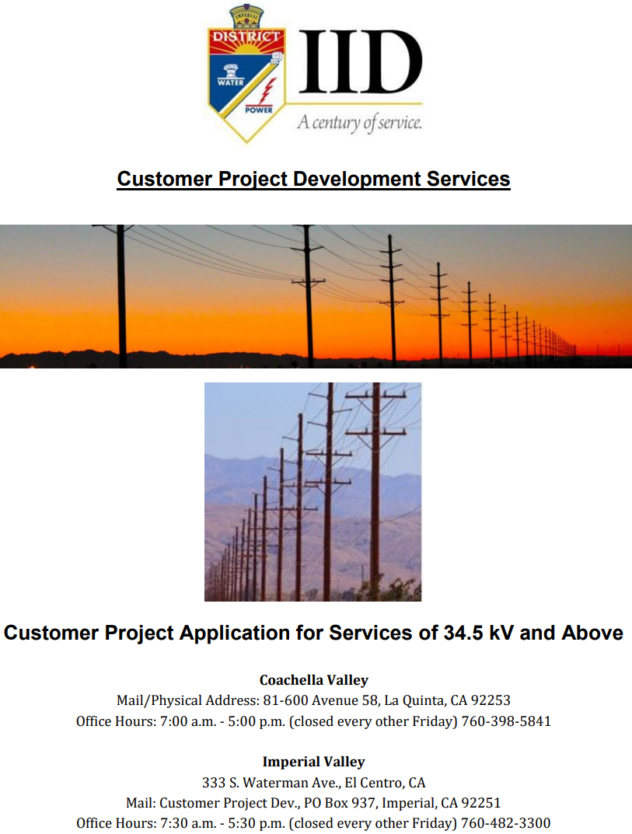
TCSP
Developers interested in more information on IID’s TCSP process they can contact TCSP@iid.com
The application can be found on IID’s website under Power Department and New Construction tab
www.iid.com/power/new-construction
9

Slide 10
Questions
Contact:
Paul Rodriguez
prodriguez@iid.com

