Slide 1
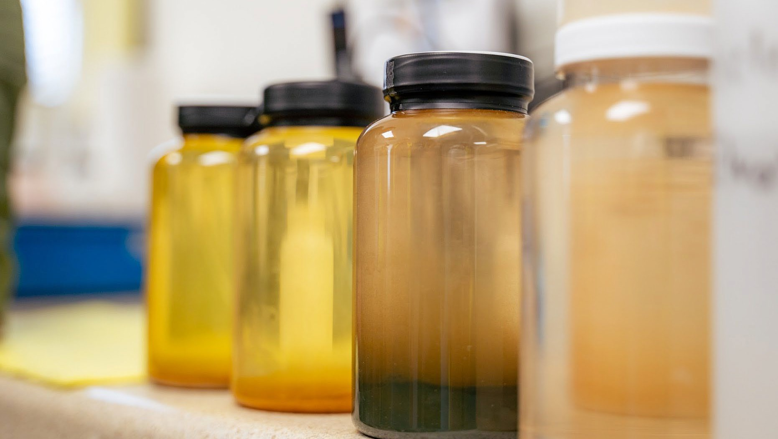
Looking beyond Li in Lithium Valley: Mn, Fe, Zn & K
Michael McKibben, Research Professor, U. C. Riverside mckibben@ucr.edu

Slide 2
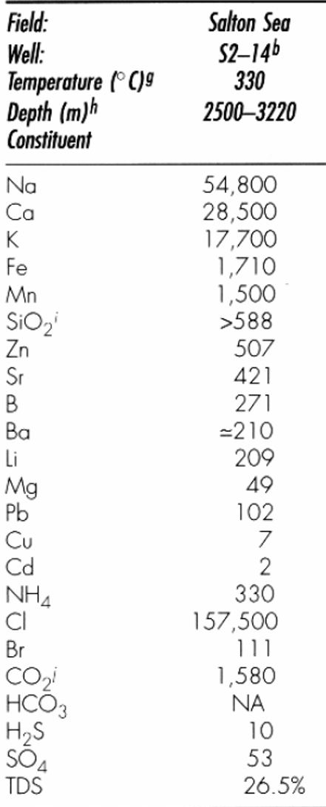
What other metals do Salton Sea brines contain?
Fe: for Lithium Iron Phosphate (LFP) batteries
Mn: for Lithium Manganese Iron Phosphate (LMFP) and Lithium Mn-rich (LMR) batteries
Zn: for galvanizing steel and immobile batteries for BESS
K: one of the 3 essential components of fertilizer (N, P)
What critical minerals don’t they contain:
Ni
Co
REEs
McKibben & Hardie 1997

Slide 3
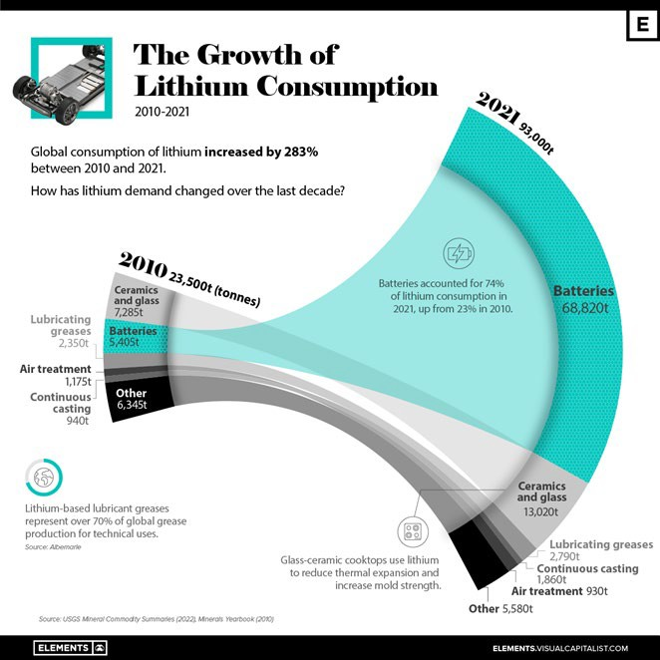
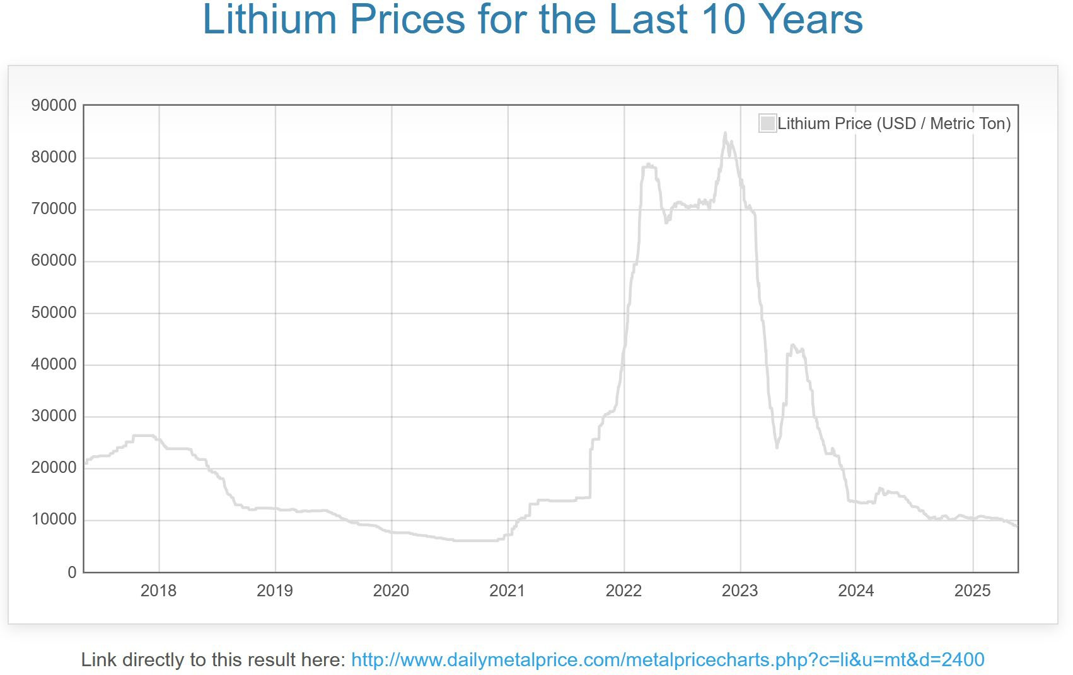
The Lithium Price Explosion and Collapse – because of long timelines for accelerating mining, metal prices fluctuate wildly with variations in demand, leading to an all too familiar “boom and bust” cycle.
2010: Li was used mainly for non-battery niche industrial applications like ceramics, glass and greases.
Sony Walkman, Apple IPod and other digital media players become popular, requiring light-weight, high-energy- density batteries. Cell phone use exploded, along with laptops, tablets, mobile appliances, EVs, power generators.
2022: 0.5 percent supply deficit; surge in EV demand
2023: Chilean brine and Chinese lepidolite overproduction, slowing in EV market growth

Slide 4
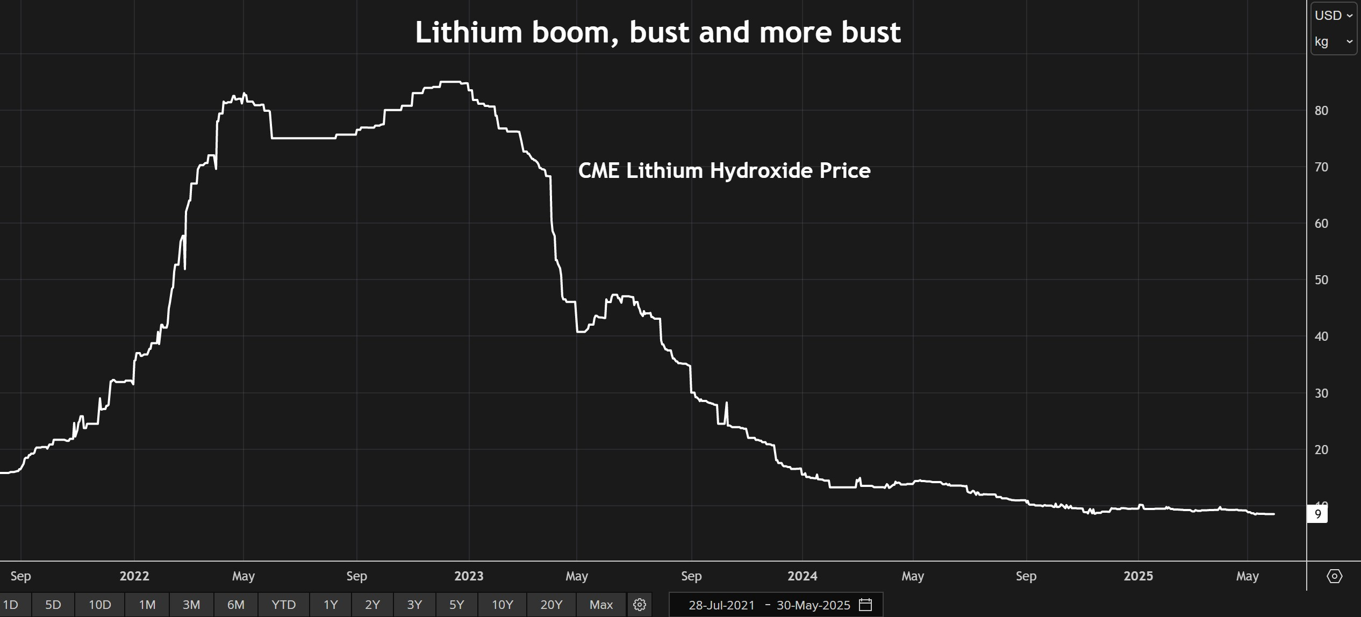
Price declines in Q1 of 2025 have been particularly brutal (~$8/kg lately). Nonetheless, lithium supply must increase by 2030 to keep pace with forecast demand. Prices well above current levels are required by ~2027. Current producers are willing to operate for 12-18 months at neutral/negative margins: $8- 10/kg LCE. Chinese also stockpile output to keep mines/plants open.
Lithium Valley suppliers could come online commercially (2028-2029) at just the right time to catch the anticipated swell in demand. But so could new Li suppliers in AR and NV!

Slide 5
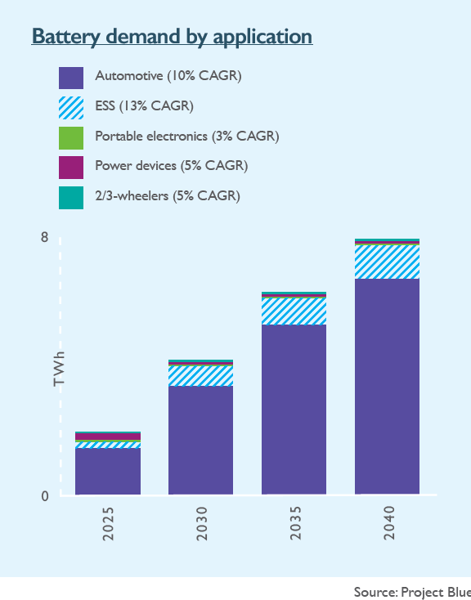
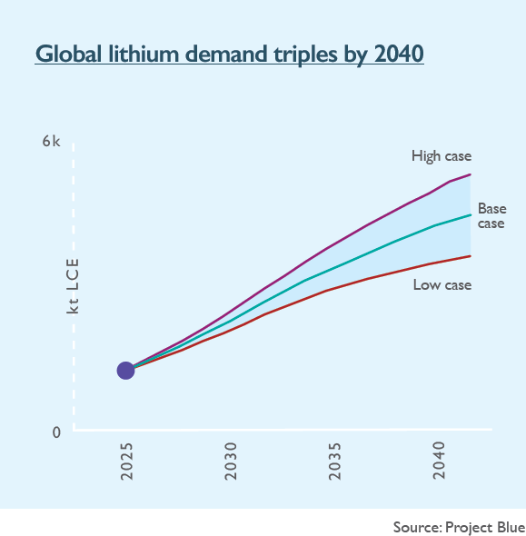
In spite of price decline, global Li usage grew by 30% last year, equivalent to the size of the entire global market in 2018.
Although the global EV market has slowed, it is still expanding steadily. Sales of new EVs rose by 25% last year and were up by 29% in the first quarter of this year. BESS is also expected to grow (13%/yr) to accommodate expanding electrical grid demands. Consequently, there is a forecast shortage of Li by 2040.
IEA 2025: Global lithium demand to grow to >500,000 tons/yr by 2040

Slide 6
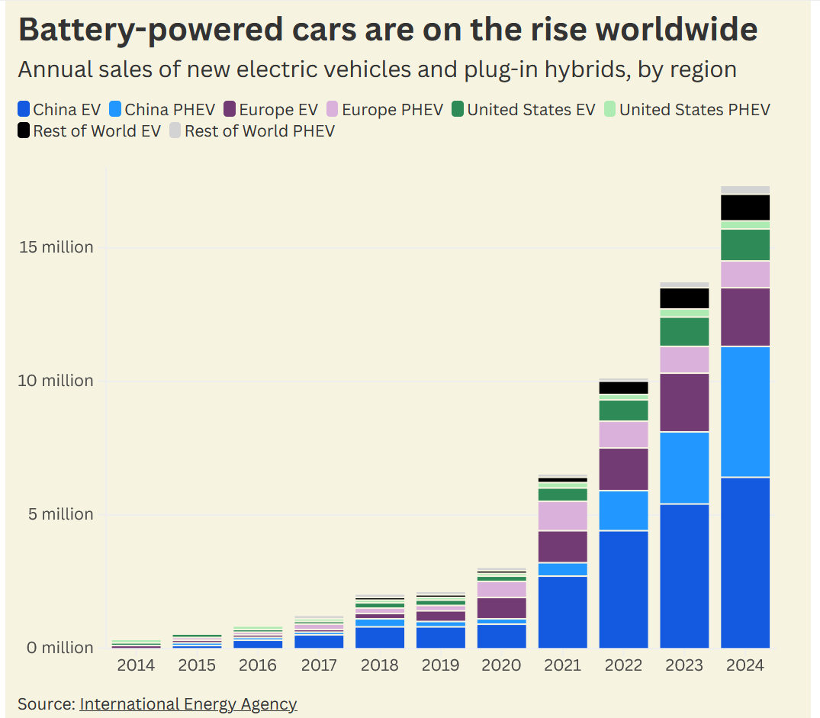

Slide 7
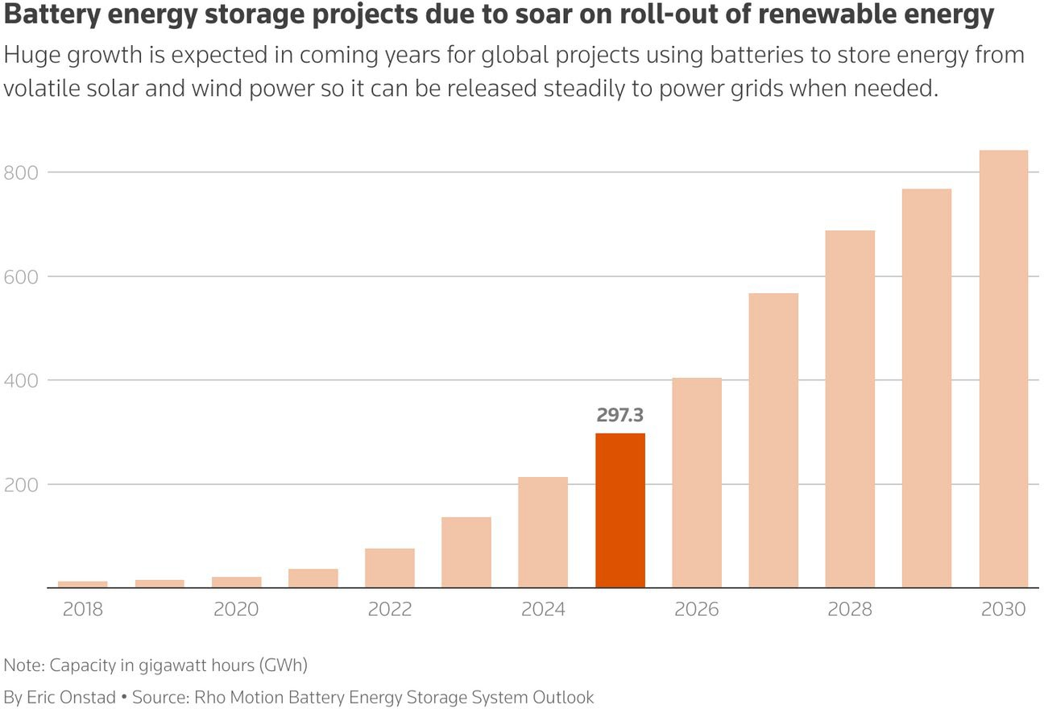
(Reuters 2025)
But changes to the IRA could cause domestic problems for many of these planned projects. They were structured around the expectation of long-term market certainty. Stripping away that certainty would not only freeze new investment but also undermine innovation.

Slide 8
Domestically, a lot depends on what the Senate does to the federal budget bill in regard to tax incentives, as well as DOE loan guarantees. There is the 45X tax credit in the IRA: 10% on critical mineral production, if it is up and running by 2029. Also there is the 48E tax credit on new geothermal power development; essential for having new geothermal DLE. Also, tariffs affect aluminum, and DLE adsorbent are alumina-based. The budget chaos and uncertainty is already having impacts:
Electric vehicle battery company halts construction of SC manufacturing plant:
https://scdailygazette.com/2025/06/05/electric-vehicle-battery-company-halts- construction-of-sc-manufacturing-plant/
The Future of IRA Clean Energy Production and Investment Tax Credits Under Draft GOP Tax Legislation:
https://www.huschblackwell.com/newsandinsights/the-future-of-ira-clean-energy- production-and-investment-tax-credits-under-draft-gop-tax-legislation

Slide 9
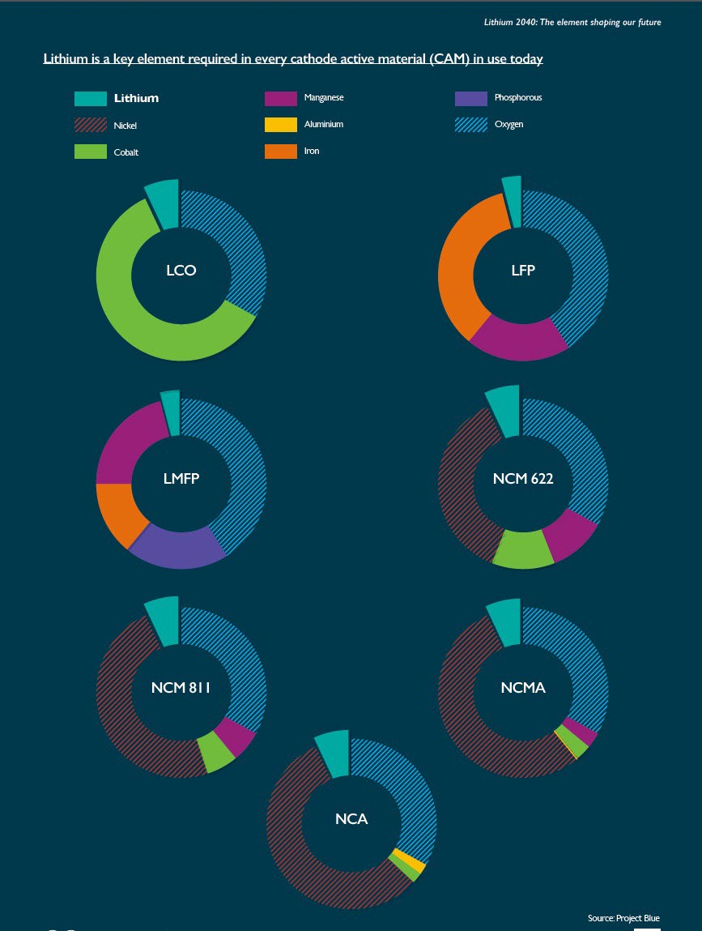
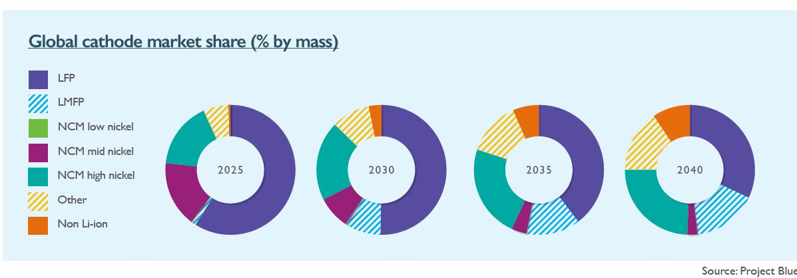
Let’s return to a basic fact: No other metal is light enough or energy-dense enough to replace the fundamental role of Li in batteries, especially for mobile applications.

Slide 10
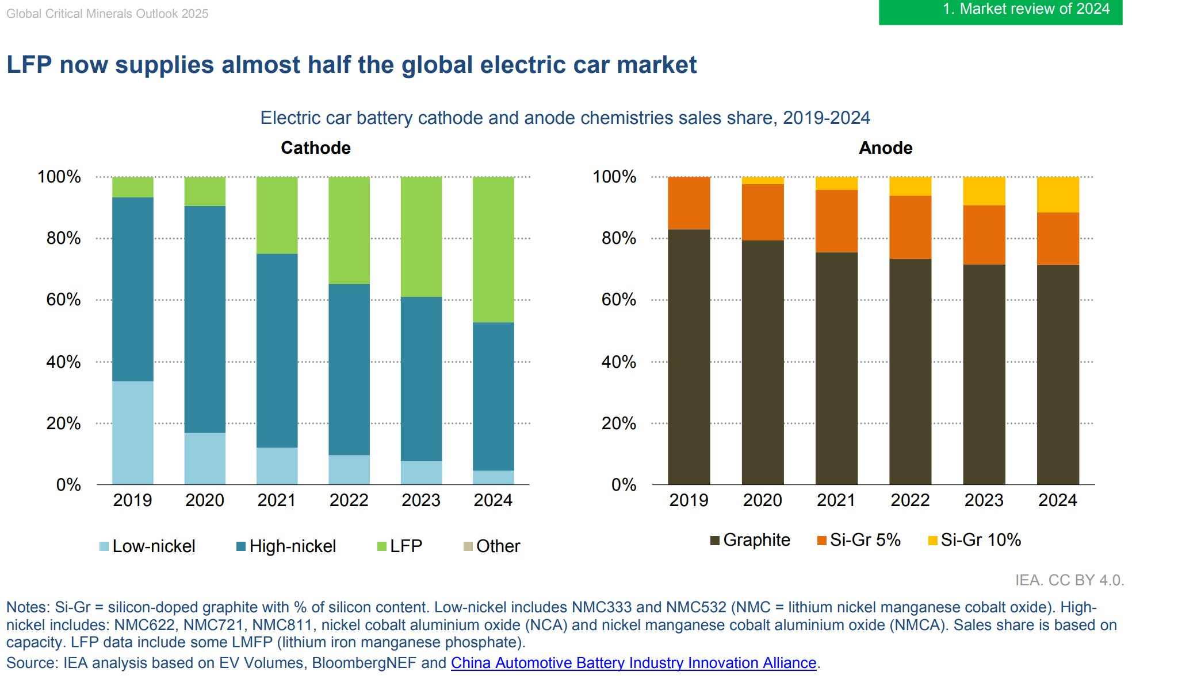
For a long time, electric vehicle manufacturers primarily used ternary NMC batteries made by combining lithium with three additional metal elements: nickel, cobalt, and manganese. However, recently, batteries have been developed that improve performance while reducing costs by increasing the content of cheaper metals.
LFP batteries are lithium-ion batteries made with inexpensive iron phosphate instead of costly nickel and
cobalt. The automotive industry reports that replacing ternary batteries with LFP batteries could reduce the price of electric vehicles by about 30%.
LG Energy Solution is converting part of their GM joint venture factory in Tennessee to an LFP battery production line. Samsung SDI is also going to produce LFP batteries at their GM joint venture factory in Indiana by 2027.

Slide 11
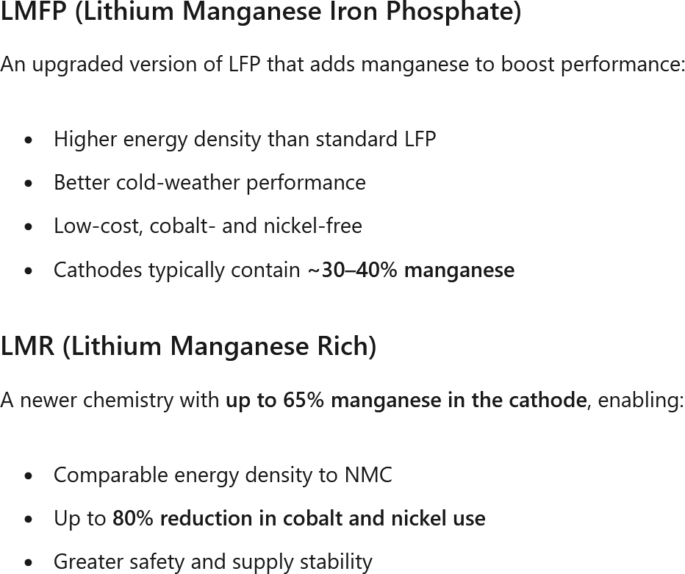
Manganese-rich chemistries are emerging to claim the middle ground between LFP's low cost and NMC's high performance:
LMR batteries minimize the content of cobalt and nickel while increasing the content of relatively inexpensive manganese to enhance cost competitiveness. Their energy density is about 33% higher than that of LFP batteries. LMFP (lithium manganese iron phosphate) contains ~26.% manganese—almost 5 times more per battery.
Ford and GM's promoted LMR chemistry reaches almost 37% manganese, nearly 7 times the NMC content.

Slide 12
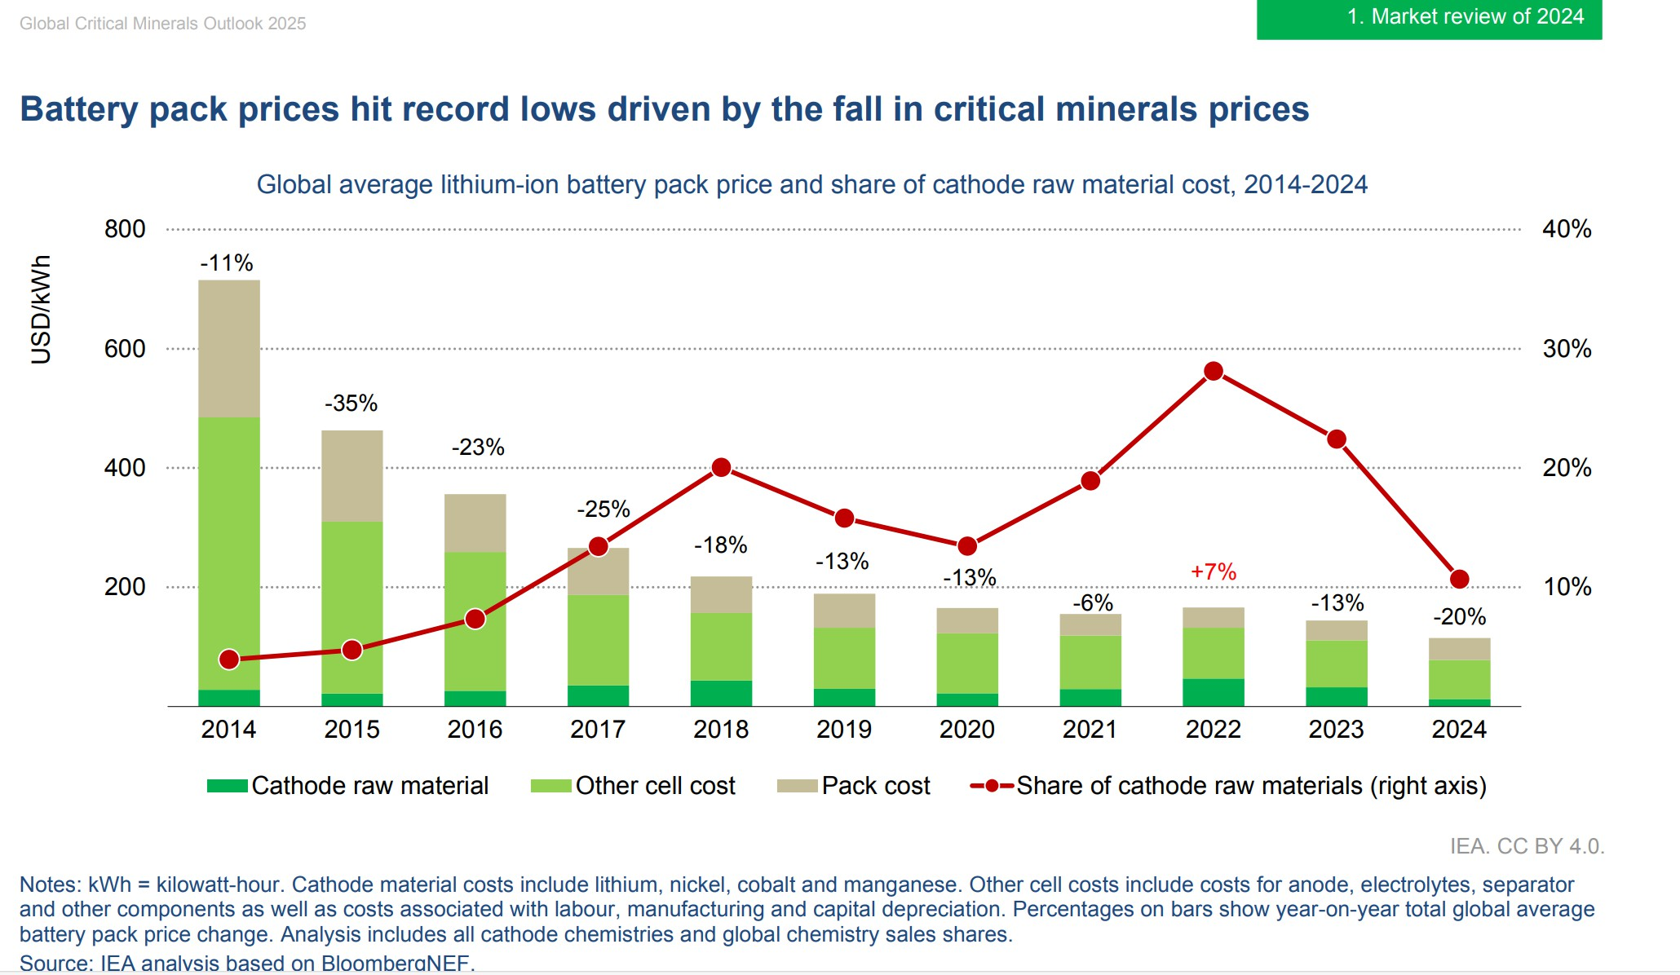
Both GM and Ford have announced development of LMR batteries for their forthcoming EVs.
https://www.wsj.com/business/autos/an-ex-tesla-engineer-is-turning-evs-into-affordable-family-cars-836c565d https://www.linkedin.com/pulse/ford-makes-breakthrough-lmr-battery-chemistry-targeting-charles-poon-wfx3c/
All of these trends should continue to drive down the costs of EVs, especially if the federal and state governments continue to support EV tax incentives.

Slide 13
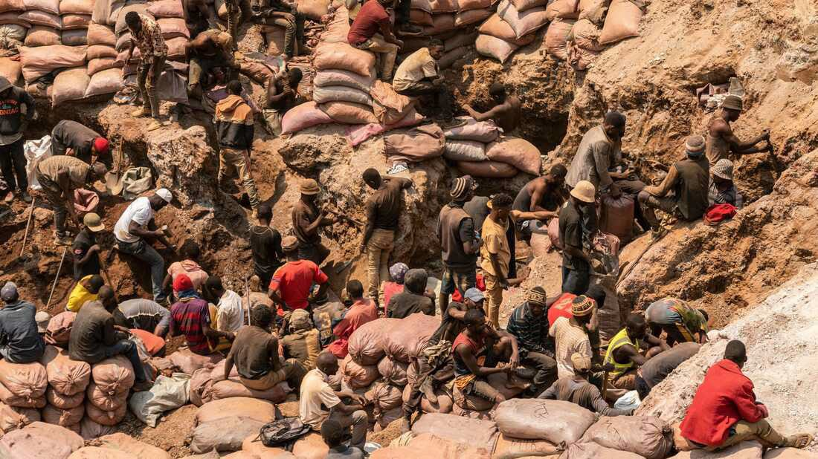
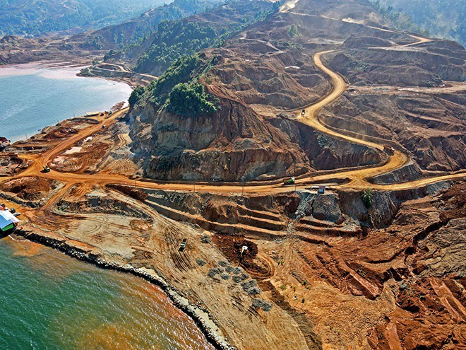
There are both economic and social advantages of using Mn over Co and Ni in Batteries:
Cost (US$/metric ton of metal):
Co | 32,000
Ni | 17,000
Mn | 1,800
Sutainability & Ethics:
Co, Ni: child labor, unsafe mining conditions, conflict $$$ issues in Chinese- controlled Co mines in DRC, Africa; Ni mines in Indonesia
Mn: could be more safely and ethically produced in North America

Slide 14
The significance of geothermal Mn
No domestic Mn production for nearly 60 years.
Mainly used for FeMn alloys in steel production.
Mn ore and FeMn imported from multiple nations.
The current power plants at SSGF produce brine with ~ 180,000 metric tons/y dissolved Mn metal. At $1,800/mt for electrolytic Mn, the gross revenue could be ~$324M/yr.
Traditionally, Mn ore is roasted and then leached in acid to produce Mn metal suitable for batteries. If the SSGF brine Mn could be produced electrolytically without those traditional processing steps, the cost and environmental competitiveness of geothermal Mn could be substantial.

Slide 15
The significance of geothermal Zn
Used to galvanize (protect) steel (e.g. the rust-proof undercoating on vehicles; steel construction framing; steel furniture). Future: Zn batteries for immobile BESS.
The U.S. exports Zn ores and concentrates, but imports 75% of its refined Zn, mainly from Canada.
The current power plants at SSGF produce brine with ~ 60,000 metric tons/y dissolved Zn metal. At $1.50/lb ($3307/mt), the gross revenue could be
~$200M/yr.
BHER produced Zn at SSGF in 2004 using IX, SX and eletecrowinning, but had problems with brine clarification and stability, up-scaling and a declining global Zn price at the time. The facility was dismantled. They learned a lot from that and the economics have improved. The process of DZE can be evaluated.

Slide 16
The significance of geothermal K
Potash (KCl) is one of the three main components of fertilizer (nitrate, phosphate).
93% of potash used in the U.S is imported, mainly from Canada, Russia and Belarus. The U.S. imports ~6M mt/yr of K₂O equivalent.
Domestic demand is growing at a 4.5% compounded annual growth rate.
The current power plants at SSGF produce brine with ~2,124,000 metric
tons/yr dissolved K metal or 4,057,000 mt/yr of dissolved KCl or 9,777,000 of K₂O equivalent. This is ~150% of U.S. annual imports.
At a current price of ~$360/mt for KCl, the potential gross annual revenue would be $1.46B/yr.
Processing (evaporation and crystallization) and purification (IX,RO,SX) costs would have to be evaluated.

Slide 17
Conclusions
Multiple critical metal supply chains could be established using SSGF brines (Li, Mn, Zn, K).
This would dampen the natural volatility of individual metal commodity prices and help strengthen and stabilize the revenue stream from Li and electricity sales.
Additional Lithium Valley jobs could be generated involving these metals and their manufacture into products such as EV/BESS batteries and fertilizer.
Additional mineral royalty and tax revenues could be realized by the County and State.

Slide 18
IVC-UCR Critical Minerals Analysis and Training Laboratory
Will give IVC students ICP-MS instrumentation experience and training in analyzing for critical minerals in brines and ores.
Funded by $2M Congressional Community Benefits grant to UCR, managed by UCR and IVC Chemistry Department.
Official press release and ribbon cutting ceremony coming soon!
Tim Lyons and Mike McKibben, UCR.
Jim Fisher, Efrain Silva and Krista Byrd, IVC.

