Slide 1
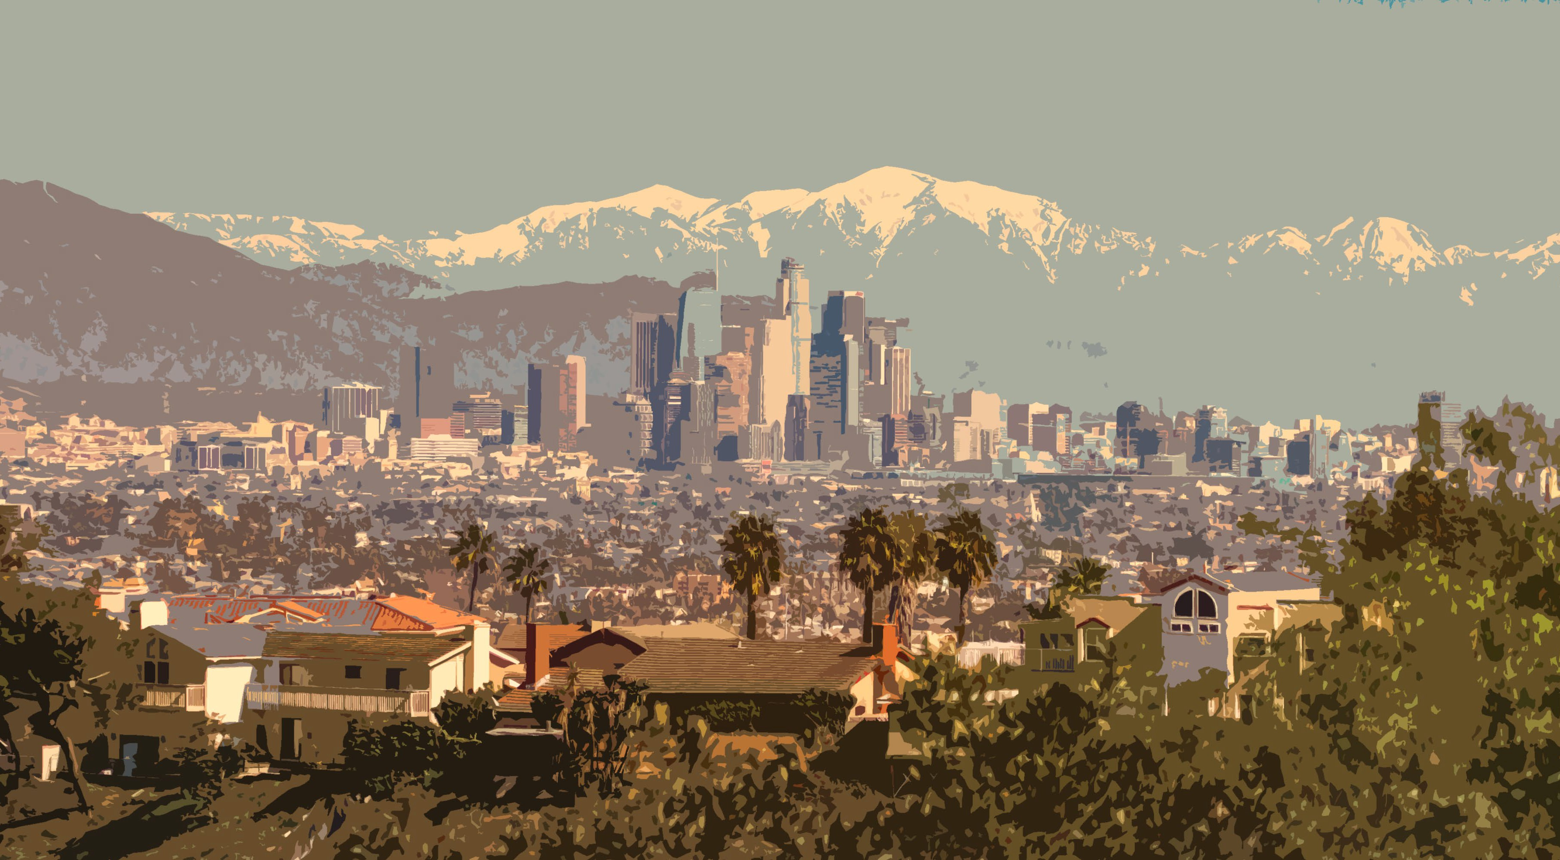
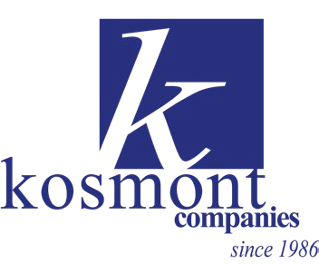
Joe Dieguez, Senior Vice President, Kosmont Companies IVEDC Annual Economic & Energy Summit
June 12, 2025

Slide 2
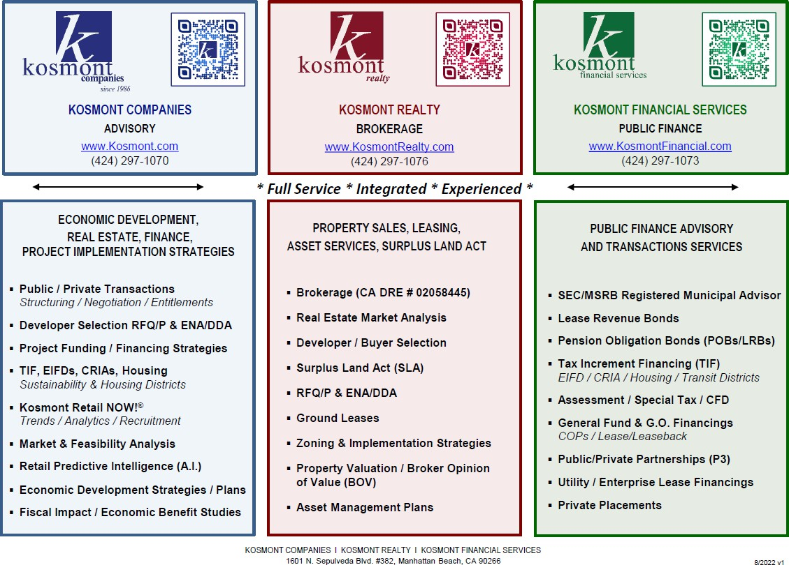
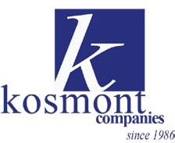
Kosmont Companies
Services Overview
PROPRIETARY DO NOT DUPLICATE
2

Slide 3
The 2025 ECON DEV PLAYBOOK:
value capture tools, housing, sustainability, grants…to reel in private $$
1
Zoning as Currency:
[Value Capture using Zoning/Specific Plan]
Value Capture via TIF:
2
New Tax Increment Financing (TIF) Districts
[EIFDs, CRDs, CRIAs]
3
Real Estate Strategies (Surplus Land Act)
[Capture value using public owned properties]
Grant Funding – Federal and State Sources
[Prop 4= $10B; IRA & IIJA = $1.6T+]
[For infrastructure, energy, climate focused investment and projects]
PROPRIETARY DO NOT DUPLICATE
3

Slide 4
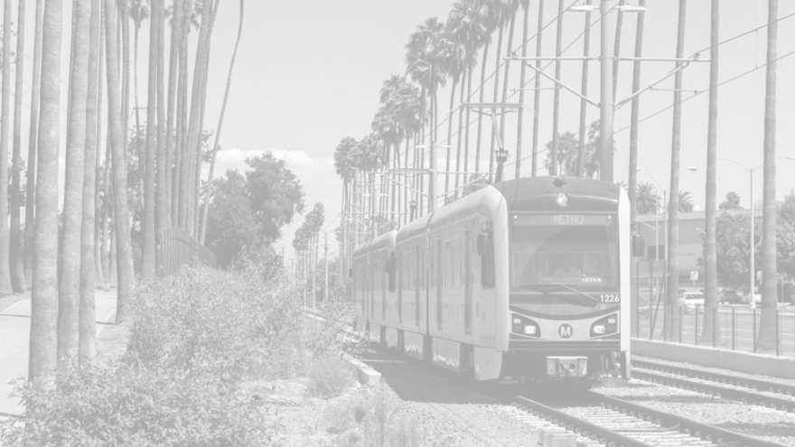
WHAT IS A TAX INCREMENT FINANCING (TIF) DISTRICT?
TIF Fundamentals
TIF is a method of capturing increased property tax revenue from new development or property value increases within a designated area to fund public improvements or those that implement public policy, such as housing.
How it Works
As private property investment occurs, the resulting increase in property tax revenue is “captured” and deposited into a separate TIF fund and used to pay for public improvements within a district.

Slide 5
TIF MECHANICS
$70B
$60B
$50B
Assessed Property Value (AV) within TIF District Boundaries
$40B
Period of New Investment
New Total Value After TIF District Benefits all Taxing Entities
$30B
New Property Value from New Development / Rehabilitation
Available to TIF District
$20B
$10B
Baseline Property Value
Property taxes continue to flow to City / County / Schools / Other Taxing Entities as normal
10 15 20 25 30 35 40 45
Years from District Formation
$0B
0
5
50
55
PROPRIETARY DO NOT DUPLICATE
5

Slide 6
ADVANTAGES OF TIF
Resource Preservation No encumbrance of existing city/county resources
Collaboration (OPM = Other Public Money) Attract tax increment contributions from other taxing entities
Grant Priority (OPM) Increased priority for grant funding
Private Sector Catalyst Demonstrated commitment to infrastructure projects to attract private development
No New Taxes Not a new tax for residents only value capture of new development
PROPRIETARY DO NOT DUPLICATE

Slide 7
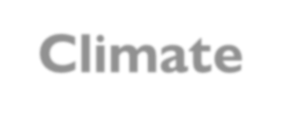
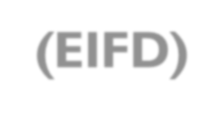
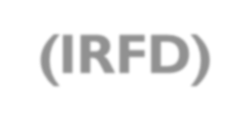
TIF ALTERNATIVES IN CALIFORNIA TODAY
Enhanced Infrastructure Financing District (EIFD)
Infrastructure & Revitalization Financing District
(IRFD)
Most flexible, most widely used
Climate Resilience District (CRD)
Community Revitalization & Inv. Authority (CRIA)
More emphasis on affordable housing (25% set-aside)
NEW, focus on resilience-related infrastructure
Flexible, voter-approval still required
Restriction to fund ONLY affordable housing (and not infrastructure) has been deemed to restrictive to be feasible in other communities
Neighborhood Infill Finance & Transit Improvements Act
(NIFTI)
Affordable Housing Authorities (AHA)
NIFTI-2
Coterminous requirement and other requirements have made NIFTI & NIFTI-2 infeasible in other communities
PROPRIETARY DO NOT DUPLICATE
7

Slide 8
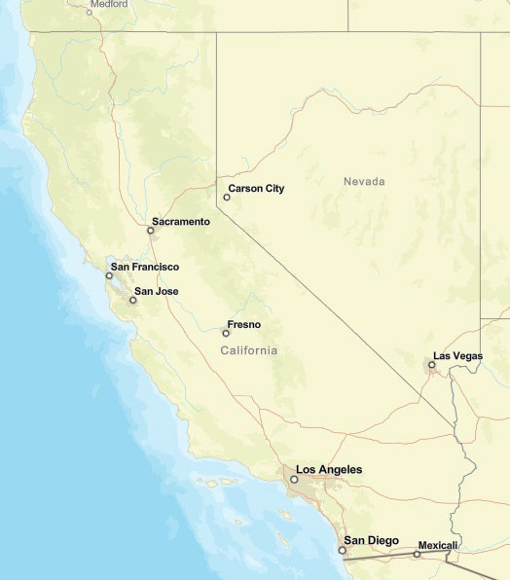
TIF PROGRESS STATEWIDE
Jurisdiction |  | Purpose
Apple Valley | Industrial and housing supportive infrastructure
Banning (CRIA) | Downtown revitalization, industrial infrastructure
Barstow | Industrial and housing supportive infrastructure
Brentwood | Housing, employment, and transit-supportive infrastructure
Buena Park | Mall reimagination, tourism-supportive infrastructure
Calipatria (CRD) | Economic and climate resilience infrastructure
Carson + L.A. County | Remediation, affordable housing, recreation
Citrus Heights | Mall reimagination
Covina | Downtown housing and blended use supportive infrastructure
Fairfield | Downtown, housing, and transit-supportive infrastructure
Fresno | Downtown, housing and transit-supportive infrastructure
Fresno County | Industrial and commercial supportive infrastructure
Humboldt County | Coastal mixed-use and energy supportive infrastructure
Inglewood (CRD) | Transportation and affordable housing
Imperial County | Renewable energy, housing and infrastructure
La Verne + L.A. County | Housing and transit-supportive infrastructure
Lakewood + L.A. County | Mall reimagination, smart streets, affordable housing
Long Beach | Economic empowerment and affordable housing
Los Angeles (Downtown, San Pedro, other) | Affordable housing and transit-supportive infrastructure
Los Angeles County West Carson | Housing / bio-science / tech infrastructure
Madera County (3 Districts) | Water, sewer, roads and other housing infrastructure
Modesto + Stanislaus County | Downtown, housing, and recreation infrastructure
Mount Shasta | Rural brownfield mixed-use infrastructure
Napa | Downtown, housing, tourism supportive infrastructure
Norwalk + L.A. County | Affordable housing and infrastructure
Ontario | Airport-related, blended use, infrastructure
Palmdale + L.A. County | Housing, blended use, transit infrastructure
Pittsburg | Housing, commercial, and tech park infrastructure
Placentia + Orange County | Housing and TOD infrastructure
Rancho Cucamonga | Blended use and connectivity infrastructure
Redlands | Education related blended use, mall reimagination
Redondo Beach + L.A. County | Parks / open space, recreation infrastructure
Riverside County Thousand Palms | Housing, hospitality, medical supportive infrastructure
Sacramento County (Unincorporated) | Industrial / commercial supportive infrastructure
Salinas | Water, sewer, and other housing supportive infrastructure
San Rafael (EIFD + CRD) | Blended-use and climate resilience infrastructure
Sanger | Commercial, hospitality, supportive infrastructure
Santa Cruz (EIFD + CRD) | Downtown, blended use, and climate resilience infrastructure
Santa Rosa + County of Sonoma | Downtown investment, affordable housing, aging infrastructure
Vacaville | Housing and business park infrastructure
Yucaipa | Housing and commercial infrastructure
Fully Formed | In Formation Process | Under Evaluation

Slide 9
TIF FORMATIONS:
COUNTIES & CITIES TEAMING UP
County Unincorporated EIFDs
Fresno County Business and Industrial Center (under study)
Humboldt County Unincorporated Samoa Peninsula (formed)
Imperial County (under study)
Los Angeles County Unincorporated West Carson (formed)
Madera County Unincorporated Riverstone (formed)
Madera County Unincorporated Tesoro Viejo (formed)
Madera County Unincorporated Riverwalk (formed)
Riverside County Unincorporated Highway 74 (formed)
Riverside County Unincorporated Temecula Wine Country (formed)
Riverside County Unincorporated Eastern Coachella Valley (formed)
Riverside County Unincorporated Thousand Palms (under study)
Sacramento County Unincorporated Metro Air Park (formed)
Stanislaus County Unincorporated Crow Landing Business Park (formed)
County EIFD Partnerships with Cities
Los Angeles County + Carson (formed)
Los Angeles County + La Verne (formed)
Los Angeles County + Palmdale (formed)
Monterey County + Gonzales (formed)
Orange County + Placentia (formed)
San Joaquin County + Stockton + Lathrop + Manteca (formed)
San Diego County + City of San Diego River Park (under study)
Sonoma County + City of Santa Rosa (under study)
Four counties have forged partnerships with cities
Six counties have started their own EIFDs
Seven counties have participation policies in place
Many ready for county partnership consideration
Counties with EIFD Participation Policies
Contra Costa County
Los Angeles County
Monterey County
Orange County
Sonoma County
San Bernardino
Sacramento County

Slide 10
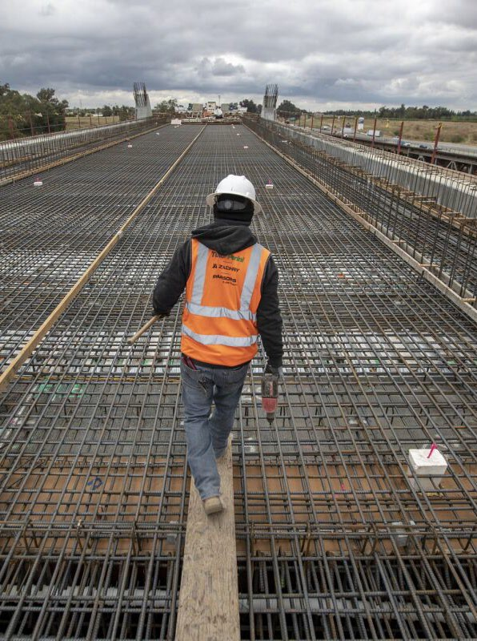
EIFD FUNDAMENTALS
District Formation 45 Years from first bond issuance; can be formed in 12-18 months
Governance Public Financing Authority (PFA), which prepares and adopts Infrastructure Financing Plan (IFP)
Approvals Mandatory public hearings for EIFD formation with protest opportunity; no public vote
Eligible Projects Any property with useful life of 15 or more years and of community- wide significance
PROPRIETARY DO NOT DUPLICATE
10

Slide 11
CLIMATE RESILIENCE DISTRICTS (CRD): NEW TIF IN TOWN
Eligible Projects | Including, but not limited to: Sea Level Rise / Flooding – sea level rise, sea walls, wetlands restoration, erosion control, levies, structure elevation / relocation, flood easements Extreme Weather – facilities / improvements for extreme heat, extreme cold, rain / snow Wildfire – fire breaks, prescribed burning, structure hardening, vegetation control Drought – land repurposing, groundwater replenishment, groundwater storage
Additional Powers | Taxing power – can levy a benefit assessment, special tax, property-related fee, or other service charge / fee Other funds – can apply for and receive federal / state grants, receive gifts / grants / allocations from public and private entities Administration – powers needed to administer district, like hiring staff
PROPRIETARY DO NOT DUPLICATE
11

Slide 12
OPM “OTHER PUBLIC MONEY”: GRANT FUNDING CAN BE ACCESSED BY CITY/COUNTY TIF DISTRICTS
Federal Sources
Federal EDA / DOT / EPA
Federal IRA and IIJA direct funds
State Sources
Caltrans ATP / HSIP grants
Prop 4 ($10B)
HCD & SGC grant / loan programs (AHSC,IIG, TCC,CERF)
Prop 68 parks & open space grants
Prop1 water/sewer funds
IBank / Climate Financing
Private Sector Sources
Development Agreement / impact fees
Benefit assessments (e.g., contribution from CFD)
Private tax credits available through IRA and IIJA for climate investments
Preferred strategy includes City partnership with County and other taxing entities
Districts with multiple partners are more likely to win grant funding sources
TIF explicitly increases scoring for CA Pro-housing incentives
PROPRIETARY DO NOT DUPLICATE
12

Slide 13
A
New Financing Program

Slide 14
CEDA - BAND
Land secured financing (CFDs & ADs) is a key component of financing public infrastructure for new development projects
Costs of development keeps rising due to rising costs for land, entitlements, and construction
CEDA BAND is a "turn-key" conduit program, which offers advantages to both developers and public agencies.
CALED’s Financing arm CEDA forms Bonds Assisting New Development (BAND)
Provides lower-cost alternative
Helps meet CALED’s mission of assisting with economic development of new communities

Slide 15
BAND Program Advantages
Developer Benefits
Flexibility
Available to cities, counties, utility & school districts
Multiple financing options: CFD, AD, EIFD, CRIA, CRD
CEDA BAND has more flexible Local Goals & Policies
Saves Costs
Single bond issue to finance multiple agencies costs
Lower issuance fees
Cost Competitive Issuance Fees
Streamlined Process
Board meetings every week
Experienced financing team already in place
Minimizes need to interact with public agency finance staff
“Turn-Key Solution”
Simply requires joining BAND: Adoption of one Resolution by local agency
CEDA 300+ members
Streamlined application process
Experienced Financing Team

Slide 16
BAND Program Advantages
Local Agency Benefits
Reduced administrative costs & burdens
District formation Bond issuance Continuing disclosure District administration
Multiple financing options
CFD, AD, EIFD, CRIA, CRD
Available to cities, counties, utility & school districts
Combine multi-agency projects
Combine smaller projects to achieve economies of scale savings
Enhanced credit profile

Slide 17
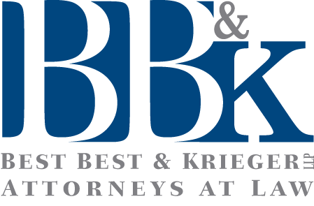
Experienced Financing Team

Slide 18
PUTTING IT ALL TOGETHER:
ENHANCE THE PROJECT CAPITAL STACK
These strategies support
public-public as well as
public-private partnerships – both of which support grant eligibility and enhance the project capital stack, whether for infrastructure or supporting
private investment.
Grants = Other Public Money (OPM)
Private Sector Dollars $$
Public Sector Value Capture Tools
Public Grants
(Public-Public)
Public Grants
(Public-Private)
Public Policy + Econ Dev Tools + Private Investment + Grant Funding = Econ Dev Success
PROPRIETARY DO NOT DUPLICATE
18

Slide 19
Thank you!
Q&A
Joe Dieguez, Senior Vice President, Kosmont Companies Jdieguez@Kosmont.com
IVEDC Annual Economic & Energy Summit June 12, 2025

