Slide 1
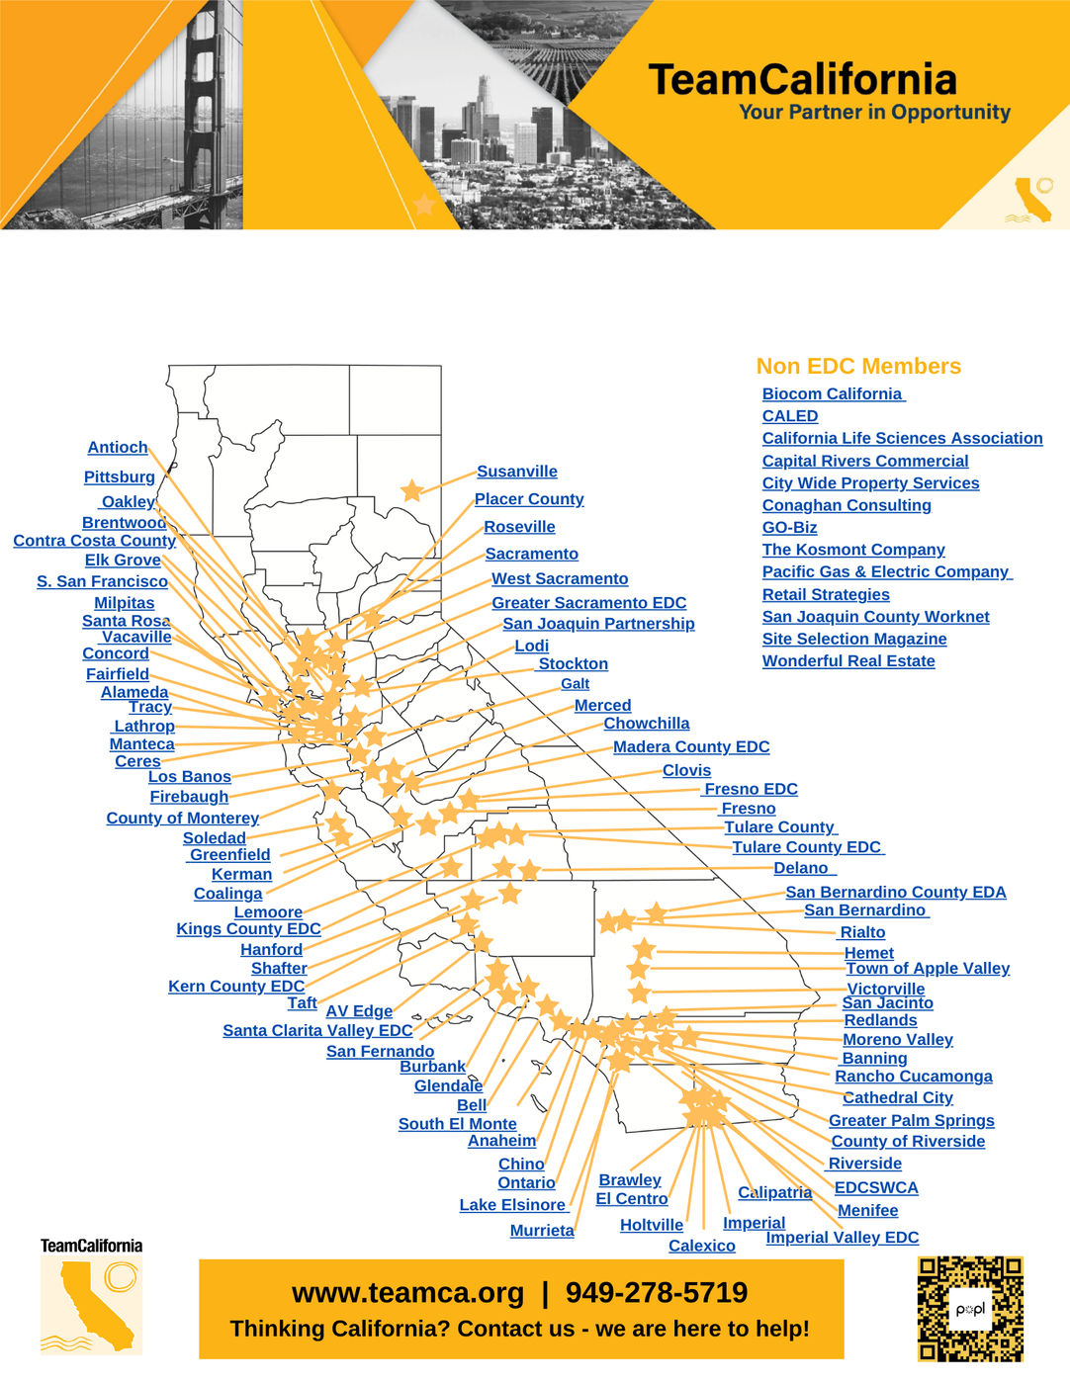
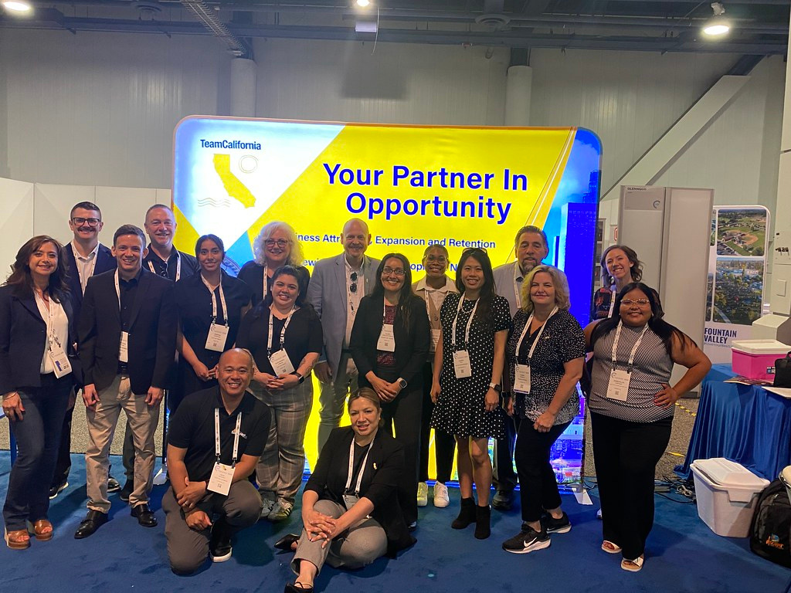
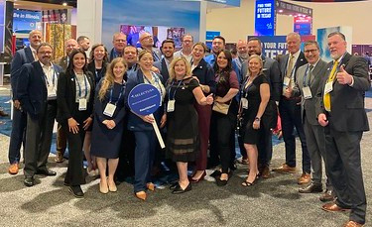

Slide 2




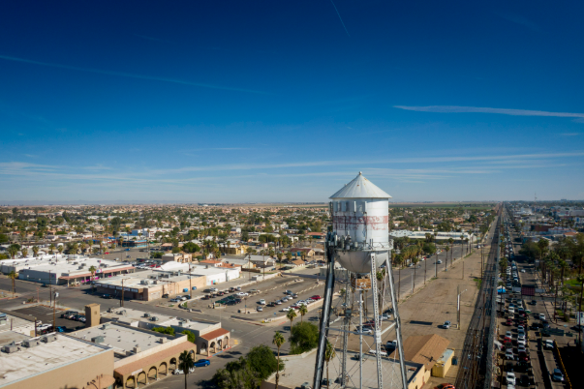
AHEAD
PARTNERSHIP
Supporting business attraction, visibility, and community marketing
SPECIAL THANKS TO OUR PARTICPATING AHEAD COMMUNITIES

Slide 3
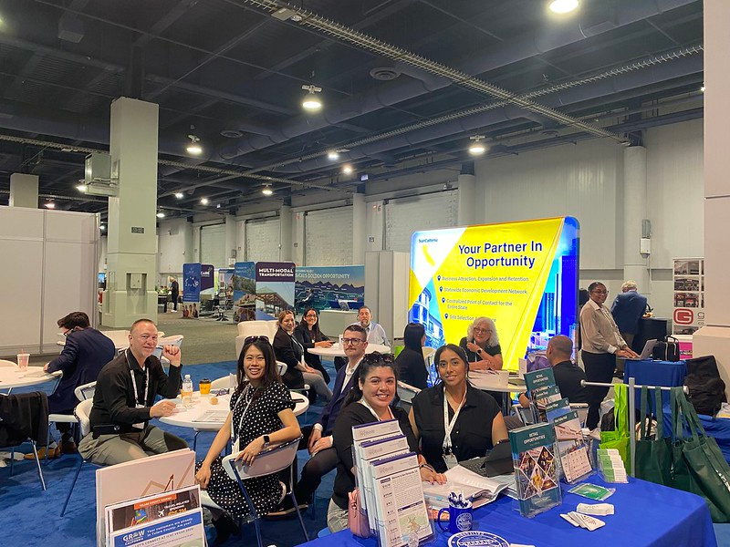
STRONG SHOWING AT ICSC
  3 AHEAD communities participated in ICSC@
Las Vegas 2025 (Imperial, Calexico & Needles)
  Excellent visibility & lead engagement
  New connections made with retailers & developers

Slide 4

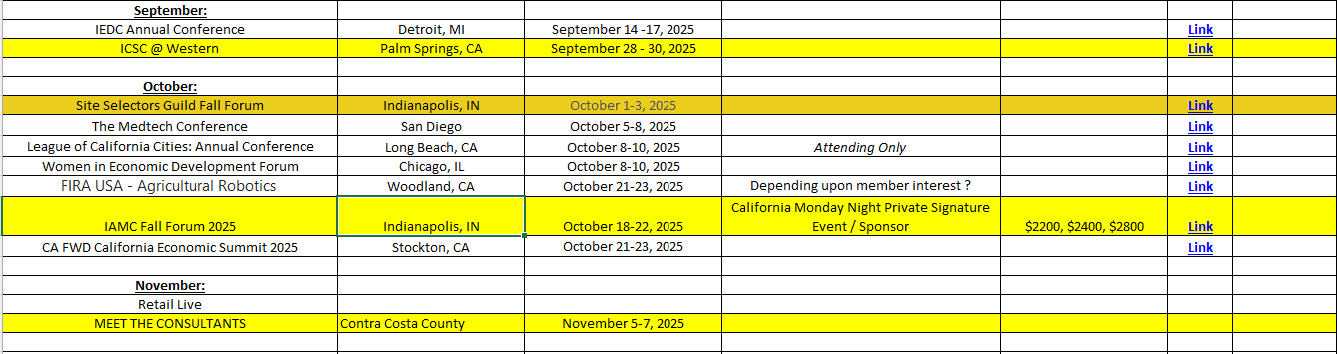
WHERE WE GO NEXT
  Multiple upcoming trade shows & events available
    ICSC Western, Site Selectors Guild, IAMC Fall Forum & Meet The Consultants Forum
  TeamCalifornia aims to support a strong Imperial County presence
  Now is the time to commit to future visibility

Slide 5

RETAIL STRATEGIES: OPTIONAL SUPPORT
  Available for free retail gap analysis and leakage studies
  Can be contracted directly for deeper engagement with their Retail Academy
  Great pre-ICSC prep tool for identifying retail attraction targets:
Upcoming Webinar June 17th 11am PST: “Small Budget, Big Impact: How Rural
Downtowns Are Winning With an Incremental Approach”

Slide 6

ACCESS TO WEBINARS

Slide 7
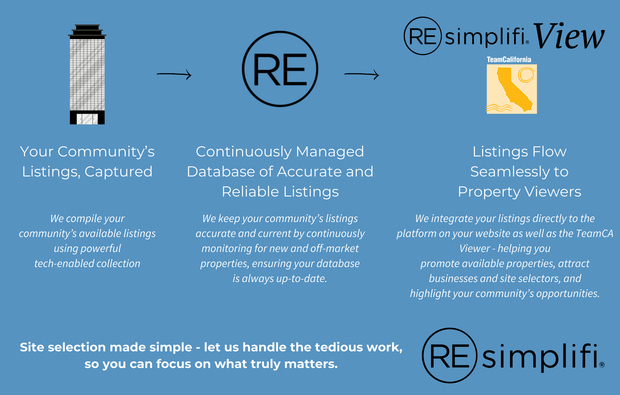
GET YOUR
PROPERTIES SEEN
  Each AHEAD community gets up to 5 featured listings
  Listings appear on TeamCalifornia’s new interactive website
  Integrated with ZoomTour, Resimplifi

Slide 8


INTERACTIVE COMMUNITY TOURS
  ZoomTour integration helps showcase your community story
  Pair with Resimplifi to show available, development-ready sites
  Captures the attention of site selectors, brokers, and investors

Slide 9
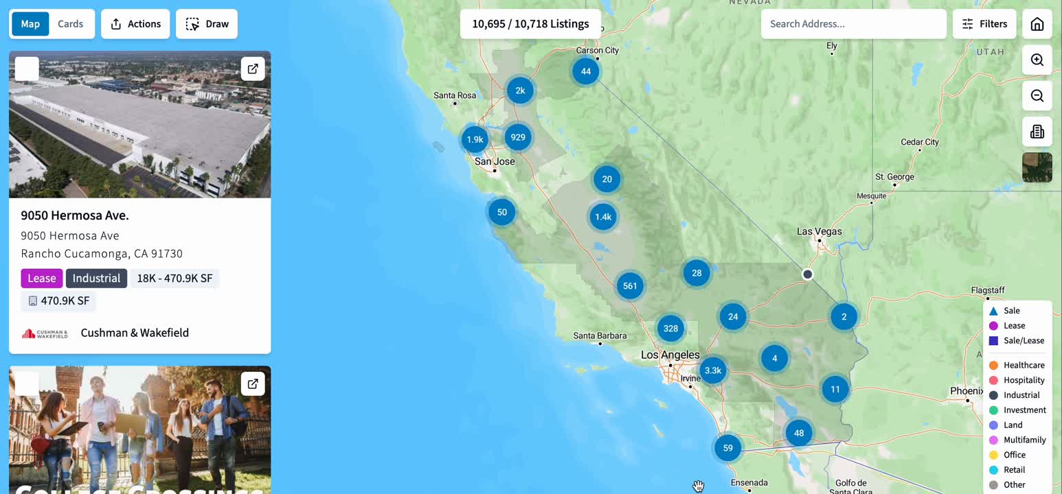

INTERACTIVE COMMUNITY TOURS

Slide 10
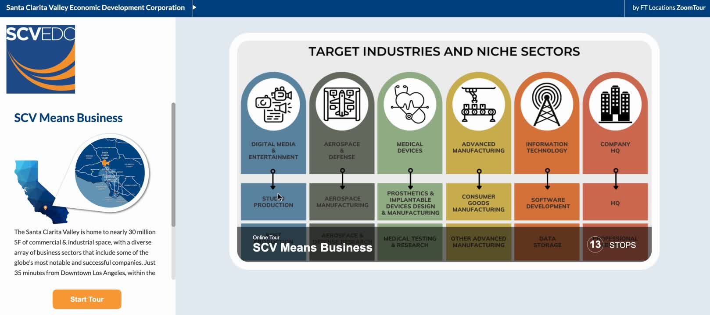
INTERACTIVE COMMUNITY TOURS

Slide 11









AHEAD GRANT COMMUNITY PARTNERS

Slide 12

WHAT WE’RE ALREADY HEARING
  Strong interest in property listings
  Your local leaders are excited to upload site details
  Prospective investors want to know more!

Slide 13


NEXT STEPS FOR YOUR
COMMUNITY
PREPARE
EXPLORE
Prepared to upload your 5 properties for the site – get all materials to Carlos, Jordan and I
Explore & engage with Retail Strategies if desired
CONTACT
WATCH
Contact TeamCalifornia for ZoomTour onboarding
Watch for upcoming ICSC, IAMC and MTC dates and plan to attend!

Slide 14

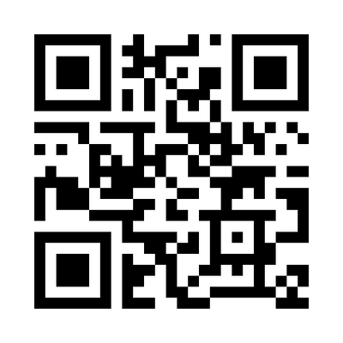
MEET THE CONSULTANTS
https://teamca.org/meet-the-consultants-25/

Slide 15

THANK YOU
Robin Reimold, TeamCalifornia
robin@teamca.org
Jordan Noyola-Murphy, TeamCalifornia
jordan@teamca.org

