Slide 1
Southern Border Region
Catalyst Pre-development Fund 1st Round - Awards

Slide 2
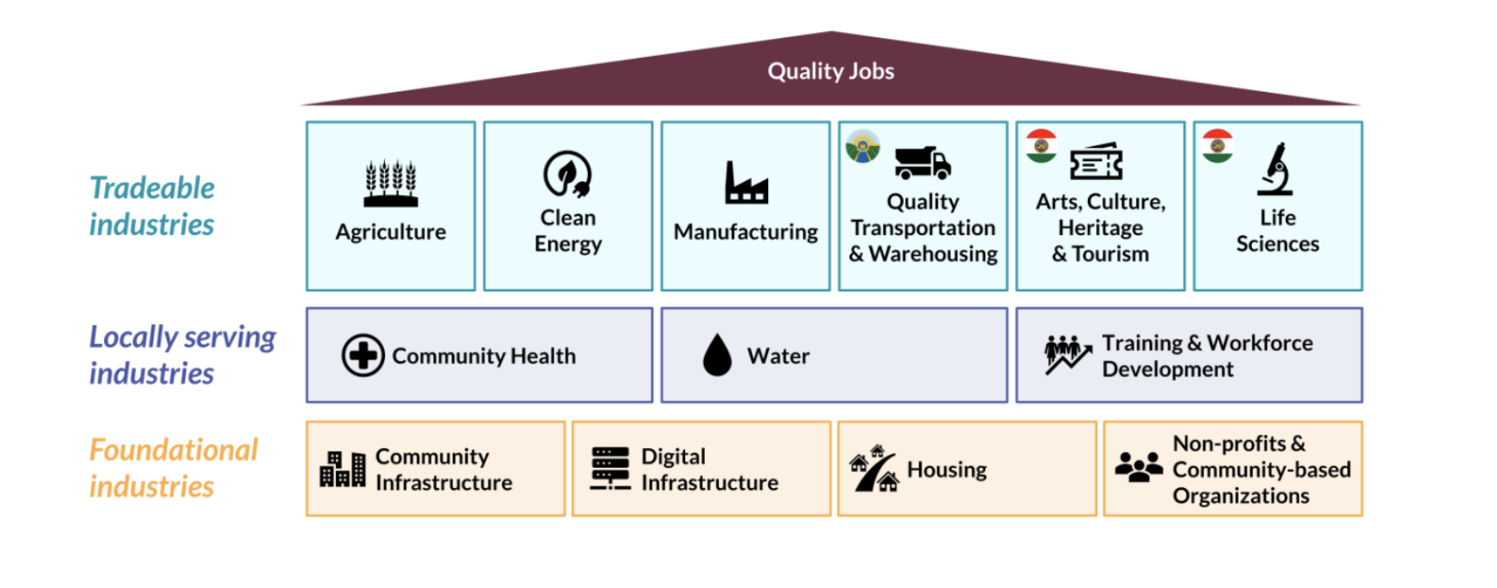

Slide 4
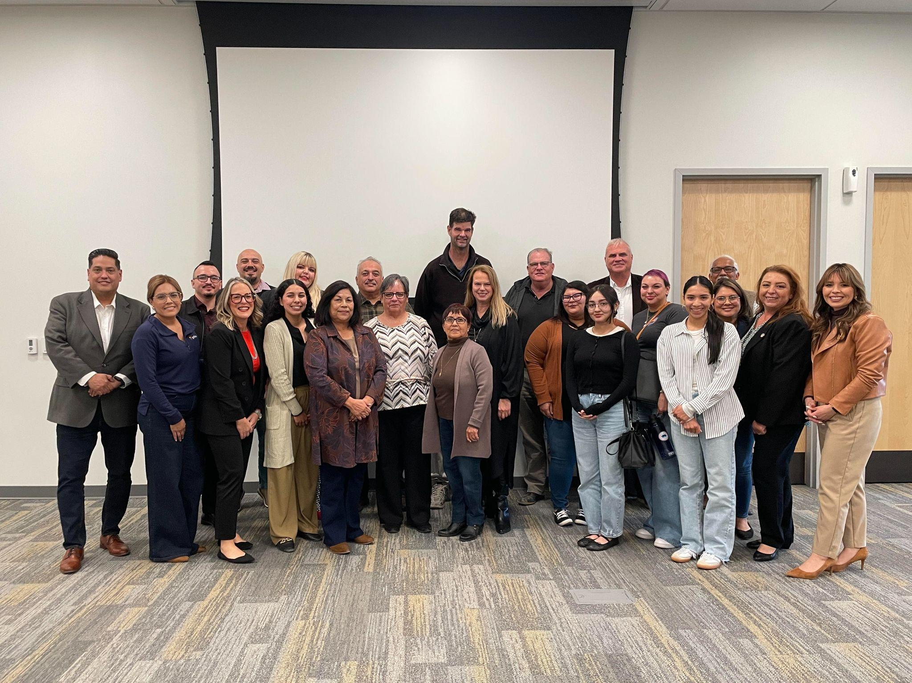
1. emPower Lithium Valley Workforce Initiative
Summary: This Initiative will organize structured convenings of the emPower the Valley coalition over 12 months, building local capacity to understand and operationalize workforce development strategies (particularly those that don’t require a 4-year degree) aligned with RAND’s recommendations and California Jobs First priorities. emPOWER the Valley is a regional coalition of 30+ community-based organizations, education providers, industry leaders, and public agencies dedicated to building a more vibrant, equitable, and prosperous Imperial Valley.
Lead applicant: Good for Others Foundation (CBO) Point of Contact: Karen Connolly, karen@goodforothers.org , 619-818-7035
County: Imperial County
Project Type: Exploratory
Website: https://www.goodforothers.org/
Notes:
This slide will be presented by: LORNA

Slide 5
2. Smart Border Tech and Data Equity Lab
Summary: The Smart Border Tech & Data Equity Lab is a pre-development workforce initiative designed to prepare for a full-scale training program that will address the digital divide and economic exclusion in San Diego’s Southern Border Region. With a focus on youth and marginalized jobseekers from BIPOC, immigrant, and refugee communities, this project will focus on planning, pilot development, employer engagement, and curriculum design for a future training program in smart logistics, cybersecurity, and AI/data equity.
Lead applicant: Black Entrepreneur Leaders and Learners (BELL) Point of Contact: Jayton Harps, (951) 235-6860, jharps@bellgroupsd.com Project Type: Exploratory Website: https://www.bellgroupsd.com/
Notes:
This slide will be presented by: ALEXIS

Slide 6
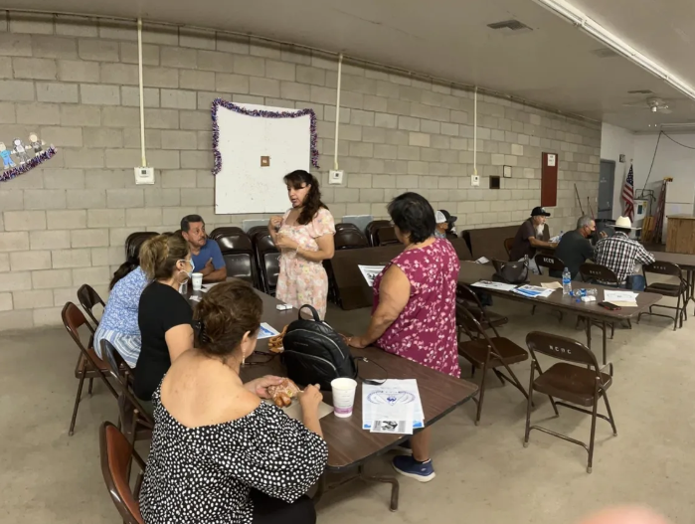
3. Building Green Communities
Summary: This Exploratory Project will create a Community-Based Organization (CBO) Workforce Development Capacity-Building and Technical Assistance Partnership between Los Amigos de la Comunidad, Inc (LADLC) as the CBO/Non-Profit engagement and outreach specialist and the Imperial County Building and Construction Trades Council (ICBCTC) as the Certified career workforce training center. The partnership will include outlining strategies and identifying recruitment best practices for pre-apprenticeship community member capacity building and entry opportunities into apprenticeship programs and careers in the Building and Construction Trades.
Lead applicant: Los Amigos de la Comunidad, Inc. (LADLC) Point of Contact: Eric Montoya Reyes, 760-550-5153 , Eric@losamigosdelacomunidad.com County: Imperial County Project Type: Exploratory Website: https://losamigosdelacomunidad.com/
Notes:
This slide will be presented by: JAVIER

Slide 7
4. Family Childcare Start and Scale for Imperial
Summary: This project is to assist primarily Latina women to (1) scale their existing Family Child Care businesses (in-home) and (2) assist women to start their family childcare business. This project will be completed by the San Diego & Imperial Women’s Business Center (WBC) and Small Business Development Center (SBDC), which are programs of Southwestern College Foundation.
Lead Applicant: Southwestern College Foundation
Point of Contact: Daniel Fitzgerald, dfitzgerald@swccd.edu , 619-216-6721
County: Imperial
Project Type: Planning
Website: www.sdivsbdc.org
Notes:
This slide will be presented by: LORNA

Slide 8
5. Micro-Entrepreneurs Planning-Pilot Project
Summary: The proposed Micro-Entrepreneurs Planning-pilot project is an innovative economic development initiative to identify Imperial County micro-entrepreneurs with tradable products that can be marketed beyond the local area. The project will adapt the framework and modular systems used by Amazon Fulfillment Centers as a guide for developing a local fulfillment center and sales process to support micro-entrepreneurs in selling their products.
Lead Applicant: Neighborhood House of Calexico (NHC)
Point of Contact: Ricardo Ortega, 760-455-0520, ricardo@nhclx.org
County: Imperial
Project Type: Planning
Website: www.nhclx.org
Notes:
This slide will be presented by: ALEXIS

Slide 9
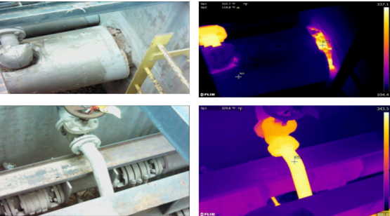
6. Mechanical Insulation Thermographic Assessment (MITA) Program
Summary: The Mechanical Insulation Thermographic Assessment (MITA) Program proposes a transformative initiative to advance energy efficiency and equitable workforce development across the Southern Border Region. This 18-month project will combine advanced thermographic assessment, workforce training, and public engagement to deliver substantial environmental, economic, and social benefits.
Lead Applicant: Heat & Frost Insulators & Allied Workers Local 5
Point of Contact: John Pierandozzi, johnlocal5@icloud.com , 909-390-3401 ext 103.
County: Both
Project Type: Planning
Website: www.hnflocal5.com
Notes:
This slide will be presented by: JAVIER

Slide 10
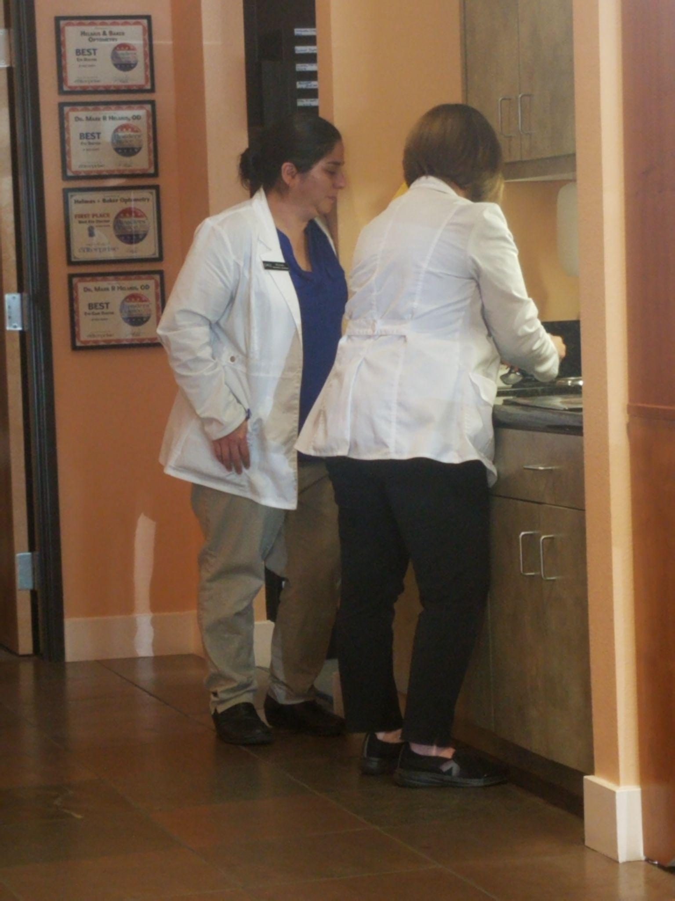
7. Blooming Community Health Worker (CHW) Certification Project
Summary: The project focuses on equipping participants with formal CHW certification and climate health literacy to meet the region’s growing demand for frontline public health workers. Special emphasis will be placed on serving historically marginalized populations—such as displaced farmworkers, individuals with limited education, the unhoused, and people with disabilities—through bilingual training, wraparound supports, and a culturally responsive curriculum.
Lead Applicant: Raizes
Point of Contact: Vivian Perez, 760-554-2204, vivian@raizesinc.org
County: Imperial
Project Type: Planning
Website: www.raizesinc.org/
Notes:
This slide will be presented by: LORNA

Slide 11
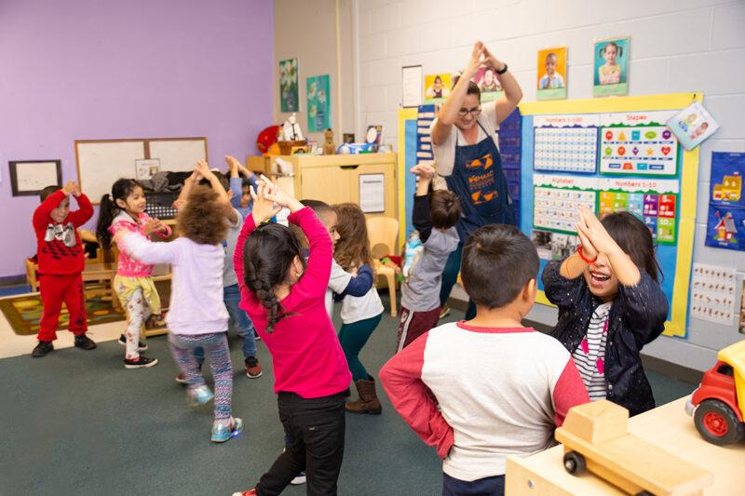
8. High Road Career Partnership
Summary: MAAC will deploy a workforce development program that will match MAAC client participants with training programs that provide pathways into high growth industries that are in demand in the southern border region. Clients will be placed in high growth career pathways that lead to jobs that pay living wages. This proposed project is a natural extension of MAAC's ongoing work, particularly in economic and workforce development. We have long recognized that self-sufficiency is tied to access to good jobs-those that offer living wages, benefits, stability, and upward mobility. MAAC's holistic model combines wraparound services, personalized case management, and workforce training to ensure that participants are not only prepared for employment but are positioned for long-term success.
Lead Applicant: MAAC
Point of Contact: Andrew Nunn-Miller, 619-551-6614, anunnmiller@maacproject.org
County: San Diego
Project Type: Planning
Website: www.maacproject.org
Notes:
This slide will be presented by: ALEXIS

Slide 12
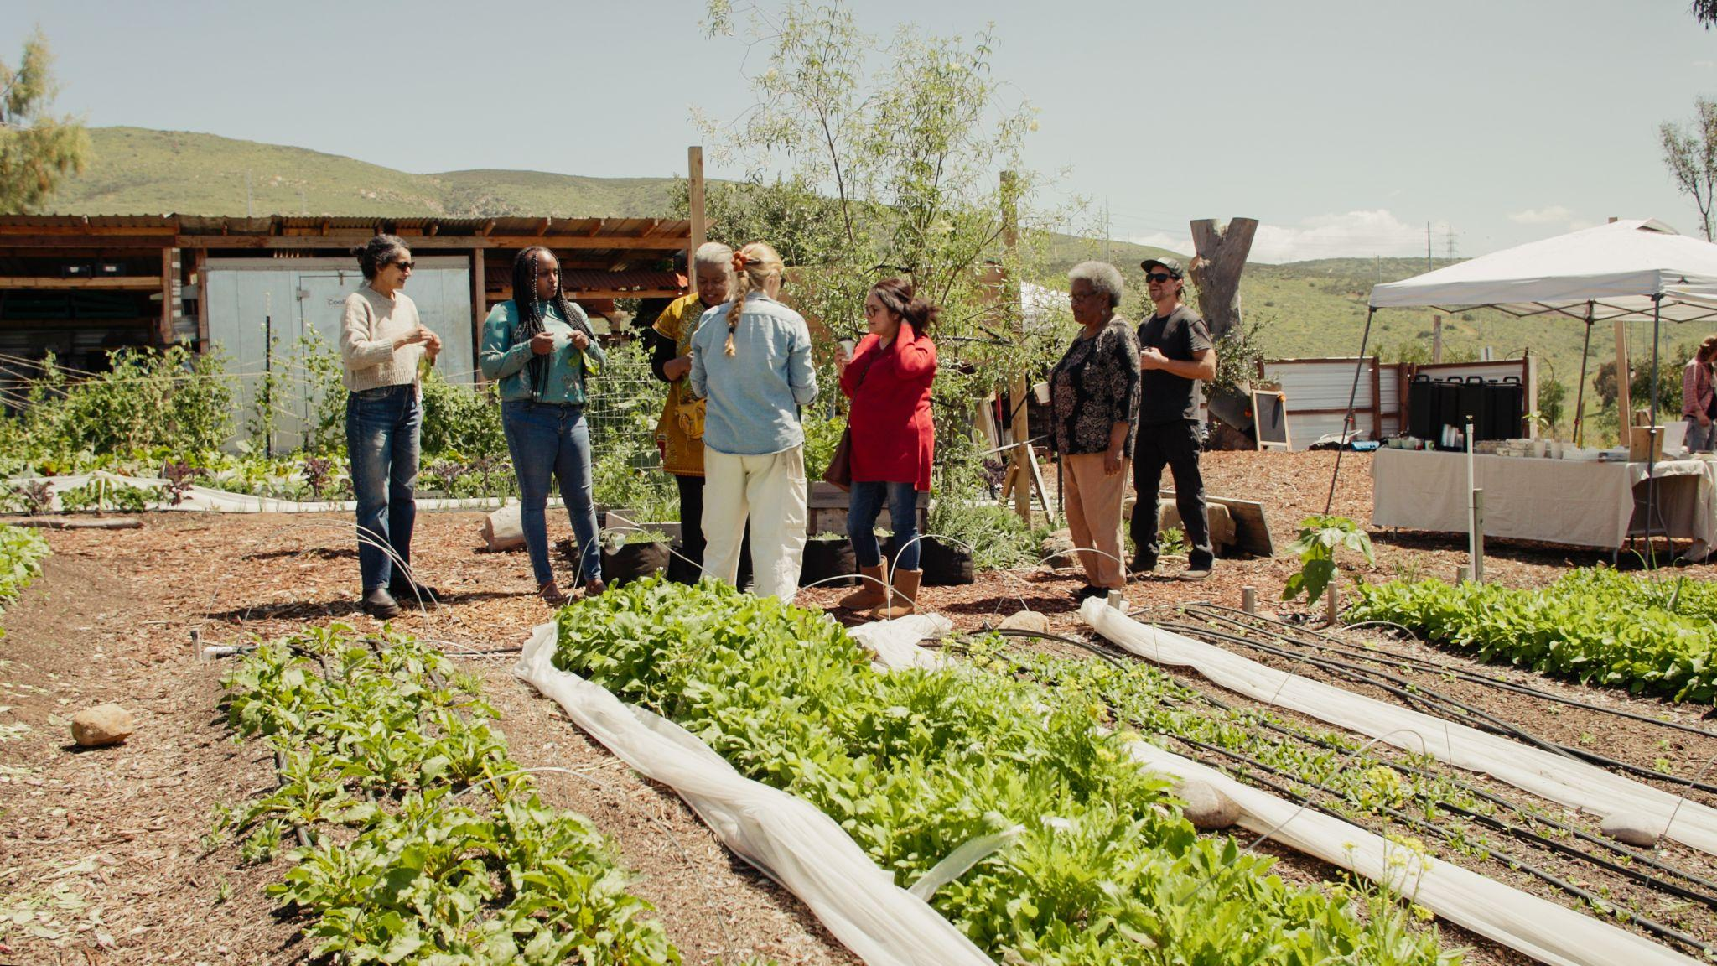
9. Planning for an Agricultural Community Land Trust in San Diego County
Summary: The San Diego Food System Alliance (Alliance) proposes the planning of an agricultural community land trust (CLT) in San Diego County. Agricultural CLTs are proven community wealth building models that acquire and permanently protect land, lease it affordably to farmers, and ensure long-term community stewardship through shared governance. The proposed CLT will advance equity, economic opportunity, and climate resilience in San Diego County’s agriculture industry. By creating pathways to land tenure for disinvested farmers and farmworkers, the CLT will expand access to agricultural careers, generate opportunities for agricultural business development, bolster the regional food economy, and conserve land for climate-resilient agriculture.
Lead applicant: San Diego Food System Alliance
Point of Contact: Geertje Grootenhuis, 858-245-3781, geertje@sdfsa.org
County: San Diego
Project Type: Planning
Website: www.sdfsa.org
Notes:
This slide will be presented by: JAVIER

Slide 13
10. Forevergreen Farms
Summary: The Becoming Project’s plan for job creation is the development of a state-of-the art indoor hydroponic and aquaponic farming facility in Imperial County. The project will integrate solar energy, closed loop water systems, and partnerships with local farmers to create A sustainable, scalable agricultural model. This initiative aims to address food insecurity, unemployment and environmental degradation while aligning with the goals of the California Jobs First Initiative and the Southern Border Coalition.
Lead applicant: The Becoming Project
Point of Contact: William A. Cooper , williamanthonycooper.esq@gmail.com, (619) 944-3306
County: Imperial
Project Type: Planning
Website: https://www.becomingprojectinc.org/services
Notes:
This slide will be presented by: LORNA

Slide 14
11. AI - Ready Manufacturing Workforce Initiative
Summary: The "AI-Ready Manufacturing Workforce Initiative” aims to safeguard and expand quality manufacturing jobs in San Diego and Imperial Counties as employers adopt AI technologies. The project will assemble a steering committee of manufacturers, labor representatives, community colleges, workforce boards, and philanthropic organizations to develop a comprehensive strategy. The initiative will map shifting skill demands through employer interviews, identify worker barriers via bilingual surveys, create transition strategies for workforce development, develop responsible AI deployment training for employers, and publish an implementable roadmap.
Lead applicant: Policy and Innovation Center
Point of Contact: Karen Boyd, kboyd@thinkpic.org , (619) 249-7061
County: Both
Project Type: Planning
Website: https://thinkpic.org
Notes:
This slide will be presented by: ALEXIS

Slide 15
12. GIS Training and Certification Program
Summary: Through this initiative, Black Tech Link will offer an accessible training program focused on real-world applications of GIS. Students will become knowledgeable of ArcGIS, the industry-standard software developed by Esri. Participants will gain the skills and knowledge necessary to pass the Esri GIS Fundamentals Foundation Certification exam and will receive job placement assistance in fields that rely on geospatial technologies. The curriculum will be co-developed with Gordon GIS, a San Diego-based consulting firm with deep experience in GIS training and implementation. Black Tech Link has also sought out the support of Blacks at ESRI, Inland Empire GIS, and Northstar GIS to provide curriculum insight.
Lead applicant: Black Tech Link
Point of Contact: Elizabeth Cotton, blacktechlink@gmail.com , (951) 223-1030
County: San Diego
Project Type: Planning
Website: https://blacktechlink.org
Notes:
This slide will be presented by: JAVIER

Slide 16
13. Tribal Energy and Climate Economic Development, Innovation, and Training Center
Summary: SCTCA coordinates and administers numerous programs for its members and the Southern California Indian community, including: Tribal Temporary Assistance to Needy Families (TANF), Law Enforcement, Food Commodities, Information Technology Services, Rincon Community Child Development Center, Adult Vocational Training, Career Development Center, Low Income Home Energy Assistance Program(LIHEAP), the Library Program, Child Care Development Services, Tribal Digital Village (TDV), Resource Prevention Program, Tribal Energy & Climate Collaborative (TECC), Tribal Energy Innovation Accelerator (TEIA).
Lead applicant: Southern California Tribal Chairmen’s Association (SCTCA)
Point of Contact: Joshua Simmons, jsimmons@prospersustainably.com , (805) 617-5685
County: Both
Project Type: Planning
Website: https://sctca.net/
Notes:
This slide will be presented by: LORNA

Slide 17
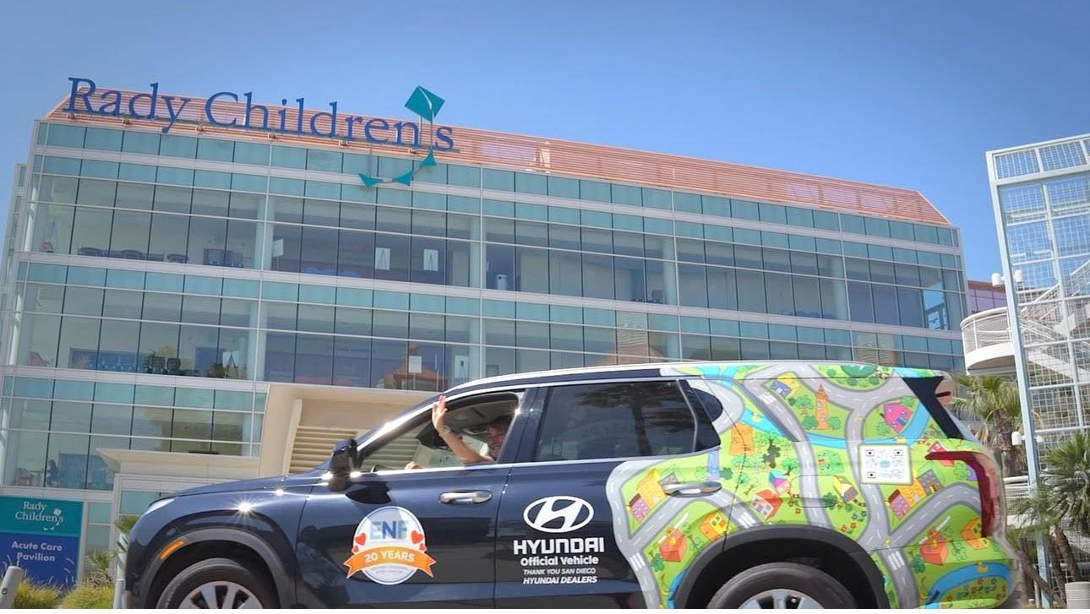
14. ENF Family Resource Center
Summary: With the closure of Imperial Valley’s only cancer resource center, families are seeking Emilio Nares Foundation’s (ENF) help to meet basic needs while their child receives treatment. We provide free transportation to pediatric cancer patients in IV—and with over 20 years of experience, we are ready to deepen our impact. With a $250,000 investment, we will launch a Family Resource Center offering bilingual guidance and wraparound services including access to shelter, food, education, mental health, and training. This center will address key social drivers of health, restore essential services, create jobs, and help families rebuild after completing treatment.
Lead applicant: Emilio Nares Foundation
Point of Contact: Monica Martinez ,monica@enfhope.org, (619) 518-7110
County: Imperial
Project Type: Planning
Website: https://enfhope.org
Notes:
This slide will be presented by: ALEXIS

Slide 18
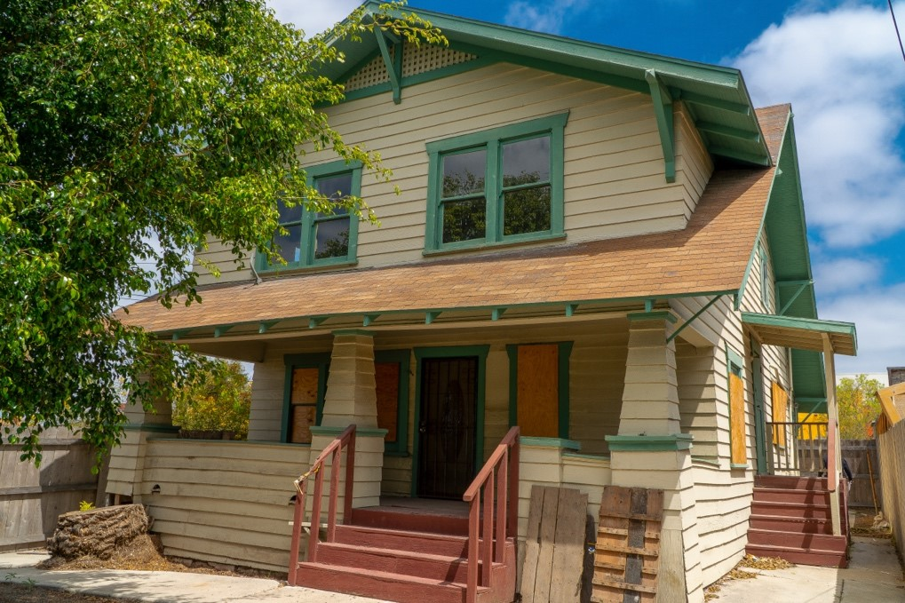
15. Community Economic Advancement & Housing Resilience Planning Project
Summary: Casa Familiar (Casa)'s Community Economic Advancement & Housing Resilience Planning Project tackles San Ysidro's dual challenges: housing instability and barriers to family-sustaining employment. This initiative creates pathways to economic mobility by rehabilitating a historical home into climate-resilient transitional housing while expanding employment support programs and comprehensive wraparound services. This project represents a new initiative within Casa’s broader housing and workforce services, introducing new infrastructure, staffing capacity, and service offerings. It will leverage proven connections between housing stability and employment success, creating sustainable infrastructure and economic opportunities in one of San Diego's most vulnerable communities.
Lead applicant: Casa Familiar
Point of Contact: Karla Samayoakarlasa@casafamiliar.org, (619) 428-1115
County: San Diego
Project Type: Last Mile
Website: www.casafamiliar.org
Notes:
This slide will be presented by: JAVIER

Slide 19
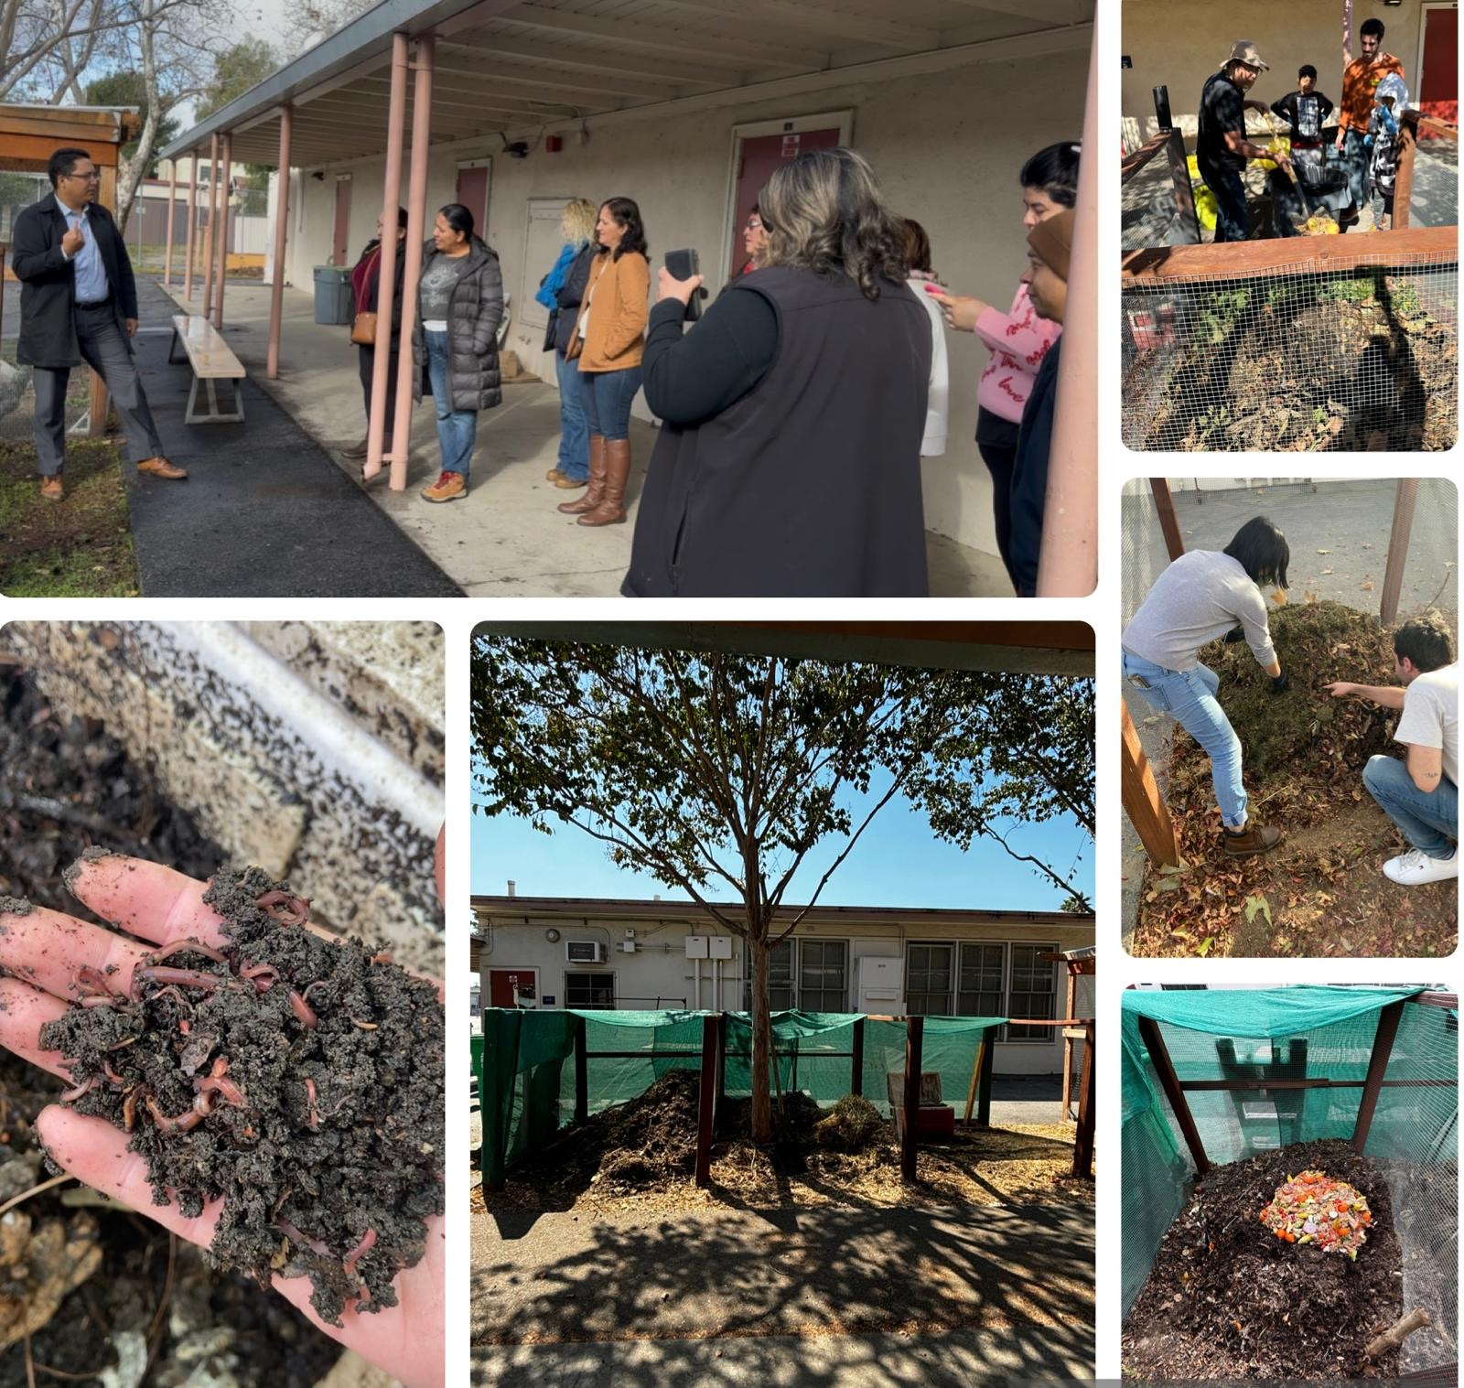
16. From Waste to Green: Workforce Development Through On-Site Organic Waste Processing and Compost Infrastructure
Summary: This project aims to up-skill the underemployed and low-wage workers, particularly independent gardeners, custodians, field farmers, disaffected and disadvantaged High School students in the Southern Border Region, in new generation green jobs by providing hands-on training in sustainable business development, Horticulture, and learn how organic waste (OW) processing. Through targeted workforce development, participants will learn essential Horticulture skills, entrepreneurship, and environmental technician skills to develop composting infrastructure on-site at businesses, schools, farms, and parks.
Lead applicant: Raízes, Inc.
Point of Contact: Vivian Perez, vivian@raizesinc.org, (760) 554-2204
County: Imperial
Project Type: Last Mile
Website: https://raizesinc.org/
Notes:
This slide will be presented by: LORNA

Slide 20
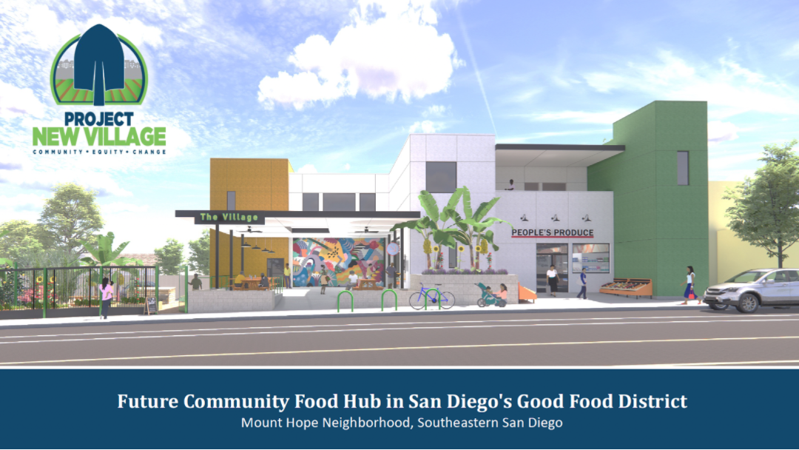
17. The Village Community Food Hub
Summary: Project New Village (PNV), a community-rooted 501(c)(3) nonprofit organization that serves Southeastern San Diego and is located within the Southern Border Region, requests last-mile project funds for final design and permit/agency fees for The Village Community Food Hub (hereafter The Village or the hub). The Village will be a 12,000-square-foot, two-story building dedicated to aggregating, distributing, and marketing locally-grown foods to support local producers' job creation and business growth. The Village will help 25+ small and socially disadvantaged, beginning, and limited-resource farmers, neighborhood growers, and food makers participate in the local food supply chain by creating new markets for hyper-local produce and providing producers with resources to scale their business. Elevating a place-making approach that builds on community cultural traditions and assets, The Village will be a permanent, community-sustained asset that creates jobs, advances economic prosperity, improves health equity, and builds community power in a historically redlined community.
Lead applicant: Project New Village (PNV)
Point of Contact: Janelle Devera, janelle@npwonks.com, (619) 517-6870
County: San Diego
Project Type: Last Mile
Website: projectnewvillage.org
Notes:
This slide will be presented by: ALEXIS

Slide 21
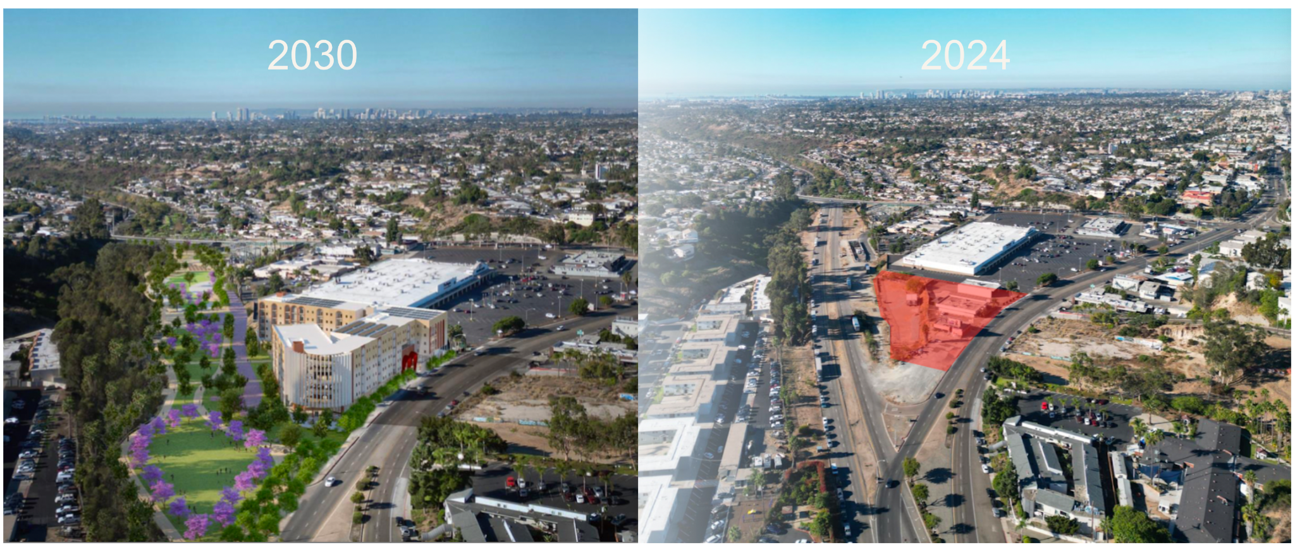
18. Global Village: Climate-Adaptive Worker Housing and Immigrant Business Hub
Summary: The Global Village will spark inclusive, sustainable economic development led by and for refugee, immigrant, and historically excluded communities in San Diego. Rooted in community ownership and cultural celebration, it will create pathways to quality jobs, worker-owned businesses, and climate-resilient infrastructure next to the Chollas Creek. As part of the Southern Border Coalition’s vision, PANA is stewarding the development of this 2.2 acre site to deliver 150+ large-sized affordable homes, 50,000 sq ft of community & health spaces for shared prosperity—reimagining the local economy through justice, belonging, and self-determination.
Lead applicant: Partnership for the Advancement of New Americans (PANA)
Point of Contact: Rachel Lozano Castro, rachel@panasd.org , (619) 344-1228
County: San Diego
Project Type: Last Mile
Website: www.panasd.org
Notes:
This slide will be presented by: JAVIER

Slide 22
19. Renewable Energy Workforce Development: Building Capacity of Solar Installation Basics Training
Summary: GRID Alternatives San Diego (GRID SD) builds community-powered solutions that advance economic and environmental justice through renewable energy. We are seeking pre-development funding to build the capacity necessary to achieve IREC (Interstate Renewable Energy Council) accreditation for our Installation Basics Training (IBT) program. This accreditation will professionalize and scale our grassroots program, making it a formal, industry-recognized pathway into the clean energy sector for workers from marginalized communities.
Lead applicant: Grid Alternatives San Diego
Point of Contact: Marissa Rogers, mrogers@gridalternative.org , (858) 761-2667
County: San Diego
Project Type: Last Mile
Website: https://gridalternatives.org/regions/sandiego
Notes:
This slide will be presented by: LORNA

